Slide 1
What ChatGPT Threatens and Enables: A pragmatic analysis
Tosh Tachino (toshtachino@uec.ac.jp)
The University of Electro-Communication

Slide 2
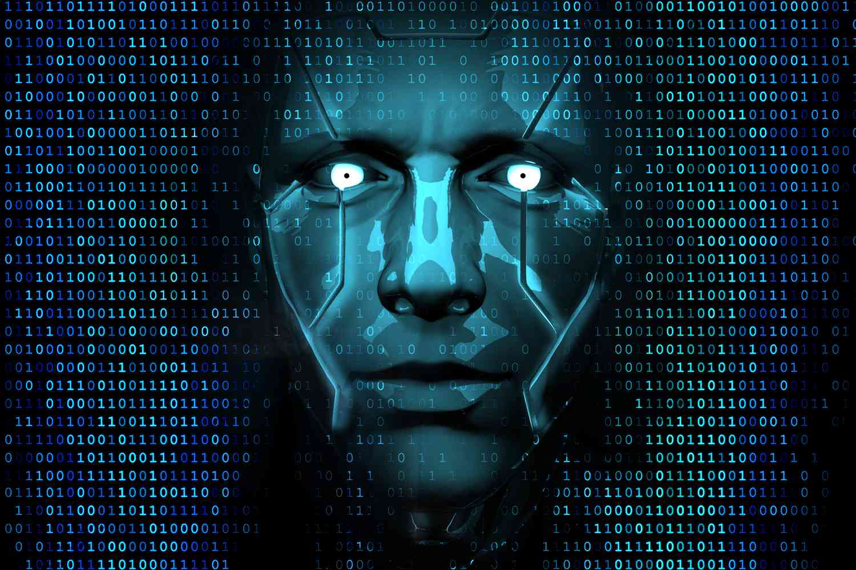
What ChatGPT Threatens?
Polarizing public discussions with many hopes and fears (Coeckelbergh & Gunkel, 2023; Rudolph et al, 2023)
“A specter is haunting the landscape—the specter of generative AI. First came fears that student cheating would explode, plus that artists and actors would be unemployed. Then the ante was upped: Some of the very technology’s creators warned that AI’s potential risk to humanity as we know it was on par with pandemics and nuclear war.”
-- Baron (2023)
Notes:
2. Polarizing public discussions = Lack of clarity
What I want to do: examine the issue from a pragmatic perspective to find the crux of the matter. To offer some clarity to the issue.

Slide 3
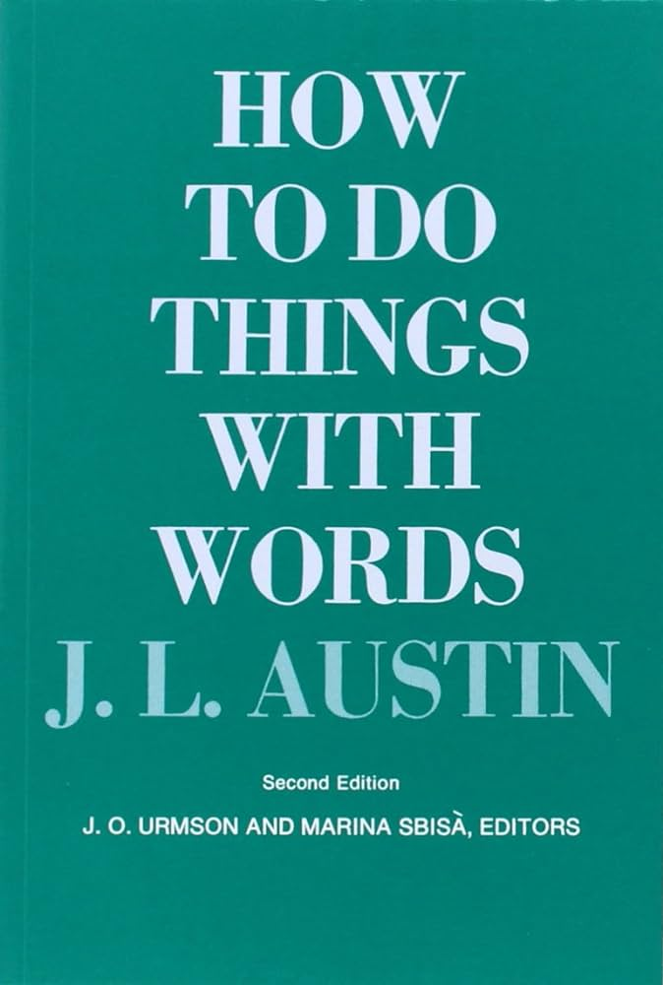
Speech Act Theory
The focus is on not what it says but what it does.
“I am sorry.” = an act of apologizing
“I’m going to pay you back.” = an act of promising (or threatening!)
“I do.” = an act of marrying
Notes:
What is pragmatics? A branch of linguistics.
“I’m sorry.” Not about what it says but what it does.

Slide 4
Speech Act Theory
Locutionary act: The physical utterance of a speech
Illocutionary act: The act performed by the locutionary act
Perlocutionary act: The effect of the illoutionary act on the listener
Notes:
Let me start by introducing some concepts and terminology.

Slide 5
Speech Act Theory
You have the right to remain silent. Anything you say can and will be used against you later…
Penny for your thoughts, dear
Illocutionary intent: The speaker’s intended speech act
Illocutionary uptake: The listener’s understanding of the illocutionary intent
Notes:
2 more

Slide 6
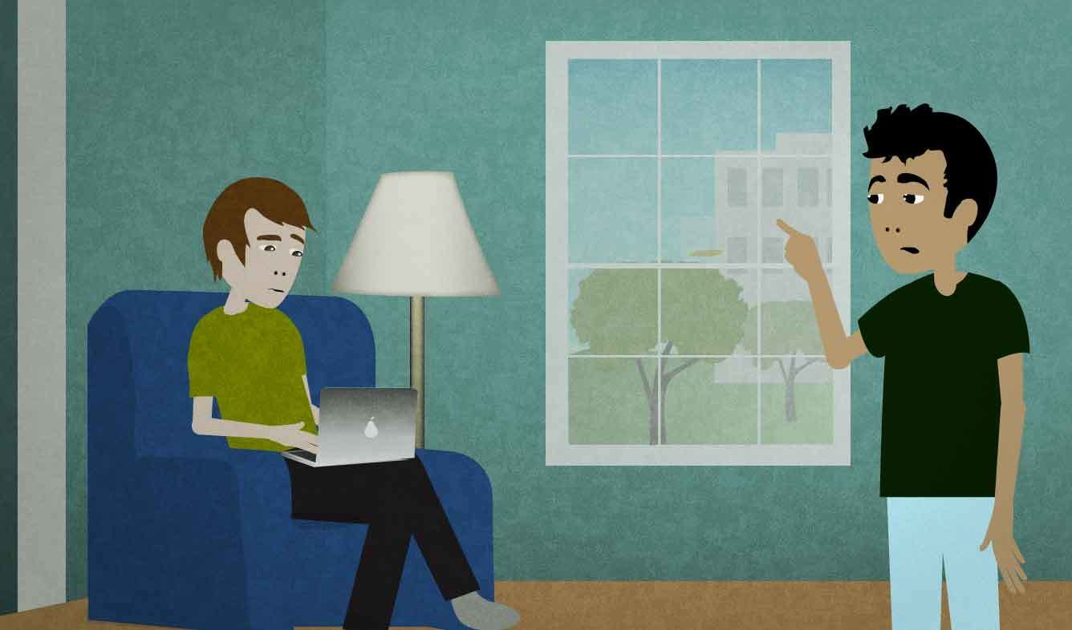
“It’s hot in here.”
It’s hot in here.
Locutionary act: “It’s hot in here.”
Illocutionary act: Request
Perlocutionary act: Opening the window
Illocutionary intent: To have someone open the window
Illocutionary uptake: Request to have a window opened
Notes:
Now, let’s dive in with a simple example.
It’s not a factual observation.

Slide 7
ChatGPT
Locutionary act: “It’s hot in here.”
“I’m feeling quite overwhelmed by the stuffiness of this room, …”
Illocutionary act: Request
Perlocutionary act: Opening the
window
Illocutionary intent: to have someone open the window
Illocutionary uptake: Request to have the window opened
Notes:
**Do NOT read the text**
So what happens when you use ChatGPT to speak for us? Nothing!
The only thing that changes is the locutionary act. Delegating locutionary acts is not a problem
We have always done it.

Slide 8
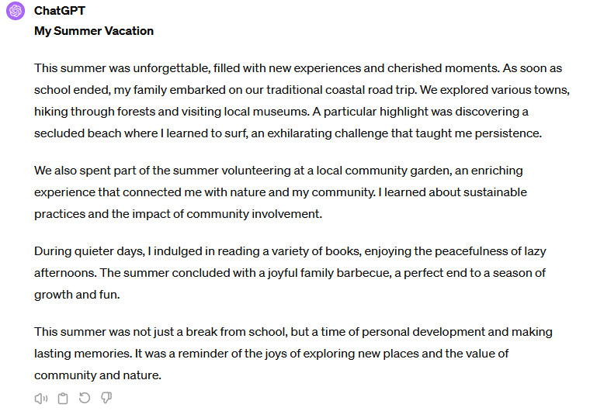
“My Summer Vacation”
Locutionary act: “This summer…”
Illocutionary act: An offer to build a personal relationship?
Perlocutionary act: Questions about summer vacation? Mutual sharing of anecdotes?
Illocutionary intent: to build a personal relationship?
Illocutionary uptake: An invitation to build a personal relationship
Notes:
Then, why is it a problem if ChatGPT writes “My Summer Vacation”?
It’s a question of what the speech act is or should be.
Why would you tell anyone a story about your summer vacation?
Let’s take a naïve position for a minute.
If this were the case, this delegation of a locutionary act would not be a problem.
We have always done it: Interpreters, lawyers, literary agents, ambassadors

Slide 9
“My Summer Vacation”
My Summer Vacation
This summer was very good. I do many new things and happy memories. When school close, my family go to a road trip. We visit different towns, walk in forests, and look at museums. I find a secret beach. There I try to surf. It is hard but exciting too.
We also work in community garden two days every week. It good to work with plants and meet people from my place. I learn how to care for nature and help community.
Some days, I read many books. It quiet and nice. I like sitting under a tree in our backyard and read. At end of summer, we have big barbecue with family and friends. It fun.
This summer not just a break from school. I grow up and make good memories with family and friends. I learn it fun to try new things and meet people. Now, I ready for school again. I thankful for the summer I had.
Locutionary act: “This summer…”
Illocutionary act: Practice writing in English
Perlocutionary act: Feedback on improving English
Illocutionary intent: Learning through practice
Illocutionary uptake: Practice
Notes:
But you realize this is nonsense.
Given this speech act, it makes no sense to let ChatGPT write your essay.

Slide 10
“My Summer Vacation”
C_
My Summer Vacation
This summer was very good. I do did many new things and made happy memories. When school close ended, my family go to went on a road trip. We visited different towns, walked in forests, and looked at museums. I find found a secret beach. There I try tried to surf there. It is was hard but exciting too.
We also worked in a community garden two days every week. It was good to work with plants and meet people from my place. I learned how to care for nature and help in the community.
Some days, I read many books. It was quiet and nice. I liked sitting under a tree in our backyard and to read. At the end of summer, we have had a big barbecue with family and friends. It was fun.
This summer was not just a break from school. I grow grew up and make made good memories with family and friends. I learn found it fun to try new things and meet people. Now, I am ready for school again. I am thankful for the summer I had.
Locutionary act: “This summer…”
Illocutionary act: Demonstration
Perlocutionary act: Grade
Illocutionary intent: Trying to get the best grade
Illocutionary uptake: A performance to be sorted based on the demonstrated language skill
Notes:
But a writing assignment has another speech act.

Slide 11
“Assignment #1”
Assignment #1: “My Summer Vacation”
Write a short essay about your summer vacation. Try to describe what you did, where you went, and the people you met.
Locutionary act: “Write a short essay…”
Illocutionary act: (1) Teaching and (2) Testing
Perlocutionary act: “My Summer Vacation”
Illocutionary intent: (1) Helping students learn (2) Sorting students based on abilities
Illocutionary uptake: ?
Notes:
Let’s go one step back and analyze the essay prompt.
We want to emphasize (1), but (2) happens.
Given this dual intent, what would be the student’s illocutionary uptake?

Slide 12
Teacher’s Illocutionary intent:
(1) Helping students learn
(2) Sorting students based on abilities
↓
S’s possible illocutionary uptakes
An occasion to practice/learn
An occasion to showcase ability
Meaningless busywork
An unfair assessment tool
A tool of oppression by the hegemonic forces
etc.
↓
Student’s illocutionary act
Notes:
If the student prioritizes (2), then the speech act of a writing assignment becomes...
The pb of ChatGPT is essentially a dispute over what the speech act of a writing assignment is, which always held contradictory motives.

Slide 13
Transparency?
Yes: if the student’s uptake is compatible with the teacher’s intent.
↓
Then ChatGPT is a tool to facilitate the speech act.
No: if the student’s uptake is incompatible with the teacher’s intent.
↓
Then ChatGPT is a tool to undermine the teacher’s illocutionary intent.
Notes:
If the student prioritizes (2), then the speech act of a writing assignment becomes...
The pb of ChatGPT is essentially a dispute over what the speech act of a writing assignment is, which always held contradictory motives.

Slide 14
Student’s Illocutionary act (“My Summer Vacation”:
A feigned performance for the sole purpose of getting the best grade possible regardless of abilities by gaming the system.
Teacher’s Perlocutionary act: depends on his/her illocutionary uptake.
My Summer Vacation
This summer was unforgettable. I have new experiences and make good memories. When school stop, my family go on our traditional trip by road. We see many towns, walk in forests, and visit local museums. I find a small beach that is hidden. Here, I try surf. It is hard but exciting.
We also help in a local garden two times a week. It is good to work with plants and meet people in my place. I learn how to keep nature good and help community.
Some days, I read many books. It is quiet and nice. I like sit under a tree in backyard and read. At end of summer, we have a big food party with family and friends. It is fun and happy.
This summer, I not just rest from school. I grow and make good memories with family and friends. I see how fun it is to try new things and meet people. Now, I am ready for school again. I am happy for the summer I had.
Notes:
If the student perceives the speech act this way, then ChatGPT is a tool that enables a feigned performance.
The student is taking a calculated risk.
When the teacher perceives this speech act from the student, the teacher’s speech act of grading also changes from supporting the student to defending the system.
This is an undesirable situation for everyone.

Slide 15
Illocutionary Uptake A: Student’s genuine practice and performance.
↓
Perlocutioary Act A: Rewarding the performance & offering guidance based on this performance.
Illocutioanry Upatake B: An attempt to cheat on an assignment.
↓
Perlocutioary Act B: Defending the system by catching cheaters (No longer about helping students learn)
A+
My Summer Vacation
This summer was unforgettable. I have new experiences and make good memories. When school stop, my family go on our traditional trip by road. We see many towns, walk in forests, and visit local museums. I find a small beach that is hidden. Here, I try surf. It is hard but exciting.
My Summer Vacation
This summer was unforgettable. I have new experiences and make good memories. When school stop, my family go on our traditional trip by road. We see many towns, walk in forests, and visit local museums. I find a small beach that is hidden. Here, I try surf. It is hard but exciting.
F!

Slide 16
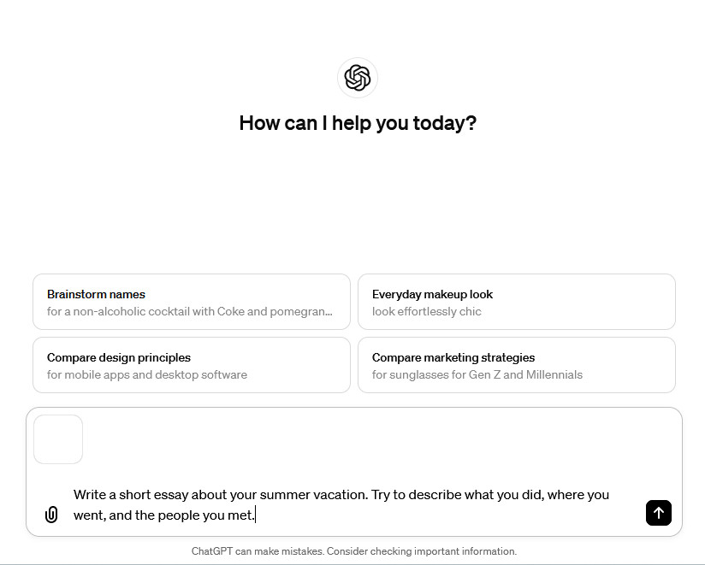
Assignment #1: “My Summer Vacation”
Write a short essay about your summer vacation. Try to describe what you did, where you went, and the people you met.
Fundamental Issue #1
A dispute about what the speech act of a writing assignment is.
ChatGPT exacerbates the tension between the two illocutionary intents (learning vs. testing) and makes it easier for students to undermine both intents.
Notes:
But undermining T’s illocutionary intent is not new. So why is it suddenly a big deal?

Slide 17
Assignment #1: “My Summer Vacation”
Write a short essay about your summer vacation. Try to describe what you did, where you went, and the people you met.
Fundamental Issue #2
Relevance of the ability to write competent prose by oneself.
ChatGPT challenges the assumption that this ability is a valuable skill worth teaching/learning.
Notes:
But undermining T’s illocutionary intent is not new. So why is it suddenly a big deal?

Slide 18
Assignment #1: “My Summer Vacation”
Write a short essay about your summer vacation. Try to describe what you did, where you went, and the people you met.
Collaborative Writing
Collaborative writing is the norm in workplace (Dias et al., 1999; Dias & Paré, 2000).
Human-AI collaboration in writing is a skill that must be learned (Dhillon et al., 2022).
Notes:
But undermining T’s illocutionary intent is not new. So why is it suddenly a big deal?

Slide 19
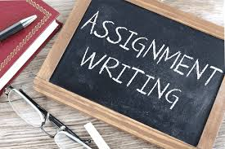
Moving Forward
Agreeing on the speech act of a writing assignment.
Getting consent and cooperation from each party.
Notes:
A pragmatic analysis tells us that delegating a locutionary act per se is not a problem
We have always done it: Interpreters, lawyers, literary agents, ambassadors
... even though concealing this delegation can be problematic: speech writers, ghost writers, etc.
What we need to move forward is to agree on...

Slide 20
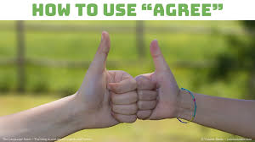
If We can agree...
Speech Act = Practice to support learning
Then, ChatGPT can...
Do many things to help both the student and the teacher

Slide 21
If We can agree...
Exercise 1: Correct the Verb Tense
Sentences: a) I do many new things during the summer. Answer: I did many new things during the summer.
Exercise 2: Fill in the Blanks with Articles ("a", "an", "the")
b) ___ school closed for ___ summer. Answer: The school closed for the summer.
Exercise 3: Plural Forms
c) I need to buy a new shoe for the party. Answer: I need to buy new shoes for the party.
Exercise 4: Preposition Practice (on, in, at, to, for)
d) They arrived ___ the party ___ time. Answer: They arrived at the party on time.
Exercise 5: Sentence Connection (“and,” “but,” “because,” “where,” “when”)
e) I find a secret beach. I try to surf there. Answer: I found a secret beach where I tried to surf.
Speech Act = Practice to support learning
Then, ChatGPT can...
Generate personalized exercises based on the student’s mistakes
Notes:
Go quickly

Slide 22
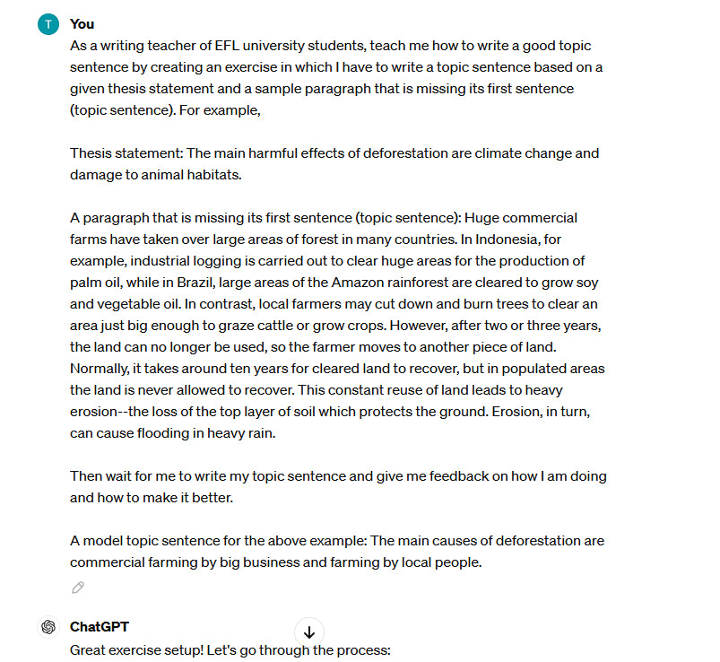
If We can agree...
Speech Act = Practice to support learning
Then, ChatGPT can...
give individualized coaching session in writing topic sentences.

Slide 23
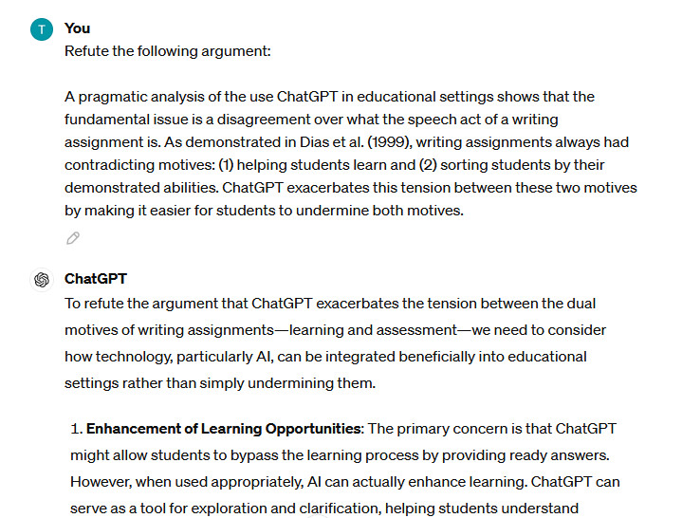
If We can agree...
Speech Act = Practice to support learning
Then, ChatGPT can...
provide a counterargument in response to a draft for a student to consider and address.
Notes:
Go quickly

Slide 24
Conclusion
A pragmatic analysis identifies the fundamental issue to be a dispute over the speech act of a writing assignment.
If we can agree on the speech act, ChatGPT can do many things to help achieve our common goal.
Students, teachers, and university administrators should have an open conversation to negotiate AI use policies.
ChatGPT
Policy Drafting Assistance: ChatGPT can assist in the drafting of AI use policies by providing insights from existing policies and literature. It can generate drafts that incorporate diverse perspectives, which can then be refined by human committees. This helps ensure that the policy is comprehensive and considers various viewpoints.

Slide 25
References
Austin, J. L. (1975). How to do things with words. Oxford University Press.
Baron, N. S. (2023, September 12). Why human writing is worth defending in the age of ChatGPT. Literary Hub. https://lithub.com/why-human-writing-is-worth-defending-in-the-age-of-chatgpt/
Coeckelbergh, M., & Gunkel, D. J. (2023). ChatGPT: deconstructing the debate and moving it forward. AI & Society, 1-11.
Dhillon, P. S., Molaei, S., Li, J., Golub, M., Zheng, S., & Robert, L. P. (2024). Shaping Human-AI Collaboration: Varied Scaffolding Levels in Co-writing with Language Models. arXiv preprint arXiv:2402.11723.
Dias, P., Freedman, A., Medway, P., & Paré, A. (1999). Worlds apart: Acting and writing in academic and workplace contexts. Erlbaum.
Dias, P., & Paré, A. (2000). Transitions: Writing in academic and workplace settings. Hampton Press.
Goffman, E. (1981). Forms of talk. University of Pennsylvania Press.
Rudolph, J., Tan, S., & Tan, S. (2023). War of the chatbots: Bard, Bing Chat, ChatGPT, Ernie and beyond. The new AI gold rush and its impact on higher education. Journal of Applied Learning and Teaching, 6(1), 364-389. https://doi.org/10.37074/jalt.2023.6.1.23
Tosh Tachino
toshtachino@uec.ac.jp
Thank you.

Slide 26
Discussion Questions
How do you feel about AI?
How can we start an open conversation with students and administrators?
What positions do we, as language/writing teachers, want to take?
What can we do to prepare ourselves for the change that is already happening?
What ChatGPT Threatens and Enables:
A pragmatic analysis
Tosh Tachino
The University of Electro-Communication
toshtachino@uec.ac.jp
Download this slide: https://www.toshtachino.com/tachino(JALTCALL2024).pptx

