Slide 1
Using machine translation tools for academic writing in language courses – perspectives of students and language teachers
Linda Lin
The Hong Kong Polytechnic University

Slide 2
AI-powered online language tools
AI-powered writing tools beyond large language models (LLMs) such as ChatGPT (Roe et al., 2023)
* Machine translation Tools (MTTs) – Google Translate; DeepL
* Digital writing assistants (DWAs) – Grammarly; WeCheck
* Automated paraphrasing tools (APTs) – Quillbot

Slide 3
Machine translators still attractive in the GenAI era?
A story to share…

Slide 4
MTT and EFL Students
Saudi university study – 96% of EFL students use MTT(Alhaisoni & Alhaysony, 2017)
Korean-speaking university students – 85% in sample use MTT (Briggs, 2018)
Sample learners of Spanish or French as a foreign language - 88% use MTT (O'Neill, 2016)
89% of a sample of French students of EFL in secondary education use MTT (Bourdais & Guichon, 2020)

Slide 5
Benefits of using MTT
MTT post-editing improving students’ linguistic awareness (Correa, 2014)
MTT process useful for “context-appropriate word choice” and noticing skills (Lee, 2020)
More advantages for lower proficiency Ss (Chung & Ahn, 2021; Garcia & Pena, 2011; Lee, 2020)
Narrows the gap between skilled and less skilled Ss (Chon, Shin & Kim, 2020)

Slide 6
Challenges caused by MTT
MTT here to stay, and we can’t prevent students from using related tools - unless assessments in controlled conditions (Korošec 2011; McCarthy 2004)
More staff AND students think universities should allow MTT than think should not (Organ, 2019)
Students need training in how to use MTT effectively (Bower 2010; Knowles 2016; Korošec, 2015)
“Disarray” in universities’ attitudes towards MTT use (Case, 2015, p.10)

Slide 7
MTT – some questions
Student attribute issues - external stakeholder requirements - graduate English proficiency?
Who are main stakeholders? Students, employers, university?
Risk of applying different measures for different members of academic community?
Domain of academic literacy / professional skills / digital literacy?
Policy?
How to frame MTT usage: false authorship? Ownership?
How/whether to control?

Slide 8
One university – York St. John, UK
Adapted assessment approach > e-portfolios including:
Short pieces of written work
Videos
Class tests – increased weighting for WTG
Extended essays (coursework) - criteria changed
Oral exams – as viva for written work

Slide 9
Changed WTG assessment criteria – York St. John University, UK

Slide 10
Policy example – York St. John University, UK
Academic misconduct
“Misuse of translation tools: Inappropriate use of online translation tools to conceal the source of text, or otherwise present work that it not a student’s own.”
https://www.yorksj.ac.uk/media/content-assets/registry/policies/code-of-practice-for-assessment-2019-20/22.Academic_Misconduct_Policy_2019-20.pdf

Slide 11
Aim of the study
Scant research to understand differences in student and teacher views on use of MTT
This in-progress study aims to examine mainland students’ use of MTT for assignments from both the student and teacher perspectives.

Slide 12
Methodology
Online student and teacher surveys and F2F interviews
47 mainland students taking an academic English course:
37 ELC teachers
Semi-structured interviews
12 interviews with students
10 interviews with teachers

Slide 13
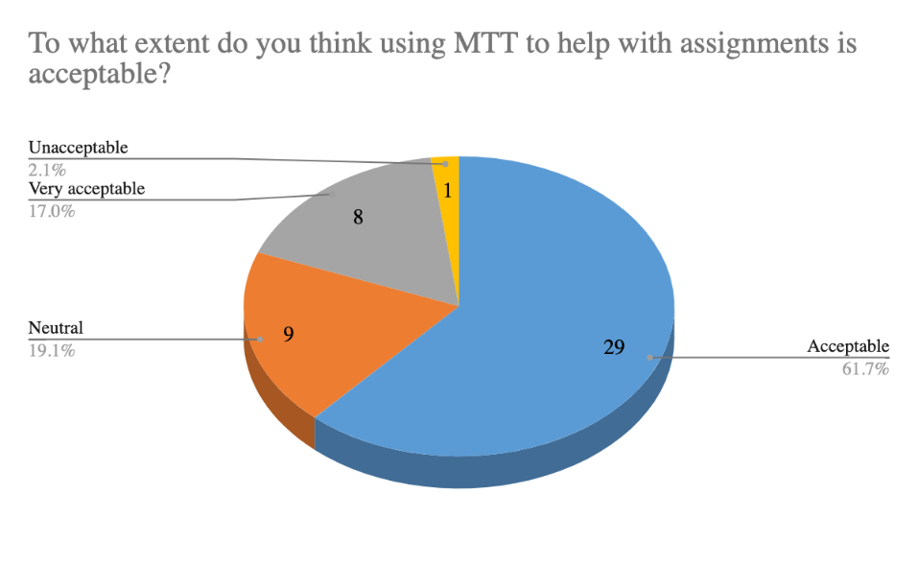
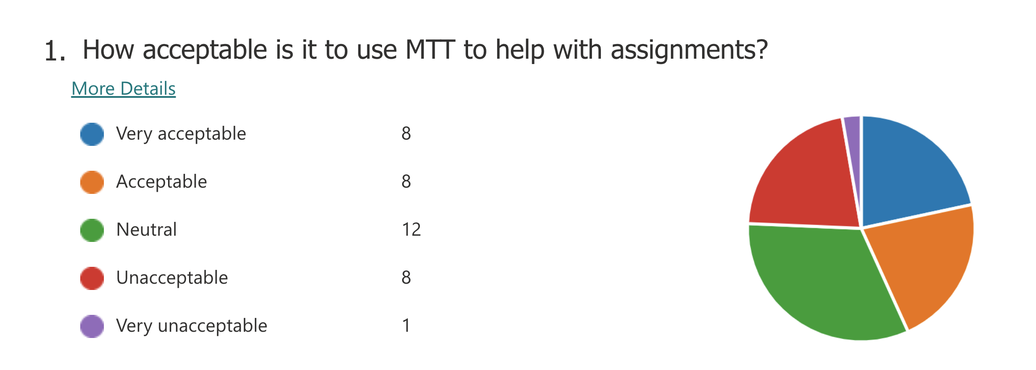
Teacher
Student
Acceptable & Very acceptable 43.2%
Acceptable & Very acceptable 78.8%
Unacceptable & Very unacceptable 24.3%
Unacceptable & Very unacceptable 2.1%

Slide 14
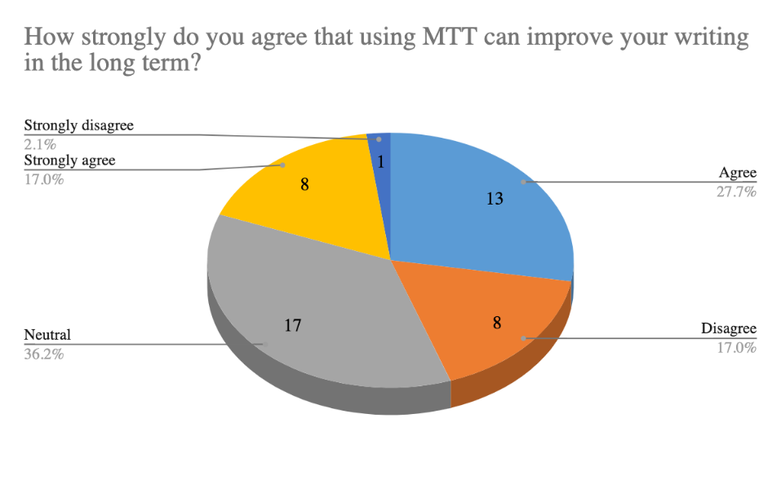
Teacher
Student
Agree & Strongly agree: 24.3%
Disagree & Strongly disagree: 32.4%
Agree & Strongly agree: 44.7%
Disagree & Strongly disagree: 19.1%

Slide 15
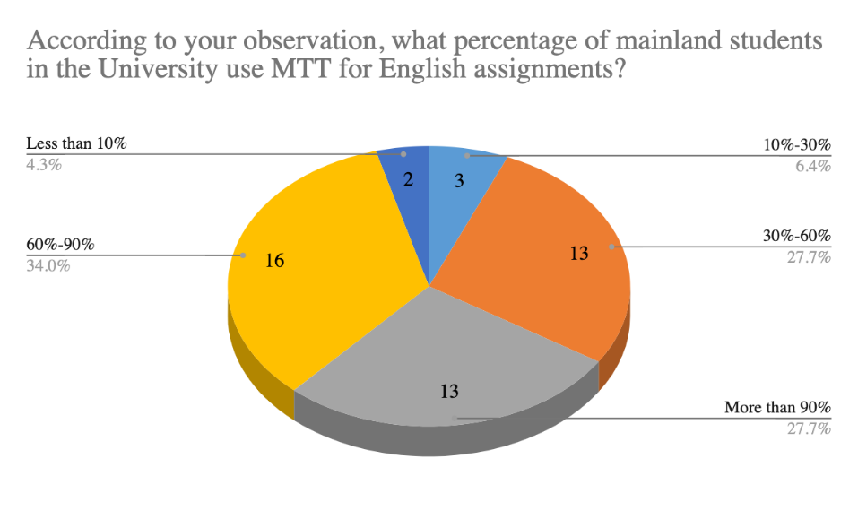
Teacher
Student
14% of respondents chose [60%-90%] & more than [90%]
38% of respondents chose [Less than 10%]
61% of respondents chose [60%-90%] & more than [90%]
6% of respondents chose [Less than 10%]
Notes:
61% of respondents chose [60%-90%] & more than [90%]

Slide 16
Teacher
Student
22.2%
1.7%
22.2%
15.5%
23.8%
36.2%
20.6%
20.7%
25.7%

Slide 17
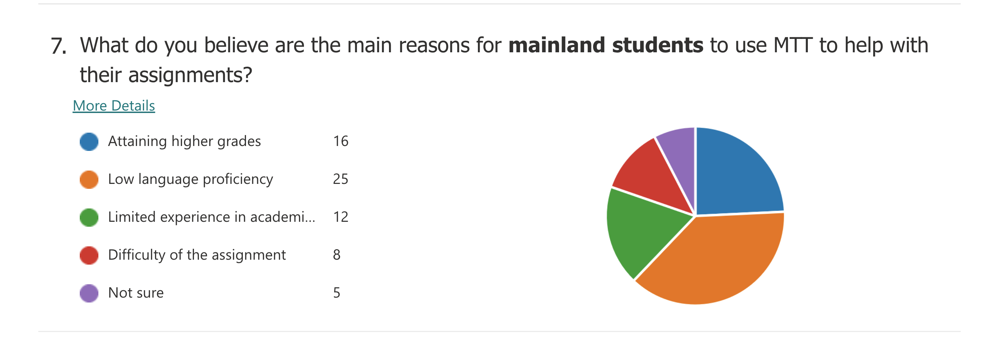
Teacher
Student
24.2%
29.9%
37.8%
17.9%
18.2%
26.9%
12.2%
17.9%
7.6%
7.5%

Slide 18
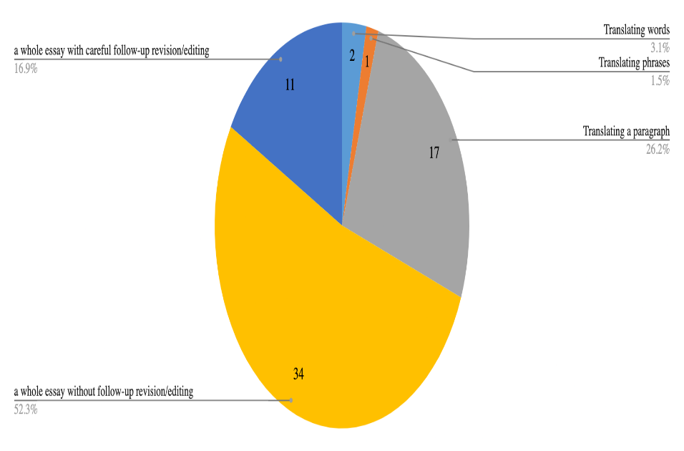
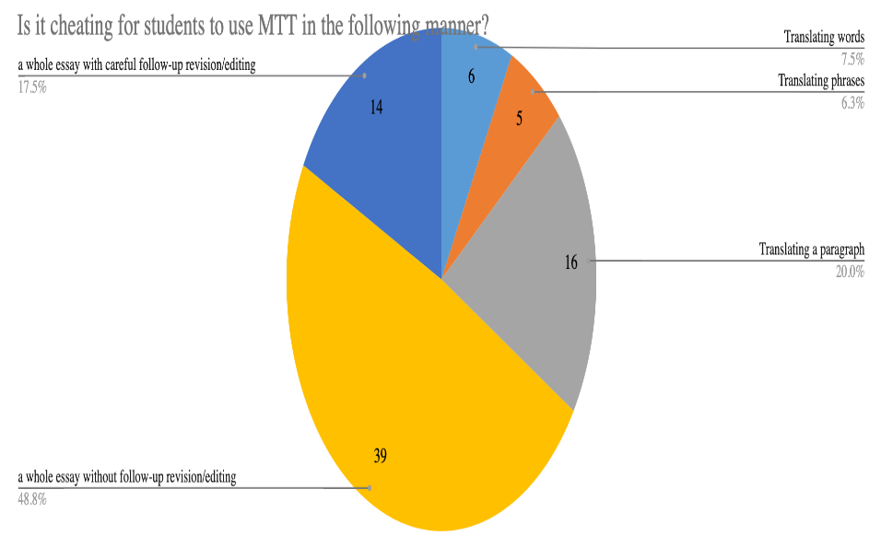
Teacher
Student

Slide 19
Interview with teachers
Reasons for accepting or not accepting using MTT for assignments
Acceptable: MTT is just another online tool student use - similar to Grammarly and online dictionaries
Acceptable: Using MTT is better than buying scripts online
Unacceptable: Undermines the ILOs of ELC courses: ELC is a language centre. One of our key ILOs is to improve student language skills.
Unacceptable: Fairness in assessment grade?
-Students who use MTT might obtain a high grade that they don’t deserve. This is unfair to those who don’t use MTT.
-However, some teachers have different views, arguing that students who use MTT are likely to obtain a low grade. They could receive a higher grade if they write the essay by themselves.

Slide 20
Interview with teachers
Can MTT help students improve their language skills in the long run?
Yes, at least at the lexical level, e.g., word collocation.
No, using MTT is merely a surviving strategy when students lack confidence in academic writing. They will not need MTT when they gain more confidence.

Slide 21
Interview with teachers
Is it difficult to identify if a student has used MTT for assignments?
Most teachers: yes, very difficult.
Some teachers, not very difficult.
a script containing sentences that are difficult to understand, but the teacher knows every word in the sentences.
Teachers could talk with the students. Most students normally tell us the truth in such cases.

Slide 22
Interview with teachers
Is it cheating to use MTT for assignments?
Not really. At least the essay ideas are from students.
Depending on how MTT is used,
e.g., translating sentences and paragraphs is cheating but helping with words and phrases is OK.

Slide 23
Interview with teachers
6. How to address the problems of students using MTT?
Communicating rather than policing
Adopting in-class assessments
Introducing regulations on use of MTT for assignments (ELC as well as PolyU).
Challenges:
a. ELC moving away from in-class assessments
a. Difficult to enforce regulations on using MTT
b. Adding workload to teachers

Slide 24
Interview data - students
A summary
MTT, an essential tool for EFL students even in the GenAI age because “We have words, phrases, or sentences that require translation.”
Awareness of affordances and challenges
A temperate surviving strategies for many students.
Moving away from using MTT tools after gaining more confidence in English

Slide 25
How students use GenAI + AI powered tools – a case study
Brainstorm and write Version 1 - ChatGPT
Translate into Chinese - Google Translate – facilitate student comprehension
Make changes in the Chinese version when necessary
Translate back to English - Google translate
Add references – copy sentences from original sources and use Quillbot to paraphrase
Paraphrase the whole essay - Quillbot (to avoid a high AI Index)

Slide 26
Conclusion
Students and teachers having different perspectives on using MTT for assignments
Diversity in teacher/student views
Students’ awareness of affordances and challenges, but some students need to use MTT for a number of reasons:
* achieving better grades;
* saving time; and more importantly
* surviving in an EMI university

Slide 27
References
Alhaisoni, E., & Alhaysony, M. (2017). An Investigation of Saudi EFL University Students’ Attitudes towards the Use of Google Translate. International Journal of English Language Education, 5(1), 72.
Bourdais, A., & Guichon, N. (2020). Représentations et usages du traducteur en ligne par les lycéens. Alsic. Apprentissage des Langues et Systèmes d'Information et de Communication, 23(1).
Bower, J. (2010). Japanese university students' use of online machine translators for English writing tasks. LSJ Journal Gengo Kenkyu
Briggs, N. (2018). Neural Machine Translation Tools in the Language Learning Classroom: Students' Use, Perceptions, and Analyses. JALT CALL Journal, 14(1), 2-24.
Case, M. (2015). Machine translation and the disruption of foreign language learning activities. E-Learning Papers, 45, 4.
Chon, Y.V., Shin, D., & Kim, G. E. (2021). Comparing L2 learners’ writing against parallel machine-translated texts: Raters’ assessment, linguistic complexity and errors. System (Linköping), 96, 1.
Chung, E.S., & Ahn, S. (2021). The effect of using machine translation on linguistic features in L2 writing across proficiency levels and text genres. Computer Assisted Language Learning, 1–26.
Correa, M. (2014). Leaving the “peer” out of peer-editing: Online translators as a pedagogical tool in the Spanish as a second language classroom. Latin American Journal of Content & Language Integrated Learning, 7(1), 1–20.

Slide 28
References
Fredholm, K. (2015). Online Translation Use in Spanish as a Foreign Language Essay Writing. Revista Nebrija, 9(18), 7. https://doi.org/10.26378/rnlael918248
Groves, M., & Mundt, K. (2015). Friend or foe? Google Translate in language for academic purposes. English for Specific Purposes, 37, pp. 112-121.
Kliffer, M. (2005). An experiment in MT post-editing by a class of intermediate/advanced French majors. In Proceedings of the 10th EAMT Conference: Practical applications of machine translation.
Knowles, C. L. (2016). Investigating instructor perceptions of online machine translation and second language acquisition within most commonly taught language courses. ProQuest Dissertations Publishing. Korošec, M. K. (2011). Applicability and challenges of using machine translation in translator training. ELOPE: English Language Overseas Perspectives and Enquiries, 8(2), 7-18.
Lee, S.M. (2020). The impact of using machine translation on EFL students' writing. Computer Assisted Language Learning, 33(3), 157–175.
Luton, L. (2003). If the Computer Did My Homework, How Come I Didn't Get an "A"? The French Review, 76(4), 766–770.
McCarthy, B. (2004). Does online machine translation spell the end of take-home translation assignments. CALL-EJ Online, 6(1), 6-1.

Slide 29
References
Niño, A. (2008). Evaluating the use of machine translation post-editing in the foreign language class. Computer Assisted Language Learning, 21(1), 29–49. https://doi.org/10.1080/09588220701865482
Nowlan, W. (2019). A plan for incorporating student training in a pre-sessional process approach essay writing course: issues and possibilities. [PowerPoint slides]. BALEAP. https://www.baleap.org/event/future-of-eap
O’Neill, E. M. (2019). Training students to use online translators and dictionaries: The impact on second language writing scores. International Journal of Research Studies in Language Learning, 8(2), 47-65.
Organ, A. (2019). Blissful ignorance? Or turning a blind eye? Language departments’ attitudes to student use of Google Translate. [PowerPoint slides]. York St John University. https://ray.yorksj.ac.uk/id/eprint/5744/
Roe, J., Renandya, W. A., & Jacobs, G. M. (2023). A review of AI-powered writing tools and their implications for academic integrity in the language classroom. Journal of English and Applied Linguistics, 2(1), 3.
Somers, H., Gaspari, F., & Niño, A. (2006). Detecting inappropriate use of free online machine translation by language students - A special case of plagiarism detection. EAMT-2006 - 11th Annual Conference of the European Association for Machine Translation, 41–48.

Slide 30
All questions are welcome ☺

