Slide 1
ChatGPT as a Tool for Authentic Dialogue Evaluation and Creation in EFL Video Production
Bethany Lacy
Juntendo University

Slide 2
Introduction
People suffering from diseases such as leukemia and lupus usually experience strong bouts of fatigue.
Notes:
Last year, I started noticing something that all of you probably also encountered. My students, who just a week before couldn’t string together two grammatically correct sentences, were suddenly writing perfect paragraphs with uncommon vocabulary and advanced grammar. Even more so, they couldn’t seem to explain what these new vocabulary words meant!

Slide 3
A little translate
Uhh…sick?
What does “bout” mean?
Did you use ChatGPT to help you on this assignment?
Notes:
It was like they were hit with an English gamma ray and became fluent English writers for a few moments, and then once the effects wore off, they were back to their regular CEFR A2-B1 levels. Of course, when I questioned them, they admitted to using ChatGPT to write their essays. ChatGPT can be a useful tool when used appropriately. If the students are relying on it to write everything from scratch, the information will not be learned. That’s why I decided to show my students this year how they can use ChatGPT as a language-learning tool without using it as a language-learning avoidance tool.

Slide 4
But I feel stressed thinking about how many mistakes I will make. I want everything to be perfect, so I’ll just ask ChatGPT to do it…
I want to learn English!
Notes:
ChatGPT can be a useful tool when used appropriately. If the students are relying on it to write everything from scratch, the information will not be learned. That’s why I decided to show my students this year how they can use ChatGPT as a language-learning tool without using it as a language-learning avoidance tool.

Slide 5
Teaching Video Production in South Korea
Video Prompt:
Create Your Own Holiday
National True Day
Notes:
I taught multimedia courses in South Korea 10 years ago and continued doing that for 5 years. The students were required to make at least one group video project per semester. I would give them broad topics that the videos could be about, and then they wrote, filmed, and edited a 3-5 minute long video. The students found value in creating short videos together with their peers, but they had a difficult time writing their scripts. They wanted to include natural expressions and correct their grammar. Here is just a short clip from my students’ project in 2015. This was quite a few years before ChatGPT was a household name, and I was available to help the students during the scriptwriting and editing process. However, I recently started thinking about my most recent groups of students and their reliance on ChatGPT. How could I facilitate the use of ChatGPT in our CLIL program, which is more like TOEFL prep in disguise?

Slide 6
CLIL Course Timeline
Individual Instructor’s Designed Course
January
Health and Medicine
Zoology
Natural History
April-May
May-June
June-July
Earth Science
Economics
Sociology
October
November
December
Notes:
All first-year students in our Faculty of Liberal Arts program must complete two semesters of English classes, 6-Koma a week. All students learn from the same in-house created modules. The modules last for about 5 weeks each and cover the following topics in order:
First Semester:
Health and Medicine
Zoology
Natural History
Second Semester
Earth Science
Economics
Sociology
December – January
The individual teachers can create their own materials for the students to wrap up the academic year. This year, I will have the students create a short video related to the modules. They will need to write a script related to one of the topics and film it together with their classmates.

Slide 7
Steps to the project
1
2
3
4
5
Conversation writing
Cover module material
Digital Literacy Skills Survey
Short research and note-taking task
ChatGPT prompt writing

Slide 8
Steps to the project
7
8
9
10
11
Create a final script based on one of the prompts
Type conversation and prompt into Google Docs
Feed the prompt and conversation to ChatGPT
Paste the response into Google Docs
Film and edit one video
Repeat steps 1-9 five times; Once for each module

Slide 9
/* This is a quote, words full of wisdom that someone important said and can inspire the reader */
—Someone Famous

Slide 10
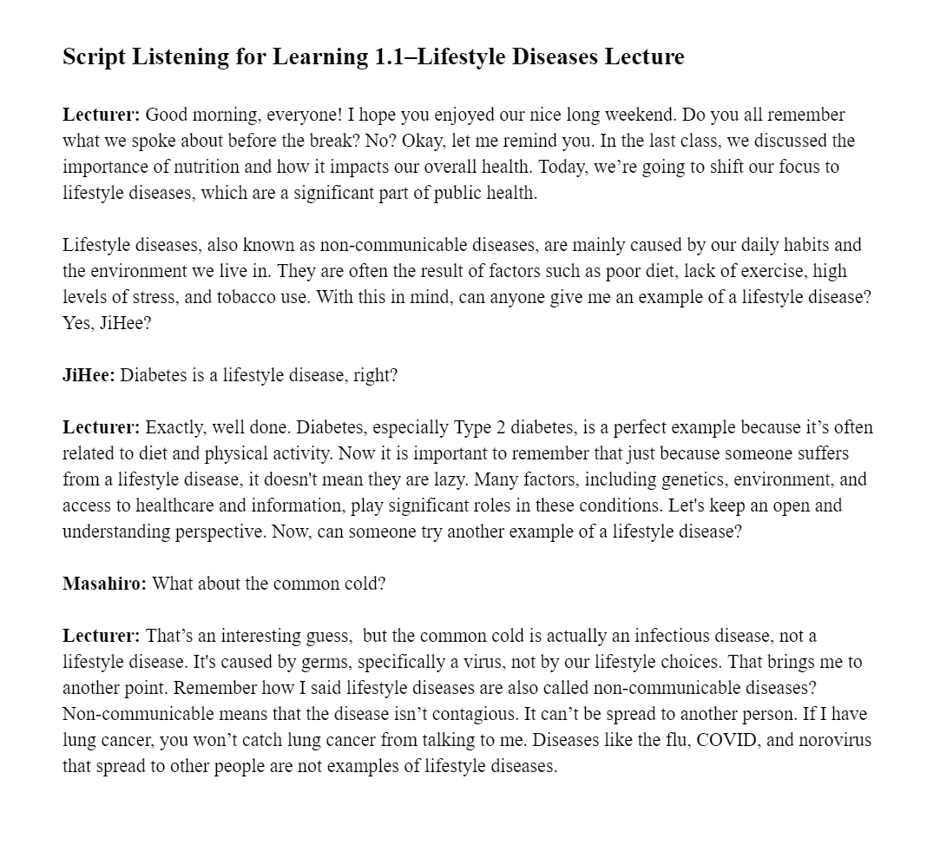
Module Contents
Reading
Listening
Grammar
CLIL
Listening
Notes:
The modules are split into three core classes, each focusing on one aspect of the materials—Reading, Listening, or Grammar. In the listening classes, which I personally designed, the students listen to (fabricated) short lectures on topics within the module and then listen to short conversations between students that also contain information related to the module. Here is an example of a lecture and an example of a conversation from the Health and Medicine Listening Module.

Slide 11
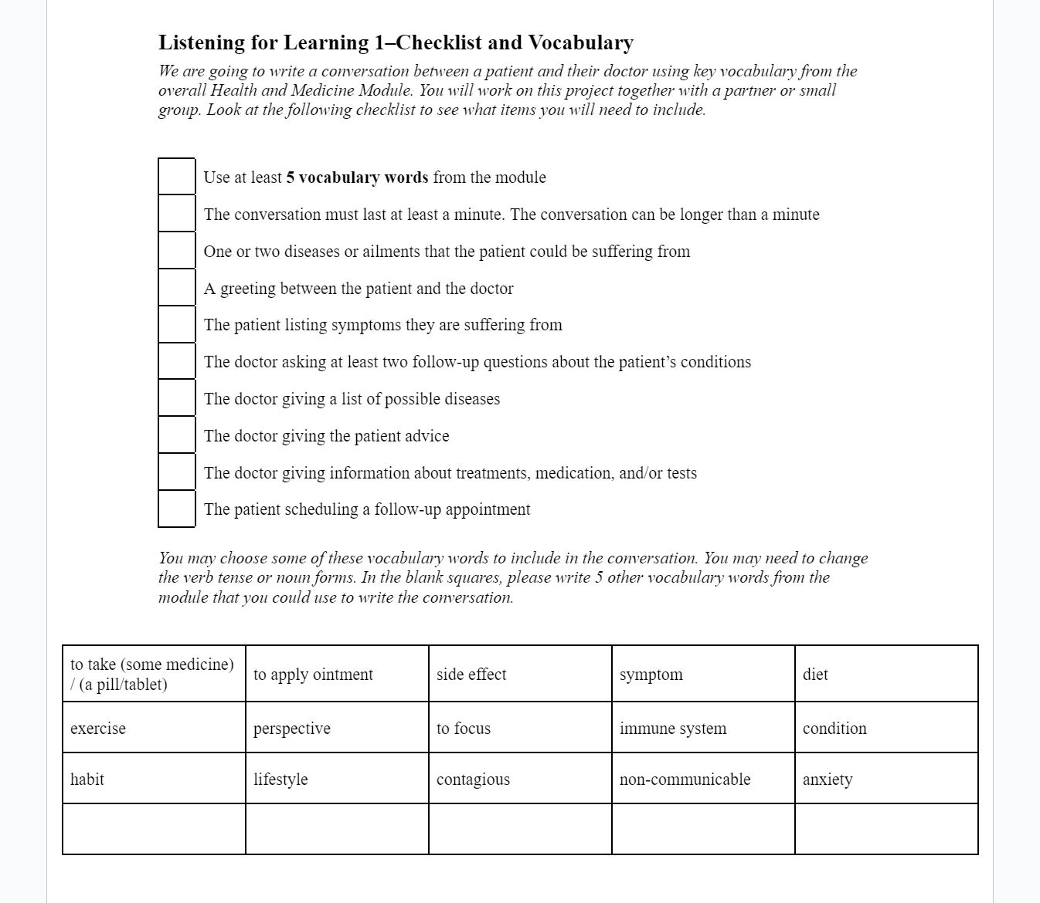
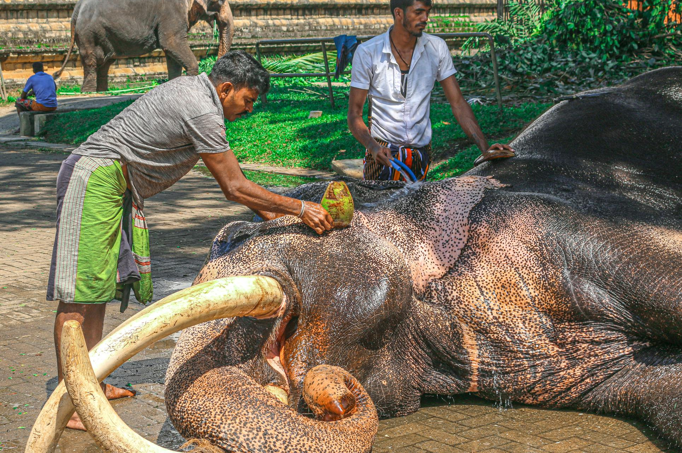
Bright Idea
English!
English!
English!
Notes:
Since there hasn’t been too much of a focus on writing in our program, I decided to incorporate some writing exercises that allowed the students to be a little creative and draw on vocabulary from the text. For each module, I have created assignments for the students to write conversations between, for example, a doctor and a patient for the Health and Medicine module or a zookeeper and a guest at the zoo for the Zoology module. Here is an example of the checklist the students must have completed for the conversation they needed to write for the Health and Medicine Module

Slide 12
Digital Literacy Skills Survey
Descriptive Statistics | N | Min | Max | Mean | Std. Deviation
Research information for class / 授業に必要な情報を調べる | 64 | 1 | 5 | 3.08 | 1.505
Study English / 英語を勉強する | 64 | 1 | 5 | 3.02 | 1.386
Ask for personal advice / 個人的なアドバイスを求める | 64 | 1 | 5 | 2.64 | 1.429
Ask for financial advice / 財務アドバイスを求める | 64 | 1 | 5 | 1.66 | 1.011
Create artwork / アート作品を作成する | 64 | 1 | 5 | 1.72 | 1.105
Write short answers or essays / 短い回答やエッセイを書く | 64 | 1 | 5 | 2.05 | 1.374
Organize personal schedules / 個人のスケジュールを整理する | 64 | 1 | 5 | 2.61 | 1.580
Ask for entertainment recommendations / エンターテイメントのおすすめ（映画、音楽など）を求める | 64 | 1 | 5 | 2.80 | 1.503
Learn new skills or hobbies / 新しいスキルや趣味を学ぶ | 64 | 1 | 5 | 2.56 | 1.511
Keep up with current events / 最新のニュースに追いつく | 64 | 1 | 5 | 2.59 | 1.509
Notes:
But before getting into the implementation, I had to see what my current students’ digital literacy skills were and how often they actually use ChatGPT. I surveyed 64 first-year students, who ranged in English fluency from B1-C1, on their digital literacy skills. The survey was written in both English and Japanese, and asked the students to rate how comfortable they are using different devices and how often they use the internet for certain things. The number 1 represents “rarely,” while the number 5 represents always. The one section I will focus on is their responses related to AI usage. First, let’s look at their overall responses:

Slide 13
Notes:
Now, let’s break it down a little more to see what their responses look like when separated by gender. So, we can see that there is a wide variety of AI usage, from students who never use it for any tasks to students who use it for many different things. But just because many of the students use AI for different tasks, that doesn’t mean they know how to use it well.

Slide 14
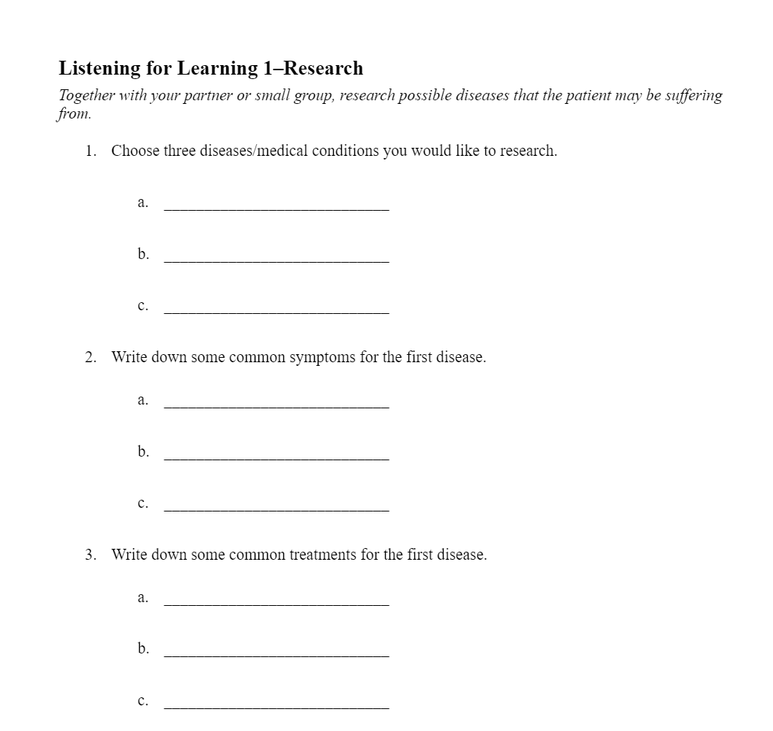
Notes:
This brings me back to the assignment. The students are required to write a conversation related to the module together with a small group. The students can research the topic beforehand and take notes, but after they finish taking notes, they can no longer use their phones or computers. They have to use their module booklets and notes from the module to write the conversations.

Slide 15
Notes:
Once they finish writing their conversation, I have them think about how they would use ChatGPT to help them edit the conversation to make it more natural or to include English expressions. Then, they write the prompt on a piece of paper. At this point, they should not type anything. This task should help them think about how to formulate a prompt and what outcome they want ChatGPT to help them with. I put emphasis on should, but so far, reality hasn’t matched my vision on this point. Here is a quick example of one of the group’s prompts:

Slide 16
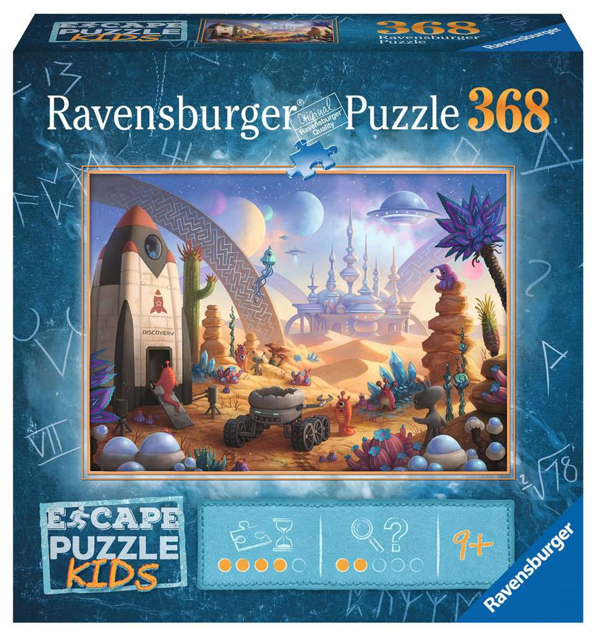
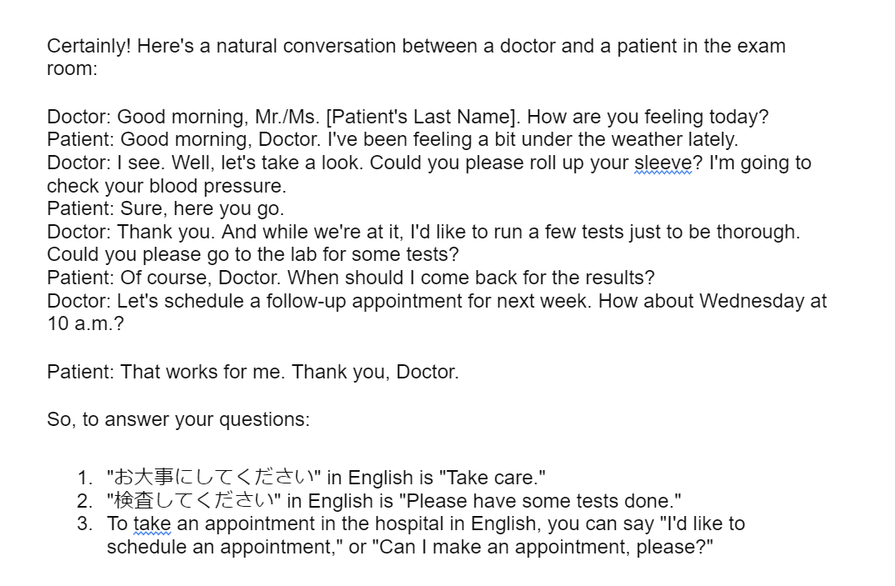
Notes:
The prompt is fine in that the group specifically wanted to know the English translation to these common hospital expressions. But my vision was for the students to give overall feedback on their conversations. This prompt isn’t exactly wrong, but this group did not feed the conversation they wrote to ChatGPT. Instead, they asked ChatGPT to create a completely new conversation. I have been focused on the big picture and how the pieces fit together. The students, on the other hand, are focused on the smaller pieces and the puzzle box cover. Here is what ChatGPT gave this group of students after this prompt.

Slide 17
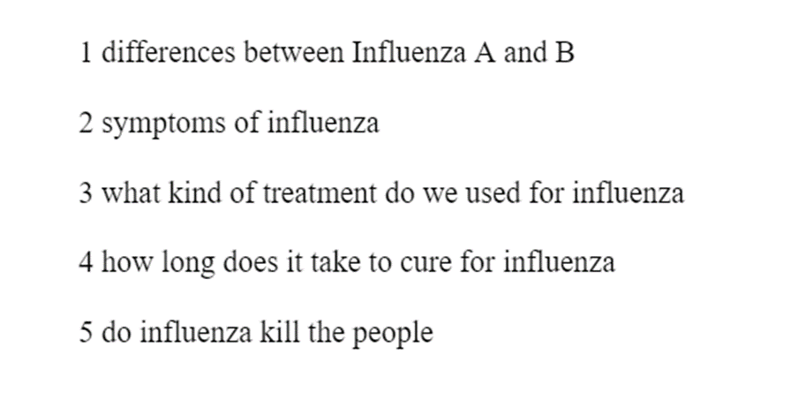
Notes:
So far, the biggest difficulty has been getting the students to understand that talking to ChatGPT is a process. They can’t just throw words at ChatGPT and expect it to know what they want. (image)
Even though a majority of the students had some kind of experience using generative AI, they had difficulties with handwriting a prompt. This could be because my own explanation…my own prompt to them… was severely lacking. It could be that the students didn’t have enough experience using ChatGPT to help them edit something in English, so they didn’t know what kinds of prompts they should write. However, some of the groups did produce a more comprehensive prompt after some guidance.

Slide 18
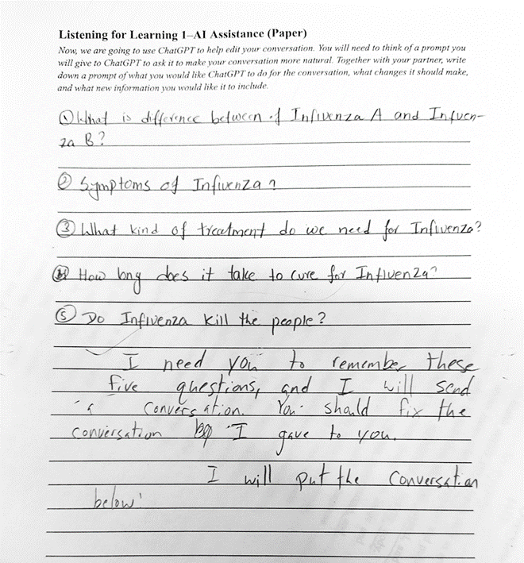
Notes:
So far, the biggest difficulty has been getting the students to understand that talking to ChatGPT is a process. They can’t just throw words at ChatGPT and expect it to know what they want. (image)
Even though a majority of the students had some kind of experience using generative AI, they had difficulties with handwriting a prompt. This could be because my own explanation…my own prompt to them… was severely lacking. It could be that the students didn’t have enough experience using ChatGPT to help them edit something in English, so they didn’t know what kinds of prompts they should write. However, some of the groups did produce a more comprehensive prompt after some guidance.

Slide 19
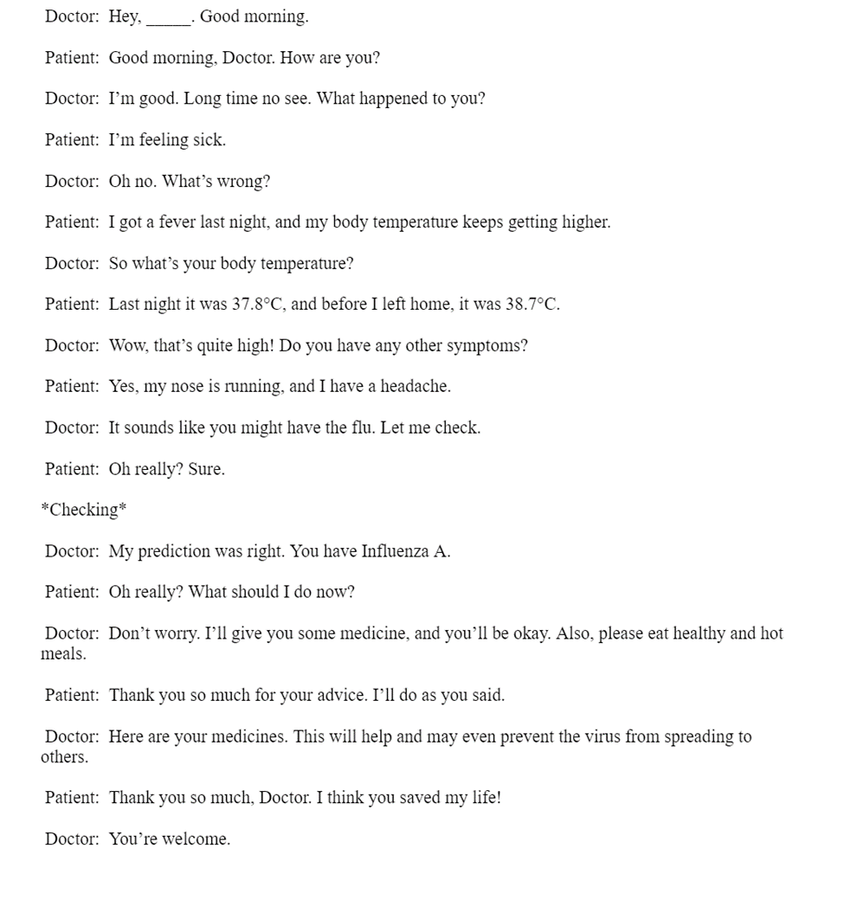
Notes:
So far, the biggest difficulty has been getting the students to understand that talking to ChatGPT is a process. They can’t just throw words at ChatGPT and expect it to know what they want. (image)
Even though a majority of the students had some kind of experience using generative AI, they had difficulties with handwriting a prompt. This could be because my own explanation…my own prompt to them… was severely lacking. It could be that the students didn’t have enough experience using ChatGPT to help them edit something in English, so they didn’t know what kinds of prompts they should write. However, some of the groups did produce a more comprehensive prompt after some guidance.

Slide 20
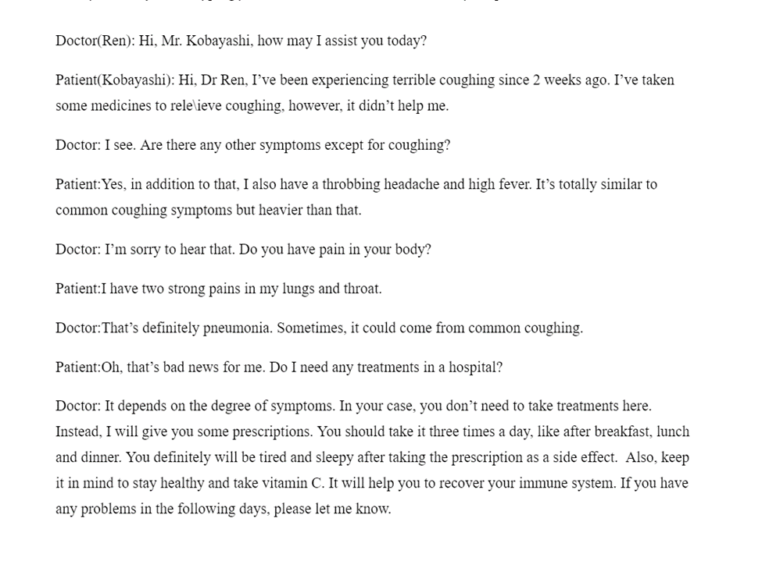
Notes:
Here is another example of a different group’s conversation….prompt…. And ChatGPT’s response

Slide 21
Notes:
Here is another example of a different group’s conversation….prompt…. And ChatGPT’s response

Slide 22
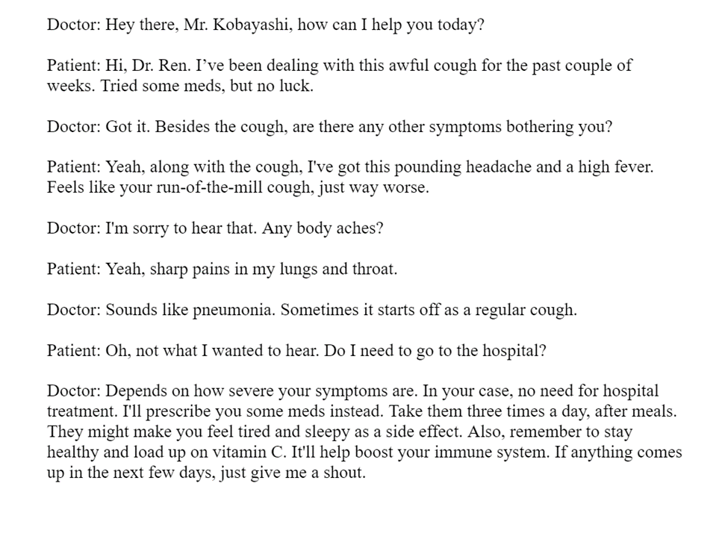
Notes:
Here is another example of a different group’s conversation….prompt…. And ChatGPT’s response

Slide 23
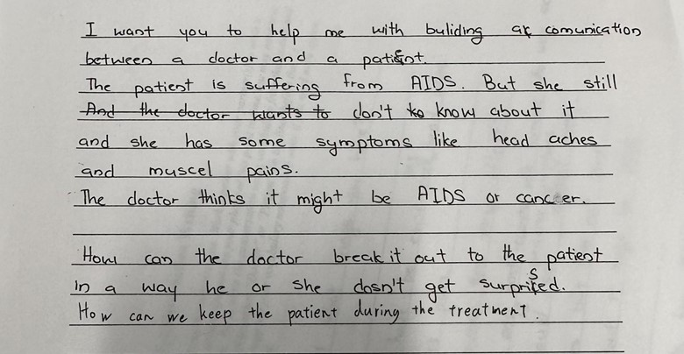
Notes:
Now, some of the students did take a more creative approach to this assignment. This group decided to research AIDS before realizing they would need to write a conversation with a doctor diagnosing a patient with AIDS. They took this assignment seriously, as they knew it was a serious topic and a devastating diagnosis. This group of students decided to ask ChatGPT what the best way to break the news to a patient would be.

Slide 24
Tasks Completed So Far
Survey
Health and Medicine Module
Doctor and Patient Conversation
Notes:
This project is still in the early stages as far as student output goes. What I’ve learned so far is that, even though students are using ChatGPT for a variety of things, they don’t know the most effective ways to communicate with ChatGPT for studying purposes. They either want ChatGPT to directly translate something for them or provide them with information without asking it to break it down into accessible pieces for them.

Slide 25
1
Issues
Prompt writing skills in English
Understanding the process of communicating with ChatGPT
Time management skills
Notes:
For the first conversation writing task, I provided very little guidance to them as far as the conversation writing and prompt writing went. I wanted to see what kind of prompts they would give to ChatGPT without interference. It appears that prompt writing is not a skill they have strongly developed despite using ChatGPT for a variety of tasks.

Slide 26
Thank you for your time!
Bethany Lacy
b.lacy.nt@juntendo.ac.jp
ResearchGate ----------------→
Notes:
I will continue to monitor the students and their prompt writing abilities for the rest of this year, and I hope I can provide more substantial results at next year’s JALTCALL conference. Thank you all for your time.

