Slide 1
Voice recognition applications in university English Reading classes

Slide 2
Mike Lyons
1982 Bought my first computer
1986 First job in Japan
1994 Opened private English school
1995 Started using Dragon Naturally Speaking
2009 Created ship-sheep.com
2022 Started using Voice Recognition applications at universities
Currently teaching at my English school and universities in Nagoya, n=350

Slide 3
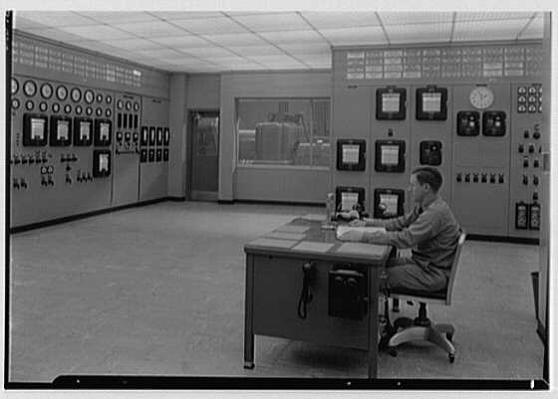
History of voice recognition software
1952: Audrey System
1960s-80s: Hidden Markov Model
1975: DRAGON
1995: Windows 95
2010: Siri
Recent years: Real-time and multilingual speech recognition

Slide 4
Benefits of Reading Aloud
Language Acquisition and Fluency
Enhanced Engagement and Comprehension
Memory Retention
Reducing Stress and Anxiety
Suitable for use with AI

Slide 5
Read Aloud software
For institutions
Google Workspace for Education – Read Along
Moodle – Poodll
MS Teams – Reading Practice
For individuals and private language schools
MS Reading Coach

Slide 6
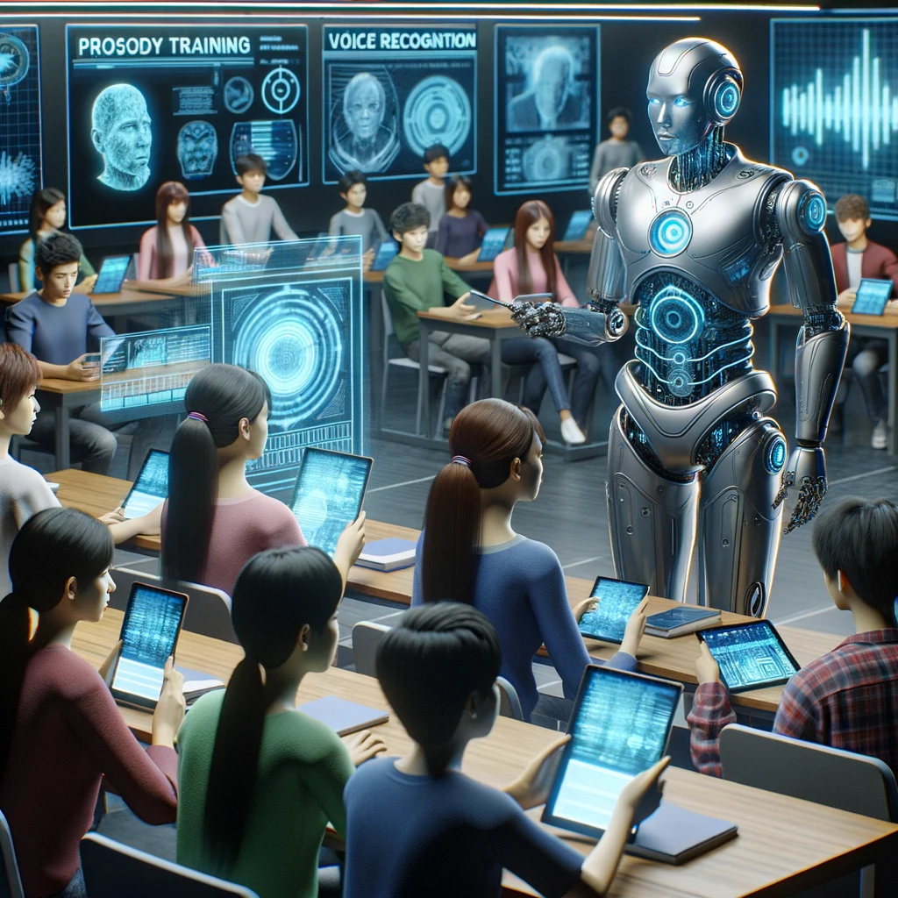
Future
Proactive coaching
Emotion recognition
Accents
Prosidy training
What do you think?

Slide 7
References
Anjasmara, A, & Wijayanto, A. (2023). The Use of Reading Aloud Technique to Reduce Student’s Speaking Anxiety. UNNES-TEFLIN National Seminar, Vol.5, 108-118. https://proceeding.unnes.ac.id/utnc/issue/view/49
Holt, P. (2023). The Power of Vocalization: 6 Ways Reading Aloud Improves Learning - E-Student. Retrieved from https://e-student.org/reading-aloud/
Rebelo, M. (2023). The best dictation and speech-to-text software in 2024. Retrieved from https://zapier.com/blog/best-text-dictation-software/?fbclid=IwAR2y2H4ZrXRuSPhTGj141vxY34_eX4ClAlaaG9XfDZSyYwJ5hQGtsyOcqw4
Senawati, J., Suwastini, N, Jayantini, I, Gustim A, Adnyani, N, & Artini, N. (2021). The Benefits of Reading Aloud for Children: A Review in EFL Context. IJEE (Indonesian Journal of English Education). 1. 73-100. 10.15408/ijee.v1i1.19880.

