Slide 1
Exploring the role of humor in intercultural communication
John Rucynski
Okayama University
2025 PanSIG, Kanda University of International Studies

Slide 2
Presentation Outline
I. Introduction: Why a course on humor?
II. Course background
III. Course contents
IV. Sample unit
V. Assessment
VI. Student reactions

Slide 3
I. Why Humor???

Slide 4
Why an entire course about humor?
“Laughter forms a bond, but it simultaneously draws a line.” (Lorenz, 1963)
Humor can help interlocutors bond (Attardo, 2002), maintain relationships (Bell, 2011), and diffuse tension (Gibbs, 2007)
Cross-cultural humor differences can lead to confusion, embarrassment, anger (Bell & Pomerantz, 2016; Lems, 2013; Rucynski & Prichard, 2020)

Slide 5
II. Course Background

Slide 6
Teaching Context
“Humor & Intercultural Communication” course
“EPOK Combined” course
Multicultural class (30-40 students; Japanese students + international students from all Three Circles of English)
English level TOEIC 600+
8 classes (x 100 minutes)

Slide 7
III. Course Contents

Slide 8
Course Units
Introduction: Benefits and risks of humor
Cultural stereotypes in humor
Crossing borders with humor
Verbal irony
Satirical news
Social issues and humor
Individual research + presentation

Slide 9
Humor: A Double-Edged Sword?
Konrad Lorenz:
“Laughter forms a bond, but it simultaneously draws a line.”

Slide 10
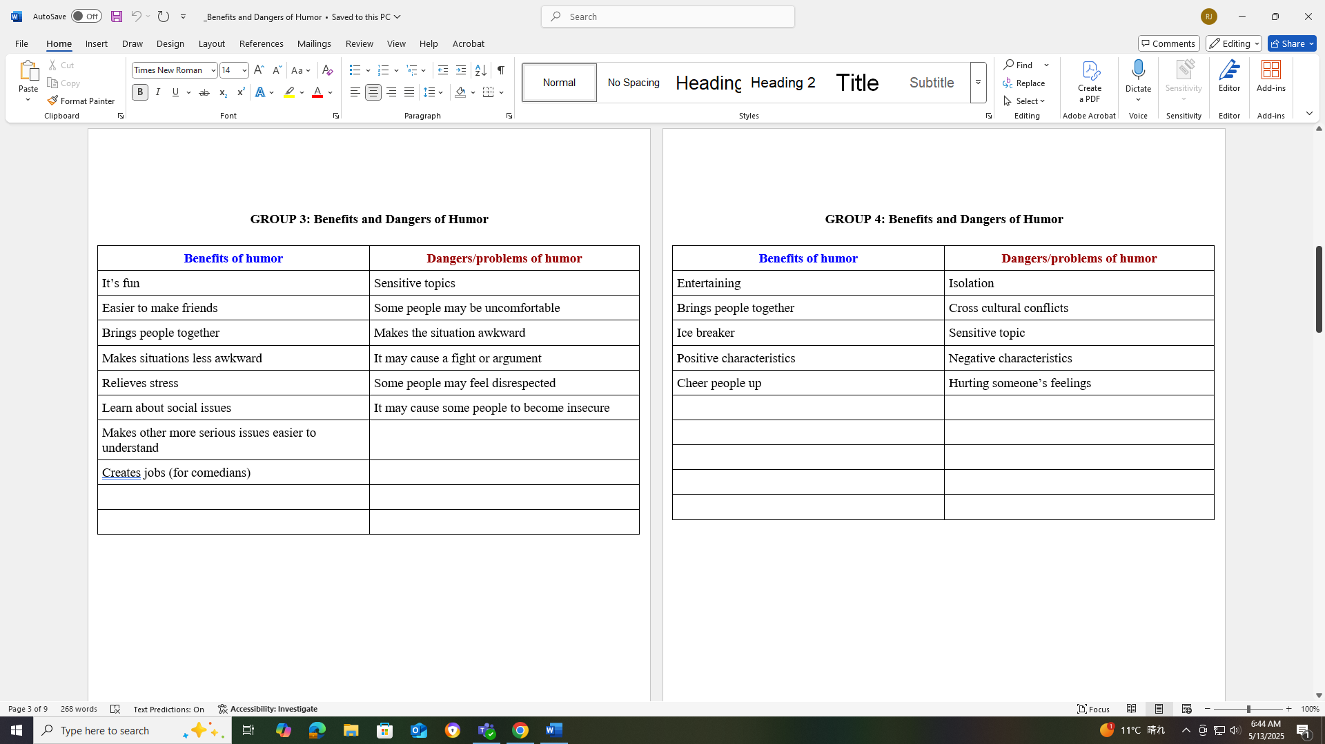

Slide 11
IV. Sample Unit: Verbal Irony

Slide 12
Rationale: Unit on Verbal Irony
1. Very common in English-speaking countries; less common in languages such as Japanese
2. Both positive and negative functions
3. Consequences if misunderstood

Slide 13
Sample Class Discussions & Activities

Slide 14
How’s the weather today?

Slide 15
Greeting in Japan?

Slide 16
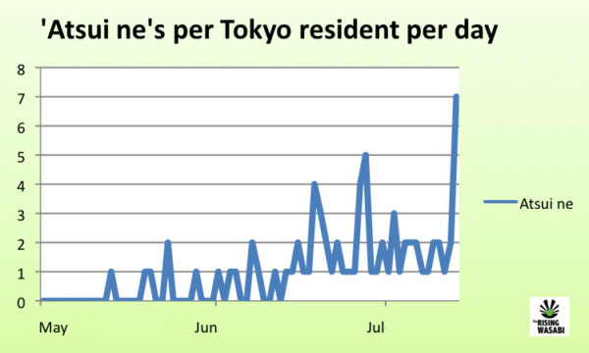
“Tokyo Reaches ‘Atsui Ne’ Yearly Peak”

Slide 17
Discuss:
1. Are you sarcastic? If so, how and with whom do you use it?
2. Is sarcasm commonly used in your culture?
3. What are the functions of sarcasm?

Slide 18
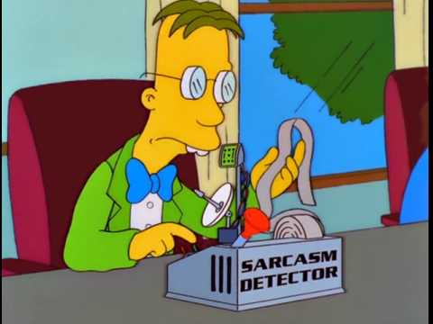
Discuss:
1. Are you good at detecting sarcasm?
2. What are the consequences of NOT getting sarcasm?

Slide 19
Humor Competency Training Stages
Detect the humor
Understand the humor
Respond to the humor
Produce humor
(Bell & Pomerantz, 2016)

Slide 20
Teaching & Detecting Verbal Irony
What are some cues people give when they use irony?
Prosodic cues (e.g., intonation, tone, stress)
Visual cues (e.g., body language, expression)
Verbal context cues (e.g., words don’t match the context/situation)
Fill out the chart as much as you can with your group.

Slide 21
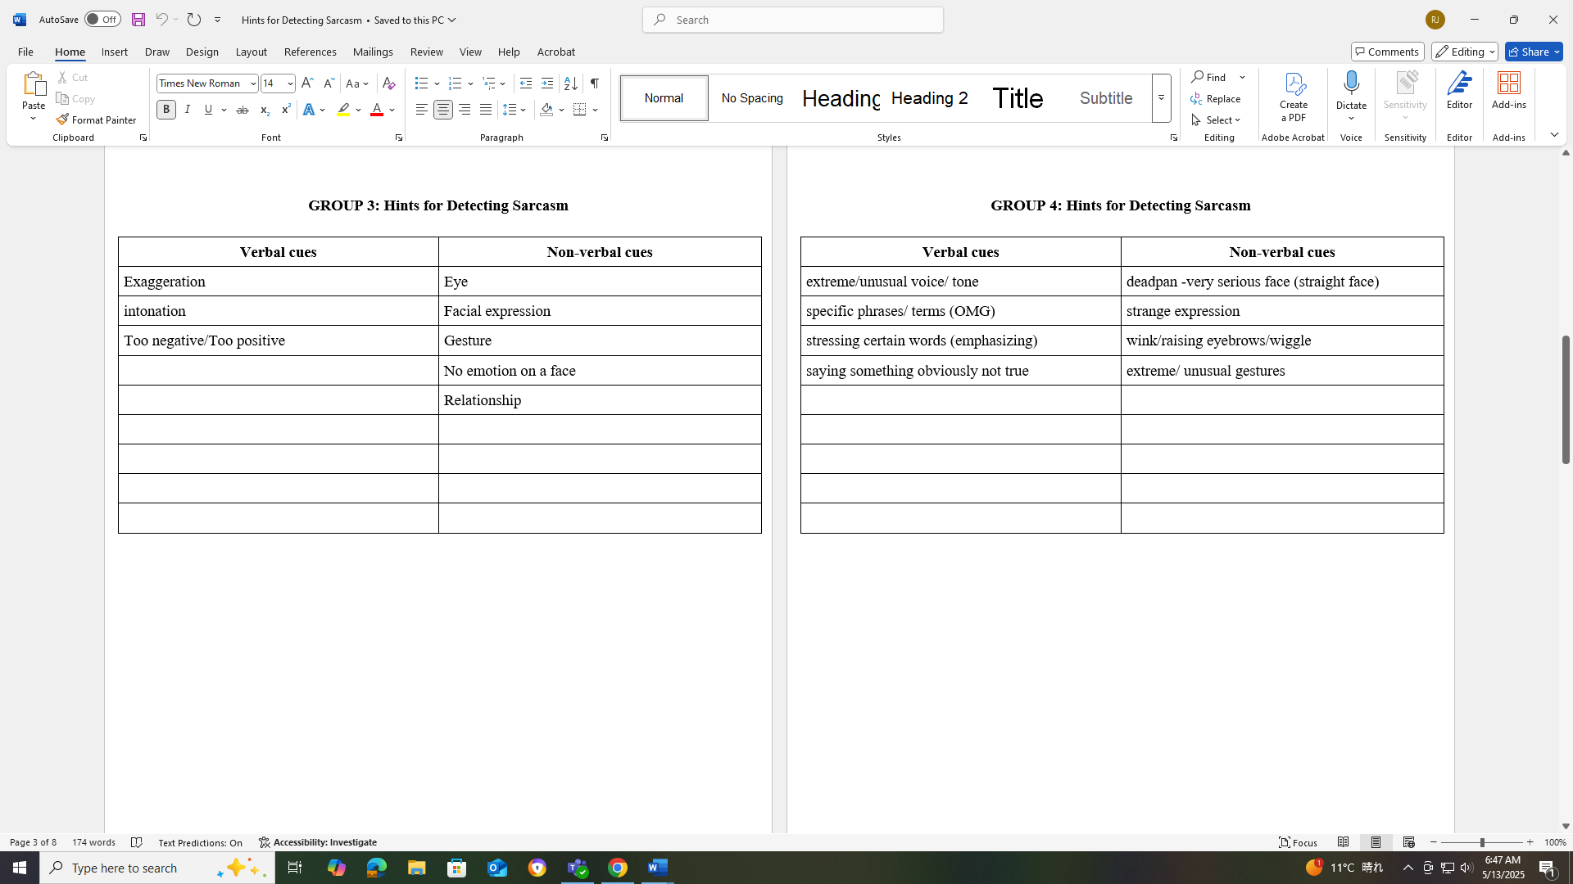

Slide 22
Visual Cues Examples

Slide 23
Visual Cues Examples

Slide 24
Visual Cues Examples

Slide 25
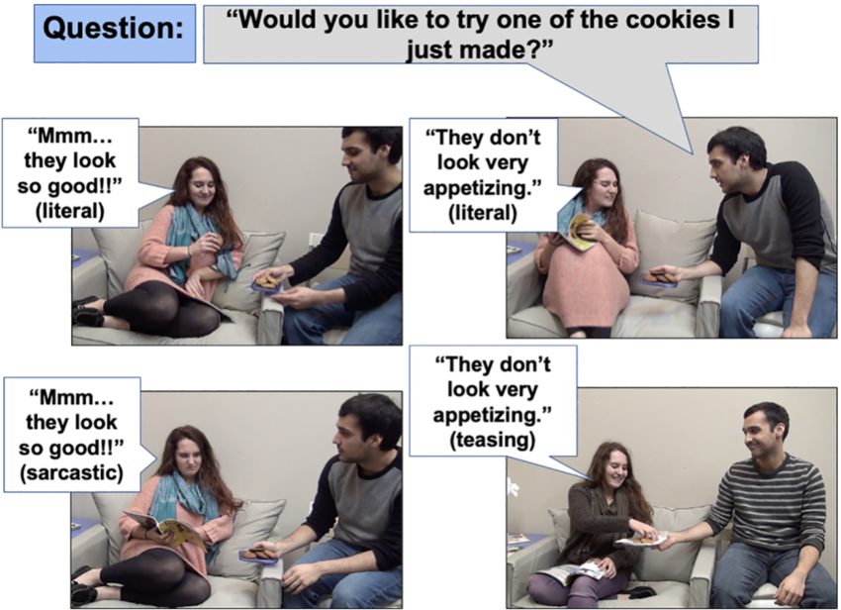
Rothermich & Pell (2015) RISC

Slide 26
Case Studies

Slide 27
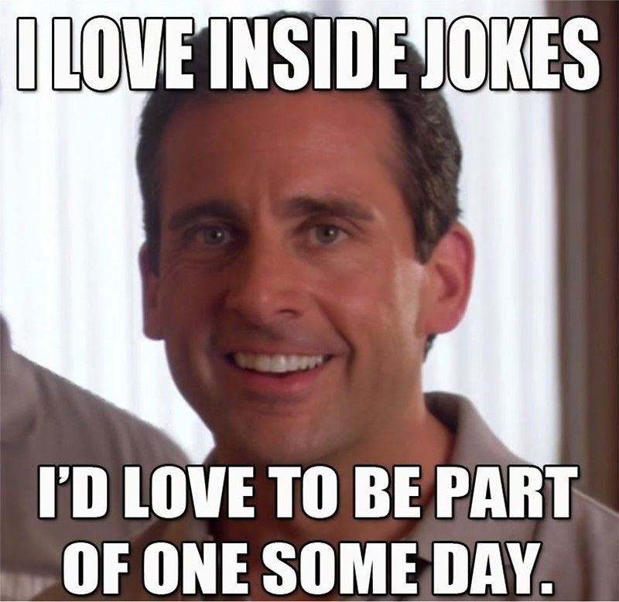
Cross-cultural humor
misunderstanding case studies?
Examining the causes (and consequences) of misunderstandings involving humor across cultures:
In interpersonal communication and/or
Humor in the mass media

Slide 28
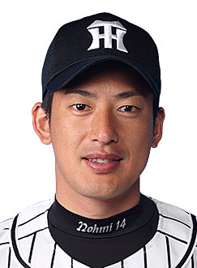
Main Characters
Matt Murton, American, batter
Atsushi Nohmi, Japanese, pitcher

Slide 29
Matt Murton in Japan
2010: Broke single-season hits record
2011: Led the team in hits
2012: Had a bad start to the season (along with the Tigers)

Slide 30
The Incident: 2012 Season
Murton made a bad play in the field during the game
Reporter: Were you trying your hardest when you made that throw?
Murton: No. I don’t like Nohmi, so I let the other team score a run…

Slide 31
Next Day Sports Newspaper Headline?

Slide 32
Case Study Discussion
1. What is the best solution to this incident?
2. What action(s) would you take as the manager or general manager?
3. What action(s) would you take as Matt Murton?
Possible perspectives / feelings to consider:
Matt Murton
Murton’s interpreter
Atsushi Nohmi
The reporter / reporters
Fans

Slide 33
Written Reaction Prompts
1. What is your general reaction to the Matt Murton sarcasm incident? For example, do you feel Murton should have been punished in some way? Do you think he should have been made to apologize to Nohmi (his teammate) or others?
2. Do you a focus on verbal irony should be included as part of English language education? If so, what aspects (e.g., detection, reaction, production) should be focused on?

Slide 34
Student Reactions

Slide 35
Prompt 2 Student Reactions
“In Australian culture...sarcasm is a part of most people’s everyday speech. People that don’t understand sarcasm can often feel isolated or maybe excluded from conversations. This form of Australian banter, however, is not something I could say I am proud about….
However, whether the sarcasm is good or bad, I think it is important for an English learner to have the knowledge to understand the mechanics of sarcasm.” (Australia)

Slide 36
Prompt 2 Student Reactions
“I had a unique experience studying English as my family moved to a predominantly English speaking country when I was younger…
However, me having had that experience which helped me understand, detect, and use sarcasm properly I believe it greatly elevated my language proficiency as well as helped me get along better with Native-English speaking people.” (Bulgaria)

Slide 37
Bond or barrier?
“One friend...culturally raised in a Japanese environment most of his life...got very upset with my sarcastic answer to his question. I did make my sarcasm very obvious…
...however, seeing that he still got hurt, I would like to emphasise on how easy one culturally-Japanese person may be offended by misunderstanding the cynical joke, no matter the obviousness, the unintentional purpose, or how hilarious the flow was.” (Japan/England)

Slide 38
V. Assessment

Slide 39
Assessment
Preparation and participation
Unit written reflections
Final presentation

Slide 40
Final Presentations: Independent Research

Slide 41
Final Presentation Theme / Details
Expand on any theme related to humor and culture
Focus on one of the course units or another theme / genre of humor
Focus on Japan or your own culture or compare / contrast

Slide 42
Independent Research Topics
How Kimie Oshima spread rakugo overseas
Language as a weapon: a look into French equivalents of humour such as “esprit”, “humeur” and “farce”
Examining “manzai” and why it is difficult for non-Japanese to get (enjoy) this type of humor
Trevor Noah’s global success
Examining the reception of pointed topics (politics, naming specific people, social issues) in Japanese comedy, specifically through the career of Daisuke Muramoto
Examining ‘funny politicians’- how political actors use humor on Twitter
The usage of satire in politics: An analysis of the Charlie Hebdo incident
The similarity of sarcastic words between England and Kyoto
The impact of the use of humor in international relations: Can humor transcend cultural barriers?
“Oh, So You Want to Learn About Sarcasm?” - What is sarcasm, and why is it so popular in the UK?
Exploring American stand-up comedy and Asian stand-up comedy: Similarities and differences
Filipino in the US via stand up comedians and social media comedians

Slide 43
VI. Student Reactions

Slide 44
Humor as Content
“I scarcely check or read political news unless professor gives me an assignment of it....my lack of interest on checking news that is because of the biased articles.
...I was amazed that The Rising Wasabi generated my interest on reading and knowing more about Japanese current political and social situation…” (Japan)

Slide 45
Humor as an Academic Subject?
“I think I put more work into this presentation than any other presentation in my two years of university....
...I was really fascinated to look into the cultural origins of all the humor I had taken for granted.”

Slide 46
Humor in Action!
“Dear Professor John,
This is _____.
Here is my essay on sarcasm due today; it's an absolute masterpiece, totally worthy of reading (exaggerated eye-roll); hopefully it's not too bad.” (Japan/England)

Slide 47
Final Thoughts

Slide 48
Humor & Cross-Cultural Communication
“...that probably wasn’t the right way to respond. But it was certainly in jest, a joke. Therein lies a cultural lesson that our jokes don’t always translate.”--Matt Murton

Slide 49
Happy Ending

Slide 50
Select Publications
Neff, P. & Rucynski, J. (2017). Japanese perceptions of humor in the English
language classroom. Humor, 30(3), 279-301.
Prichard, C. & Rucynski, J. (2019). Second language learners’ ability to detect
satirical news and the effect of humor competency training. TESOL Journal, 10(1), e00366.
Prichard, C. & Rucynski, J. (2022). L2 learners' ability to recognize ironic online
comments and the effect of instruction. System, 105, 102733.
Rucynski, J. & Prichard, C. (Eds.). (2020). Bridging the humor barrier: Humor
competency training in English language teaching. Lexington Books.
Rucynski, J. (Ed.). (2016). New ways in teaching with humor. TESOL Press.
Rucynski, J. & Prichard, C. (2021). Implementing humor instruction into
English language teaching. English Teaching Forum.

Slide 51
Recent Book Chapters

Slide 52
Exploring the role of humor in intercultural communication
John Rucynski rucyns-j@okayama-u.ac.jp
Okayama University
2025 PanSIG, Kanda University of International Studies

