Slide 1
Pre-Talk Discussion
Talk to your partners. Can you identify any possible learner issues with the following intensifier collocations?
It’s very interesting, very fun and very cool.
That journey was beautiful indeed.
It is bitterly hot outside right now.
I’m absolutely tired.
It’s quite good.
The storm was terrific in its destruction.
The game last night was well good, wasn’t it?
He’s like totally innocent.
Teaching intensifying adverbs: The case for autonomy, and its limits
John Shaw
13:40 – 14:05

Slide 2
Teaching intensifying adverbs: The case for autonomy, and its limits PanSig 2025 Sunday 18th May 2025 John Shaw John.Shaw380@gmail.com

Slide 3
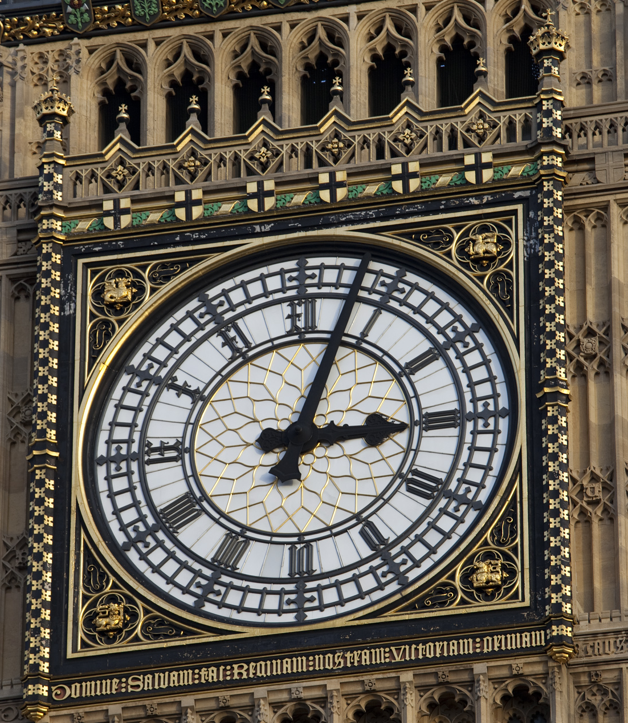
Presentation
What are intensifiers, why and how to teach them?
Learner Issues: The Answers – Part 1
Activity 1: Encouraging the use of corpus data
Learner Issues: The Answers – Part 2
Activity 2: Noticing register and sociolinguistic discussion
Conclusions
Questions and Answers

Slide 4
What are intensifiers?
“...adverbs or adverbial phrases that strengthen the meaning of other expressions and show emphasis.”
Cambridge Dictionary. Accessed 10/08/24, retrieved from https://dictionary.cambridge.org/.

Slide 5
Lebedeva, I. S., & Pavlova, E. B. (2016:49). ‘Intensifiers in Modern English’ in Vestnik Moskovskogo Gosudarstvennogo Lingvisticheskogo Universiteta, 21 (760), pp. 43-56.

Slide 6
Lebedeva, I. S., & Pavlova, E. B. (2016:49). ‘Intensifiers in Modern English’ in Vestnik Moskovskogo Gosudarstvennogo Lingvisticheskogo Universiteta, 21 (760), pp. 43-56.

Slide 7
Why are they important?
Emotive language is a primary way people express their feelings.
Intensifiers like “very” are used with very high frequency.
Using them gets you higher marks in exams – especially low frequency ones!

Slide 8
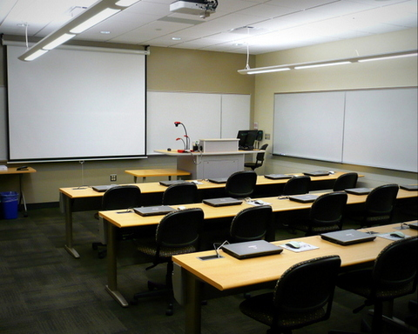
How do we cover them in English courses?

Slide 9
A study of seven non-L1 English teachers participating on a DELTA 2 course who studied English as a foreign language
Experience of learning intensifiers:
 | Number | Comments
Don’t remember studying intensifiers | 3
Remembers simple structure, “very”, “really”, “pretty”. | 2 | One remembers very at A1; another remembers learning them at B1.
Learnt them on a grammatical pedagogical course | 2 | Both teachers were Georgian.
John Shaw (2024)

Slide 10
A study of coursebooks in the library
Book | Context | Task
Face to Face Advanced U2A | Gradability - Decontextualised | Ss need to cross out adverbs that do not collocate, check against a list and then make true statements about their life.
Objective Proficiency U6.3 | Listening Part 2 task about violins. | A small box telling people that adverb-adjective collocations are frequent and Ss should remember them.
Speakout Upper-Int U7.3 | Taught as a part of the function of emphasis. | Adding emphasis to newspaper stories.
John Shaw (2024)

Slide 11
My Own Experience
Coursebooks and Supplementary books cover gradability and intensification.
Exam coursebooks focus on collocations in speaking task practice.
Sociolinguistic?
Notes:
Grammar and Lexis focus, but not sociolinguistic

Slide 12
The long history of intensifiers has resulted in many complicated layers where older intensifying adverbs co-exist with newer ones, while others drop out of fashion, or are completely transposed.
Hopper and Traugott (2003)
Notes:
As we saw earlier the grammar can be quite overwhelming; even more so when to delve deeper.
90% of adjectives are ungradable
All the teachers said they learnt lexically except the two Georgians who were focussing on teacher training.

Slide 13
Common Learner Issues
1) Grammar (Gradability)
2) Lack of lexis (Collocations)
3) Sociolinguistic (Age, Nationality, Gender...)
4) Pronunciation (Intonation and Stress)

Slide 14
Learner issues – Part 1
1) It’s very interesting, very fun and very cool. (Overuse)
2) That journey was beautiful indeed. (Flexible form)
3) It is bitterly hot outside right now. (Wrong Collocation)
4) I’m absolutely tired. (Gradability)
Notes:
Pronunciation and sociolinguistic
Grammar / Lexical (A lot of post modification in colloquial English)
Prosody of Bitterly is negative and conflictual but doesn’t collocate. Lexical/Sociolinguistic (Scorching hot / Bitterly cold)
Grammatical – just got to learn it – still need to learn grammar at some point.

Slide 15
Grammar/Lexis
In Turkish, the structure for very, more and too is the same. Swan (2005:224,239)
Many speakers including L1 speakers overuse overgeneralise ‘very’.
Exam textbooks teach adverb-adjective collocations, but it is a ‘drop in the ocean’ compared to the possibilities that exist.
Foley, M and Hall, D. (2012: 76-79 and 389). My Grammar Lab C1 and C2. Harlow: Pearson Education Limited.

Slide 16
Activity One: Corpus Task
Adapted from Leo Selivan’s task about memorable movie quotes.
Involves teaching students how to use corpora and creating their own scripts.
Selivan, L. (2018:214-215).

Slide 17
Procedure
Lead-in to introduce the topic

Slide 18
What are these films? What do you think the context is?
Hold on. We are talking about an animal here.
____highly intelligent________________.
You're going after her with non-lethals.
We have $26 million invested in that asset. We can't just kill it.
The Dark Lord isn't resting.
You and Black, you're two of a kind.
Sentimental children ____________ bitterly unfair ________________.
Well, it may have escaped your notice, but life isn't fair.
Your blessed father knew that. In fact, he frequently saw to it.

Slide 19
What do you think the context is?
Hold on. We are talking about an animal here.
A highly intelligent animal. 400 meters to the beacon.
You're going after her with non-lethals.
We have $26 million invested in that asset. We can't just kill it.
The Dark Lord isn't resting.
You and Black, you're two of a kind.
Sentimental children forever whining about how bitterly unfair your lives have been.
Well, it may have escaped your notice, but life isn't fair.
Your blessed father knew that. In fact, he frequently saw to it.

Slide 20
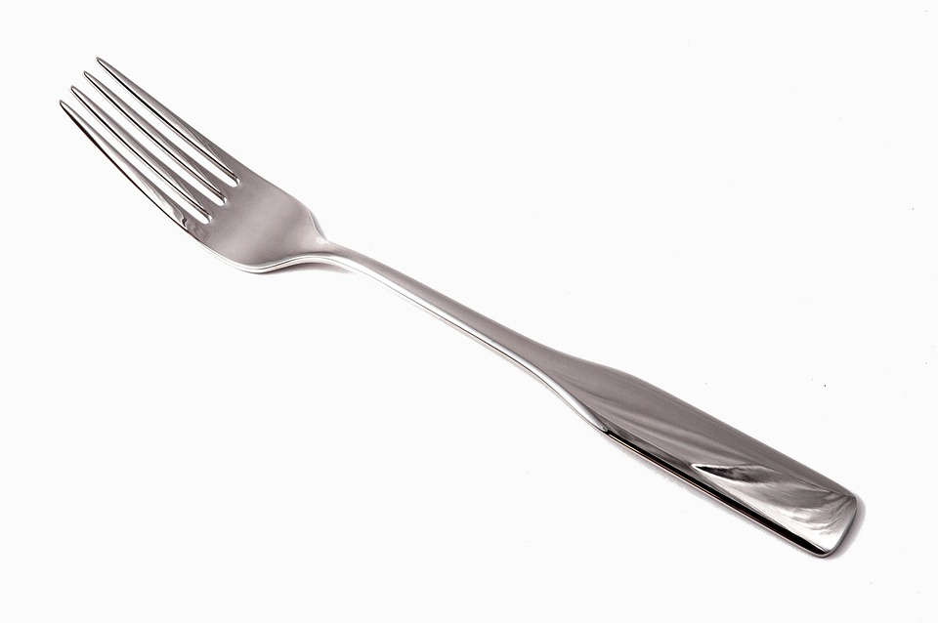
Procedure
Lead-in to introduce the topic
TTT (Test-Teach-Test) – students brainstorm word forks

Slide 21
Word Forks
Perfectly | clear
 | legal
 | good
 | safe

Slide 23
Adverb-adjective Intensifiers
Extra stage to aid noticing.
Adverbs have semantic prosody, e.g. “bitterly” collocates with some kind of conflict or suffering.
Notes:
Delirious is not a positive adjective, but the adverb collocated with words like happy.

Slide 24
Procedure
Lead-in to introduce the topic
TTT (Test-Teach-Test) approach – students brainstorm word forks
Students use different corpora to check and find new examples

Slide 25
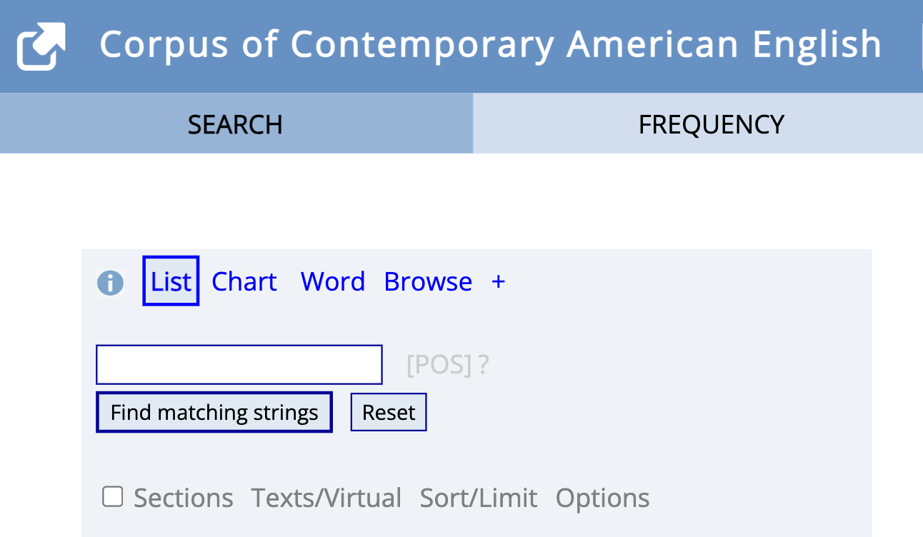
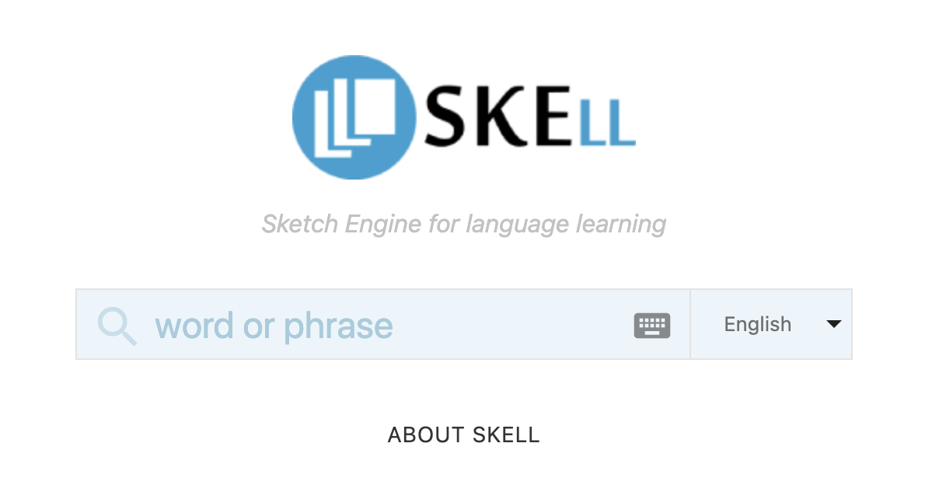
Corpus Data
https://skell.sketchengine.eu/#home?lang=en
https://martinweisser.org/corpora_site/online_corpora.html

Slide 26
Procedure
Lead-in to introduce the topic
TTT (Test-Teach-Test) approach – students brainstorm word forks
Students use different corpora to check and find new examples
Students find movie quotes from a database and do controlled practice with phonological features.
Students make their own scripts using adverb-adjective collocations they’ve learnt.

Slide 27
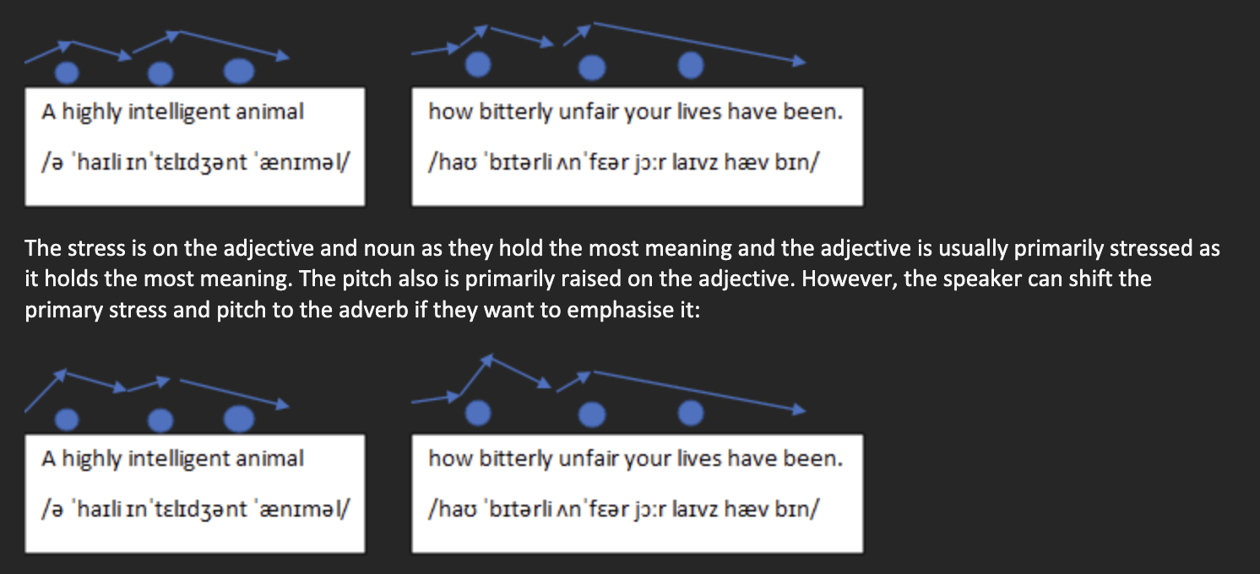
Quodb
https://www.quodb.com/

Slide 28
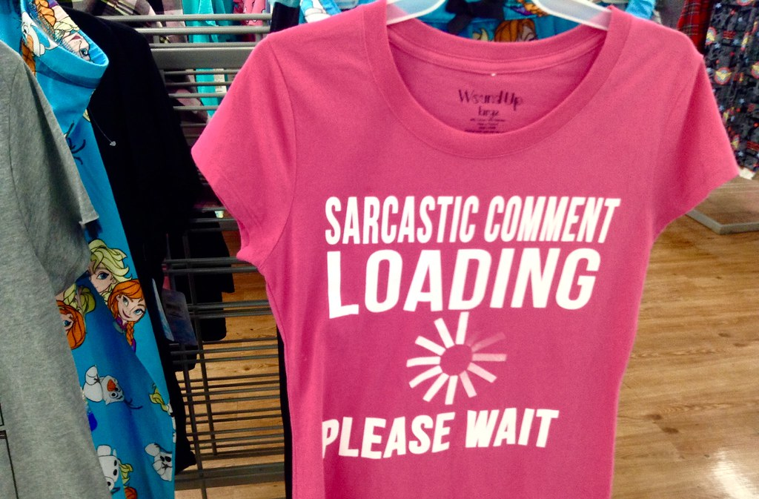
Pronunciation
Changing the tone or the stress can make an intensifier strong or even sarcastic.
Learners need compensatory paralinguistic features.
Suprasegmental features like connected speech.

Slide 29
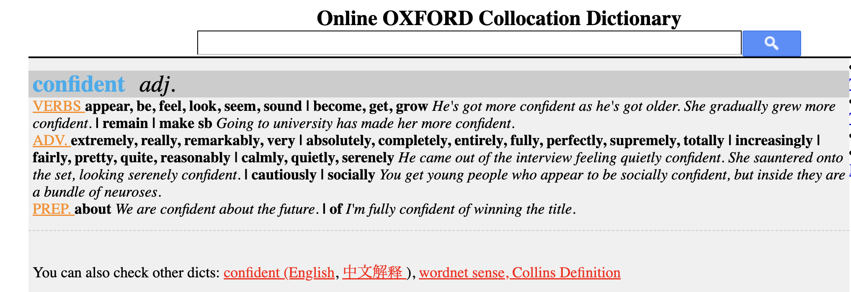
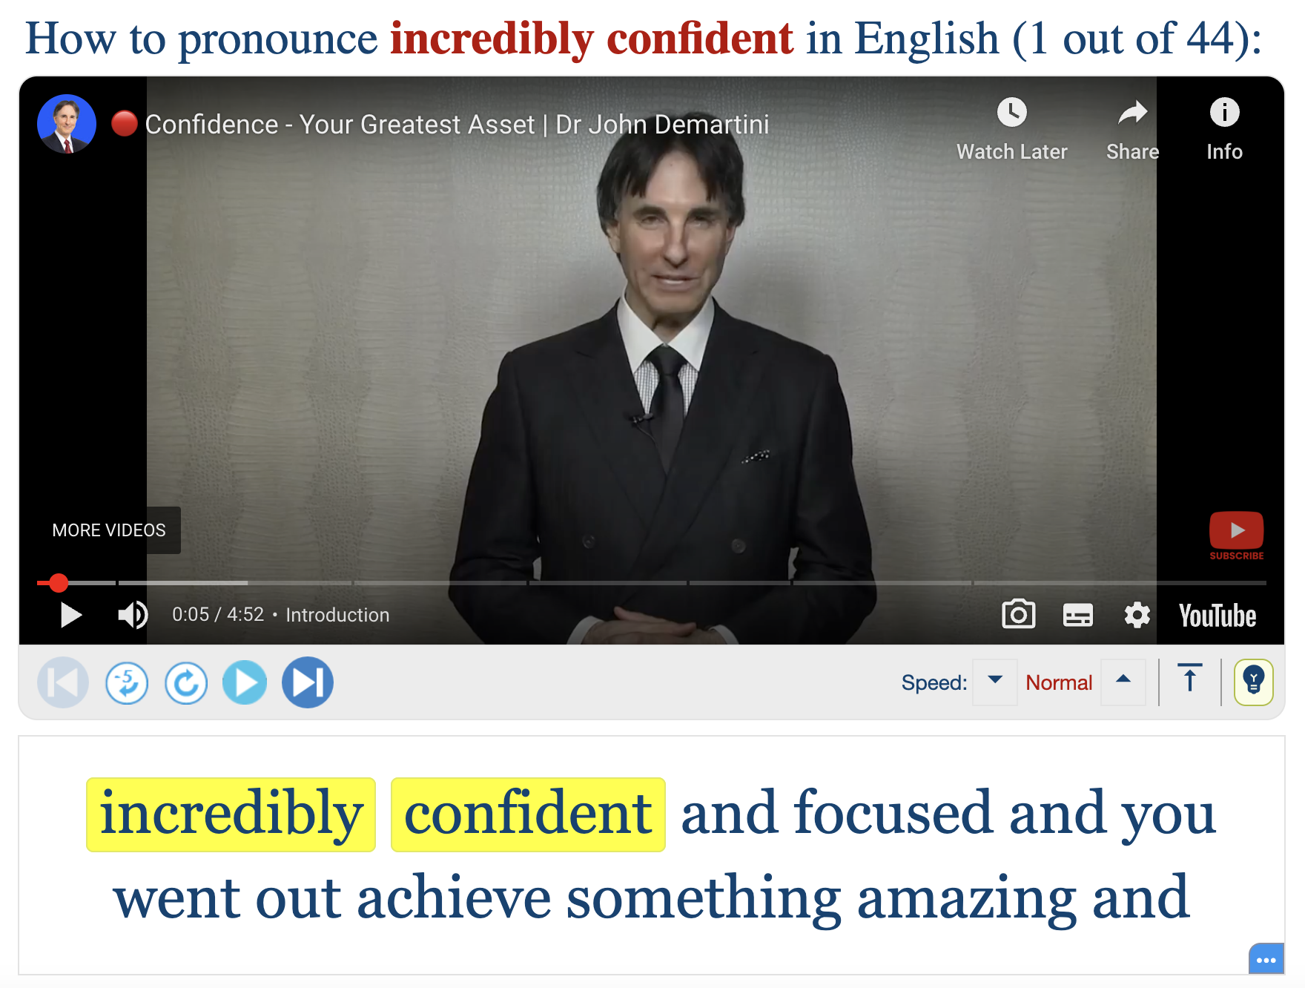
Lower-levels
Task: To describe their ideal role model.
Oxford Collocation Dictionary
Youglish

Slide 30
Summary
TTT approach helped students understand that there was a gap in their knowledge.
Students felt confident that they could use these tools in independent study.
Are there any dangers?

Slide 31
Learner issues – Part 2
5) It’s quite good. (Quite can be an amplifier and downtowner in British English; pronunciation and paralinguistic features are important)
6) The storm was terrific in its destruction. (Transposed meaning)
7) The game last night was well good, wasn’t it? (Sociolinguistic)
8) He’s like totally innocent. (Sociolinguistic)

Slide 32
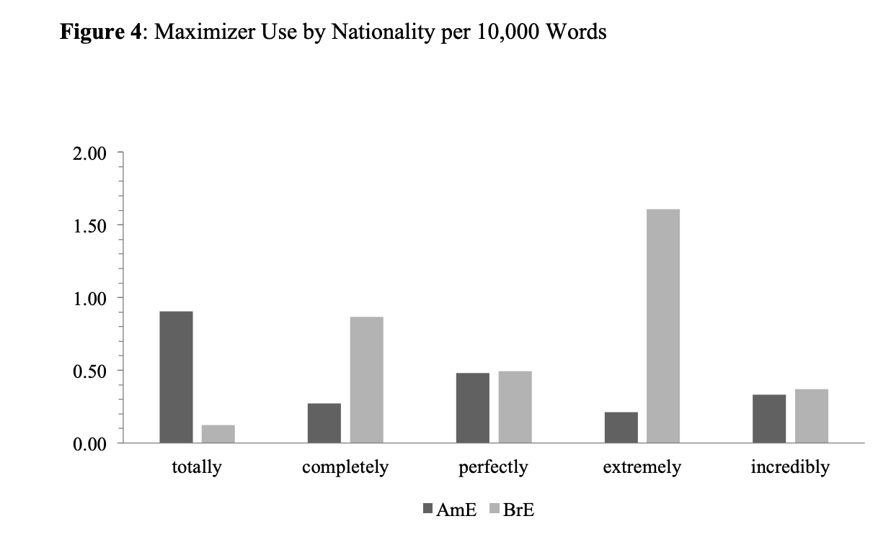
Sociolinguistic
Language is always evolving.
Regional differences exists.
Well and Propper became intensifying adverbs when I was a teenager.
6) The storm was terrific in its destruction.
Reichelt, S. and Durham, M. (2017:19)
7) The game last night was well good, wasn’t it?
Stratton, J. (2018). ‘The Use of the Adjective Intensifier 'well' in British English: A Case Study of The Inbetweeners’ in English Studies 99 (8), pp. 793-816.

Slide 33
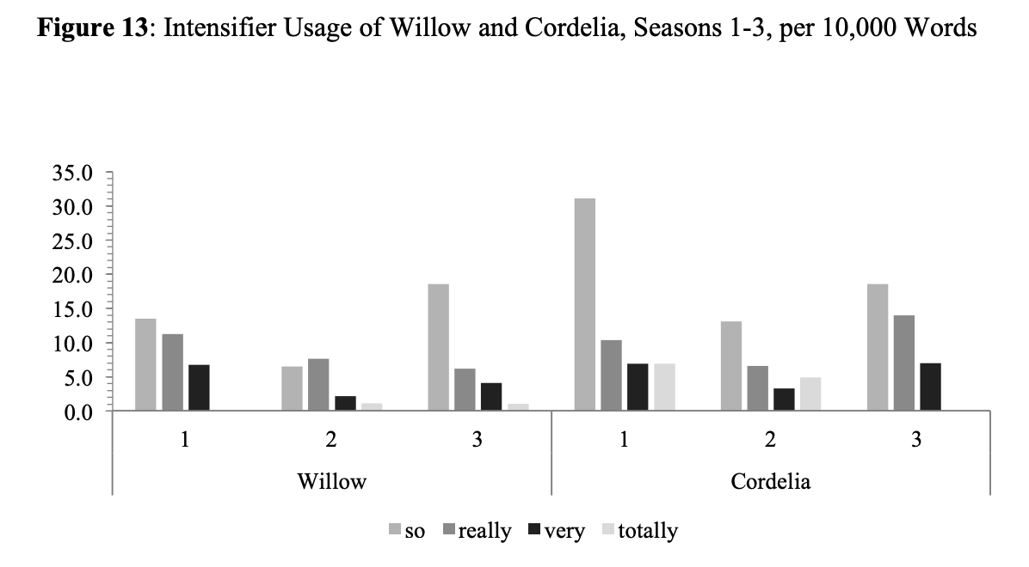
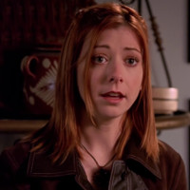
Sociolinguistic
A choice to use intensifiers can indicate social class and personality.
The use of intensifiers have had legal impacts in court. Long and Christensen (2008)
8) He’s like totally innocent
Willow
Cordelia
Reichelt, S. and Durham, M. (2017:31).
Notes:
LA Valley Girl Accent - For those who use it, it identifies that you are in their social group, and you are a good and cool person. Others look down on the accent as unserious. If men use this accent, it can be an identification that he is openly homosexual. This research is very important for translanguaging and code switching, and this is especially the case when it comes to legal and business.

Slide 34
Activity 2: Sociolinguistic Task
This is a case for continued teacher intervention.
Discussion and mistakes can be made in a safe environment.

Slide 35
Gist Task
Notes:
Play Recording

Slide 36
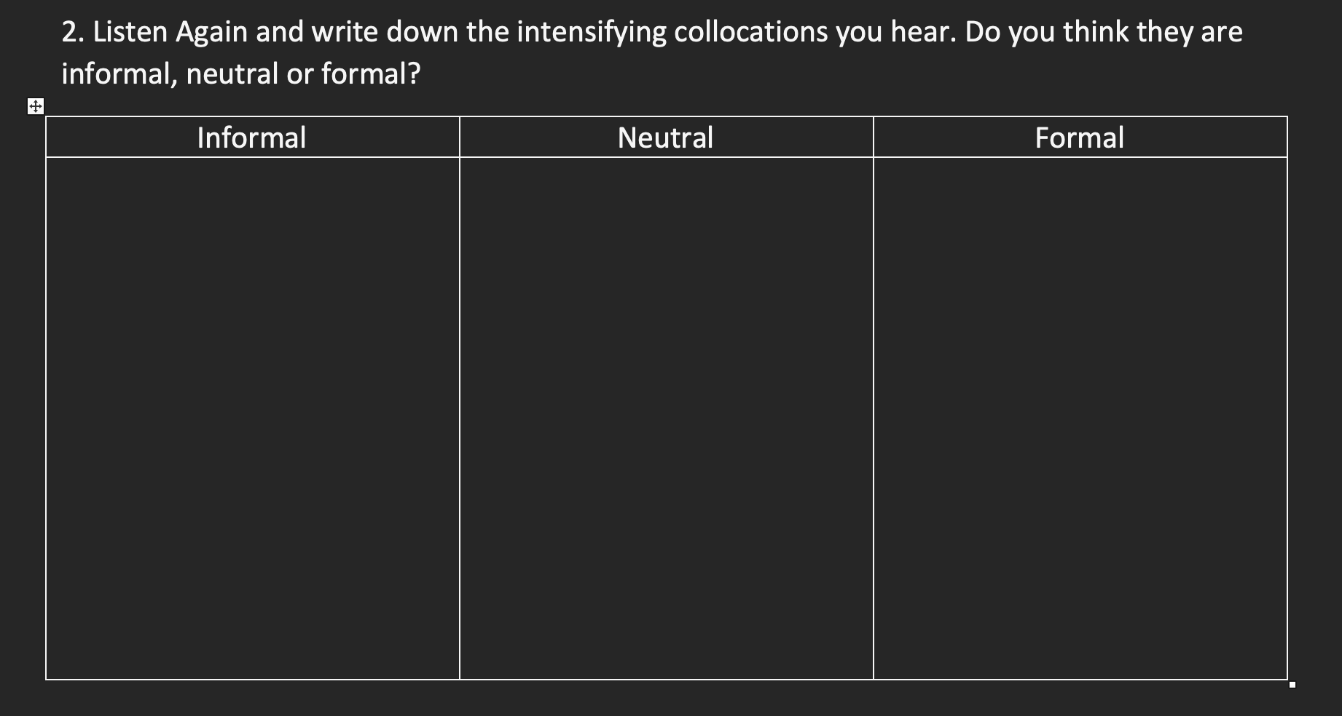
Noticing and Discussion
Notes:
Noticing Skills

Slide 37
Summary
More appropriate for higher level students.
Role play with another teacher or can use AI.
Led to many debates about code-switching.
Notes:
Code switching debate / authority / Defiance
ELF debate – Teachers who have lived in that community have a big advantage

Slide 38
Conclusion
Integral part of language, not easy to teach and avoided by textbooks.
Can be approached grammatically, lexically and sociolinguistically.
Corpora can help them with autonomy - independent study, incidental learning.
Teacher will always have a role in guiding students.

Slide 39
References
Cambridge Dictionary. Accessed 10/08/24, retrieved from https://dictionary.cambridge.org/.
Foley, M and Hall, D. (2012:369). My Grammar Lab C1 and C2. Harlow: Pearson Education Limited.
Hopper, P and Traugott, E. (2003). Grammaticalization. Cambridge: CUP.
Lebedeva, I. S., & Pavlova, E. B. (2016). ‘Intensifiers in Modern English’ in Vestnik Moskovskogo Gosudarstvennogo Lingvisticheskogo Universiteta, 21 (760), pp. 43-56.
Long, L and Christensen, W. (2008). Clearly, ‘Using Intensifiers is Very Bad - Or is It?’ in Idaho Law Review, retrieved 09/08/24 from https://ssrn.com/abstract=1138084.
Reichelt, S. and Durham, M. (2017). ‘Adjective Intensification as a Means of Characterization: Portraying in-group Membership and Britishness in Buffy the Vampire Slayer’ in Journal of English Linguistics, 45 (1), pp. 60-87.
Selivan, L. (2018). Lexical Grammar: Activities for Teaching Chunks and Exploring Patterns. Cambridge: CUP.
Stratton, J. (2018). ‘The Use of the Adjective Intensifier 'well' in British English: A Case Study of The Inbetweeners’ in English Studies 99 (8), pp. 793-816.
Stratton, J. (2021). The Emerging Intensifier 'proper' in British English in English Today 37 (4), pp. 206-213.
Swan, M. (2005). Practical English Usage (3rd ed.). Oxford: OUP.

Slide 40
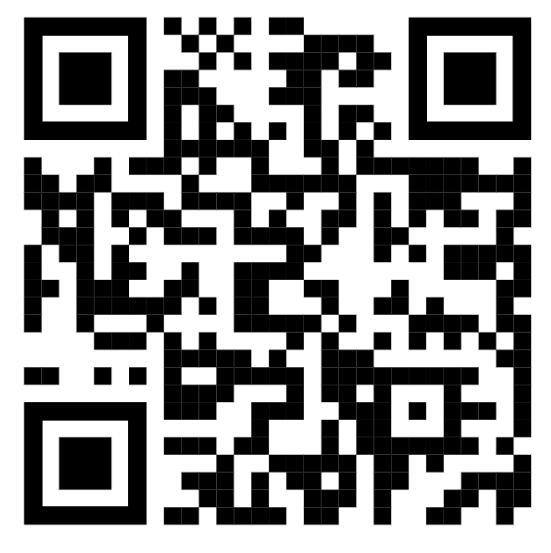
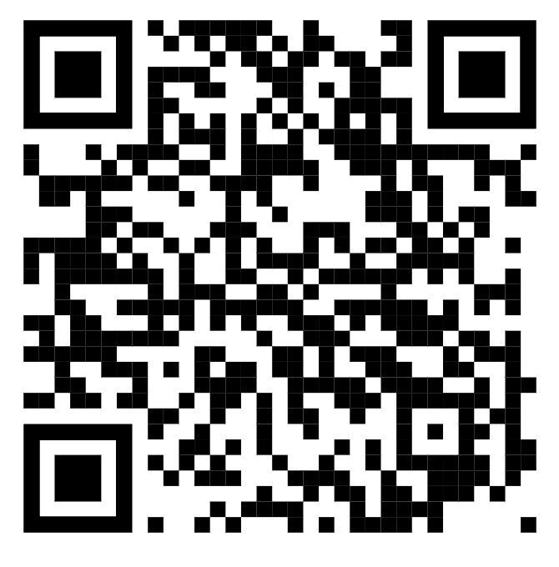
Corpus Data
COCA
SKELL
https://www.english-corpora.org/coca/
https://skell.sketchengine.eu/

Slide 41
Quodb
https://www.quodb.com/

Slide 42
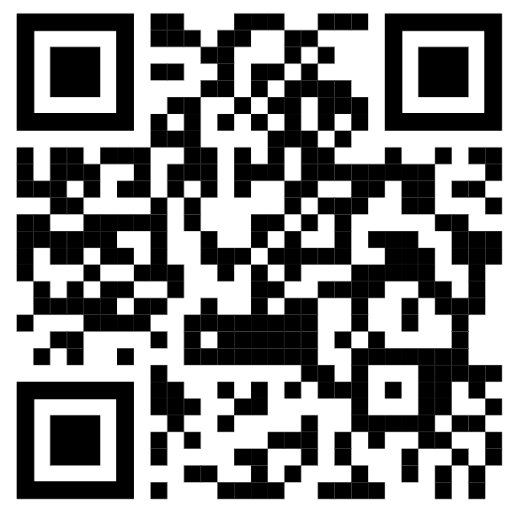
Other Corpus Tools
Oxford Collocation Dictionary
Youglish

