Slide 1

Sustainable Development Goals (SDGs) for Young Learners of English: Supporting Language and Critical Thinking
Dr. Eda Nur ÖZCAN
Bursa Technical University, Turkey
Prof. Dr. Esim GÜRSOY
Bursa Uludağ University, Turkey

Slide 2
Content
Personal motivation
Background of the study
Implementation
Methods
Outcomes

Slide 3
Personal Motivation
The first author’s career journey from private to public education in Turkey
Private school’s bilingual curricula and environmental programmes

Slide 4
Research Participants
26 young learners (9-10 years old)
a 4th-grade classroom
A1 to A2 level
From convenience sampling to purposive sampling

Slide 5
Critical Language Pedagogy
Critical
Transformative
Democratic
Dialectical
Student-focused
Action-oriented
( Jackson and Kennett, 2025, p.13)

Slide 6
Key Competencies for ESD
System thinking
Future thinking
Critical thinking
Normative competency
Strategic competency
Collaboration competency
Self-awareness competency
(Rieckmann, 2018)

Slide 7
Paulo Freire’s problem-posing pedagogy
Decodification
Recodification
(Wallerstein & Auerbach, 2004)

Slide 8
The localized problem-posing model and ESD key competences
Phase | Description | Key ESD Competence
Animation viewing | Students watch a researcher-made animation that depicts two characters addressing an environmental problem in L2. | Systems thinking & Future thinking
Exploring problems | Students discuss collaboratively to identify the environmental problem presented in the animation in L1. | Critical thinking
Sharing experiences | Students share real-life experiences related to the problem with the class in L1. | Collaboration competence
Exploring solutions | Students propose ways to deal with the problem in L1. | Strategic & normative competence
Language empowerment | Researcher introduces target language and vocabulary using the animation and students’ generative words; students engage in L2 practice. | Integration
Whole-class reflection | Students discuss what they learned about environment and language in L1. | Critical thinking & collaboration competence
Individual reflection | Students write diaries in L1 about their in-class experience. | Self-awareness competence
External engagement | Every two weeks, students receive an L2 mission letter and are encouraged to take environmental actions. | Strategic & Action competence

Slide 9
Understanding the local context
In Freire’s problem-posing model, much of the content derives from learners’ lives (Wallerstein & Auerbach, 2004), not from their hobbies and interests, but their problematic realities (Rashidi & Safari, 2011)
OECD’s Environmental Performance Report 2019:
overreliance on fossil fuels
greenhouse gas emissions at an increasing rate
low quality of air in urban and industrialised areas
insufficient recovery and recycling of solid waste
subsidies causing environmental harm
climate change

Slide 10
Understanding the local context: Generative Themes
Generative Themes | f
Littering | 16
Traffic | 4
Violence | 3
Vandalism | 3
Extreme weather | 3
Air pollution | 2
Deforestation | 2
Animal mistreatment | 2
Water pollution | 1
Environmental Literacy Questionnaire
Generative Themes:

Slide 11
The Instructional Content
Themes | Week
Local environment | Week 1,2
Waste | Week 3,4
Forest conversation | Week 4,6
SPRING BREAK
Water conservation | Week 7,8
Pollution | Week 9,10
Animal welfare | Week 11,12

Slide 12
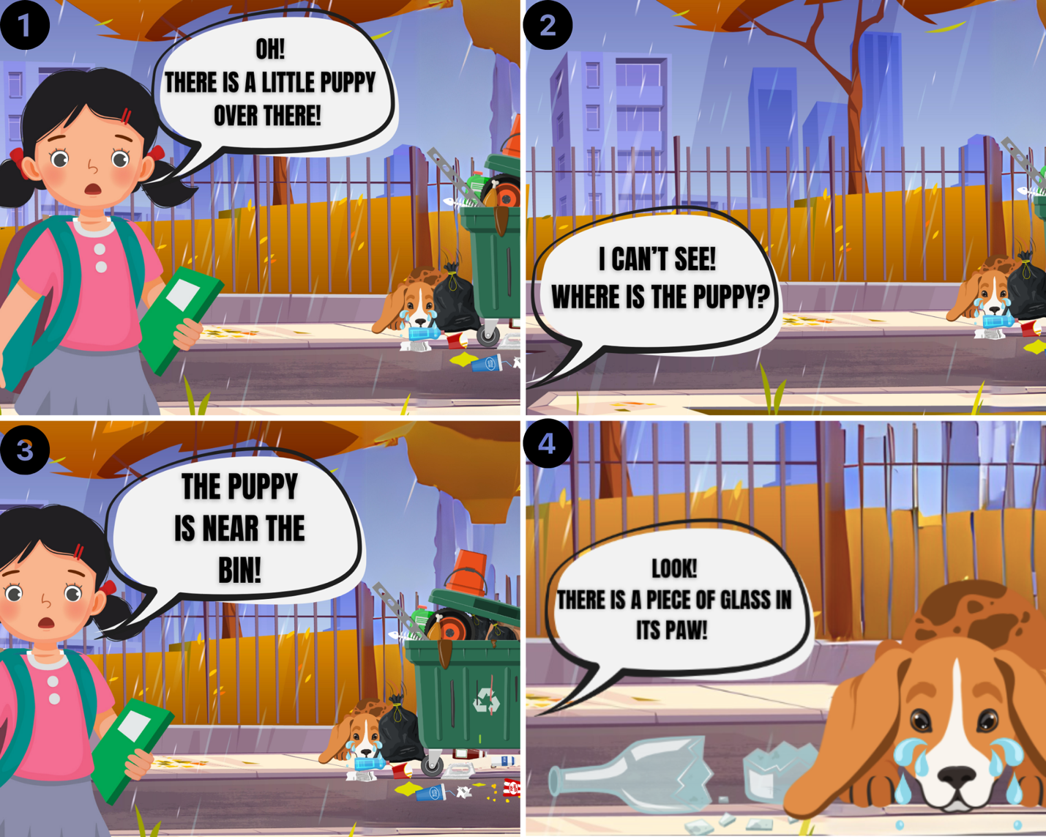
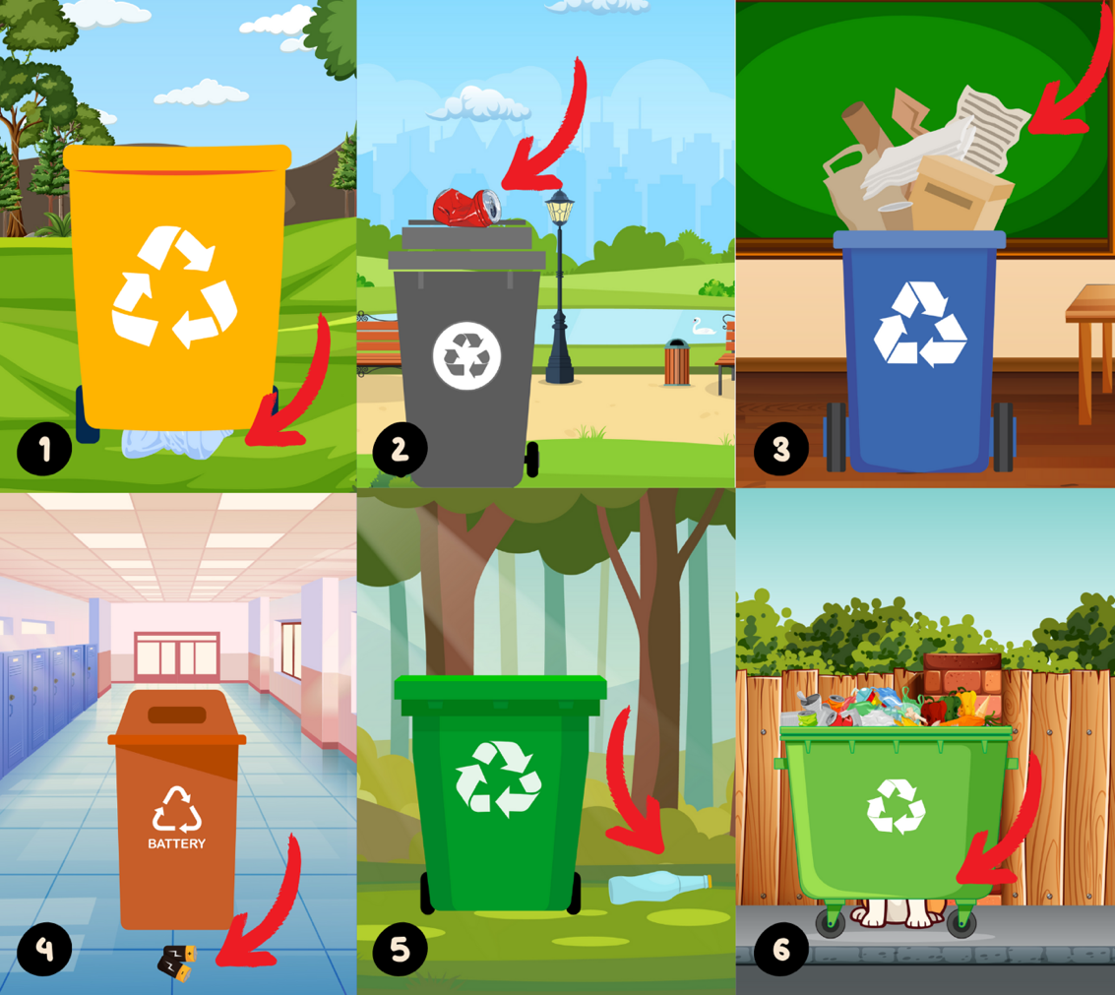
SAMPLE LESSON MATERIALS

Slide 13
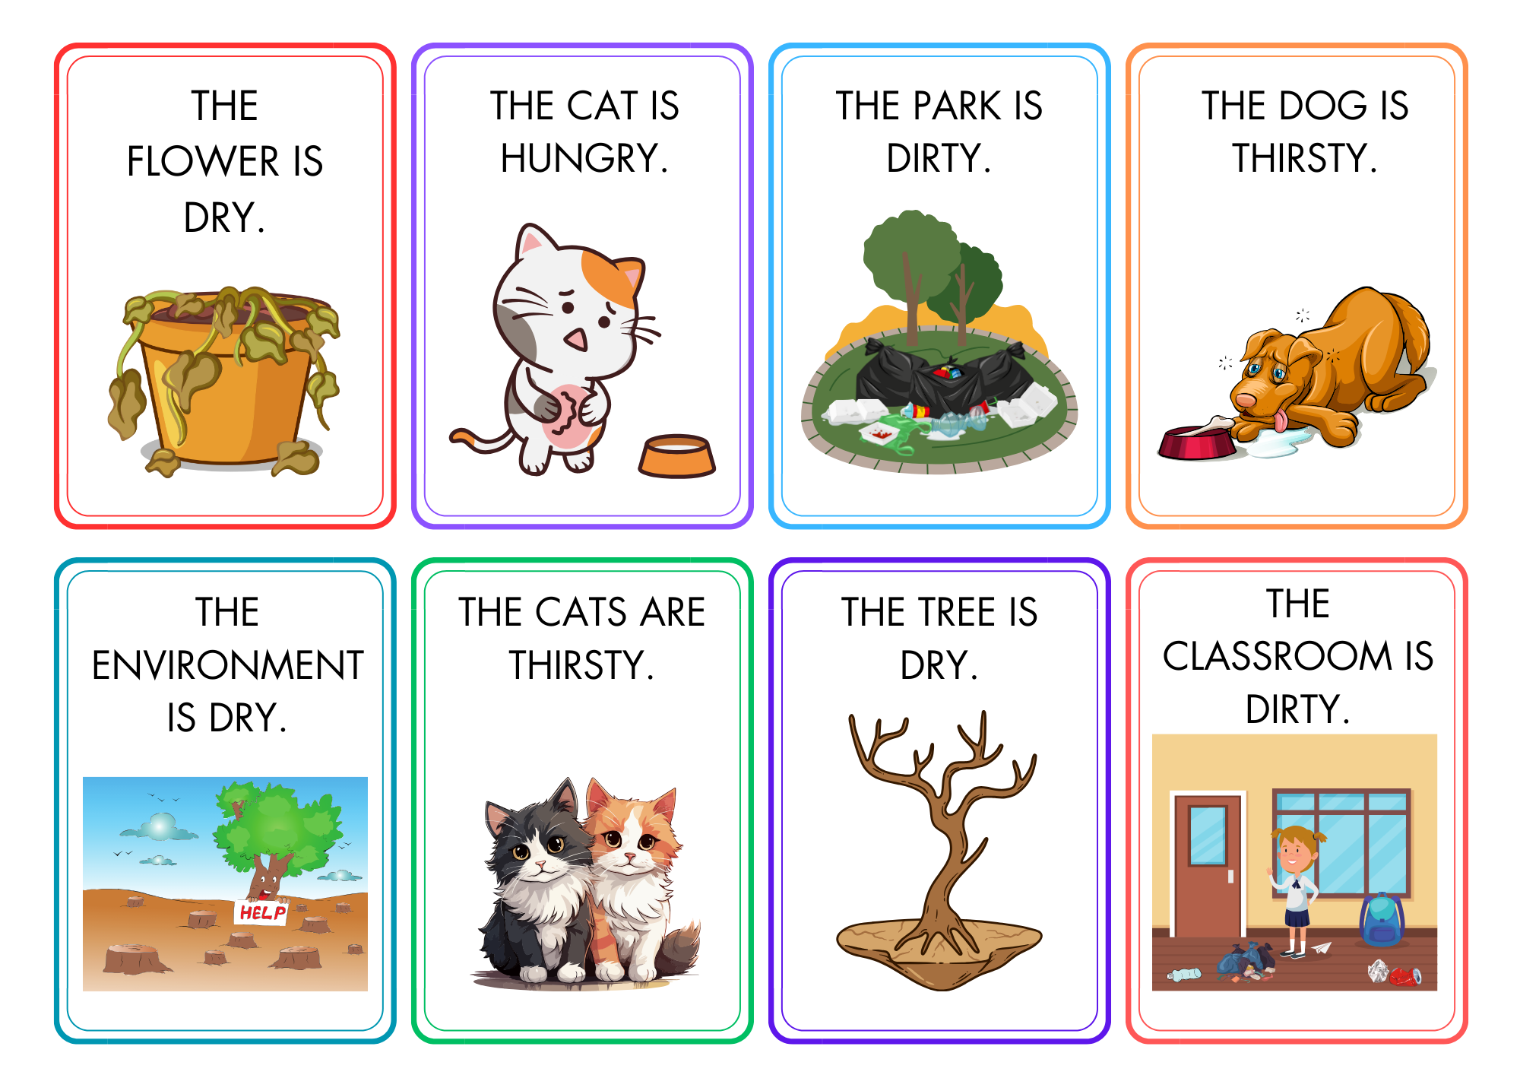


Slide 14
Theme: Local Environment
Number of lesson hours: 4 (2 weeks)
Content Goals | Target Vocabulary | Target Language Function | SDGs
Awareness: Students will be able to recognize environmental problems in their local environment. | Sad Happy Hungry Thirsty Sick Clean Dirty Hot Cold Dry Pick up litter Throw litter Water a plant Feed an animal Plant a tree | Expressing basic needs and feelings Describing the environment Expressing ability Understanding simple inquiries | SDG 4. Quality Education SDG 11. Sustainable Cities and Communities SDG 15. Life on Land
Knowledge: Students will be able to express basic needs and feelings related to environmental problems in their local environment.
Knowledge: Students will be able to express basic needs and feelings related to environmental problems in their local environment. |  | Exemplary structures: How do you feel today? I feel... How is the environment? My environment is... Can you ...? Yes, I can / No I can’t.
Attitude: Students will be able to develop a sense of responsibility towards problems in their local environment. |  | How do you feel today? I feel... How is the environment? My environment is... Can you ...? Yes, I can / No I can’t.
Skill: Students will be able to observe the environmental problems in their local environment and propose appropriate solutions.
Participation: Students will be able to participate in discussions and activities related to problems in their local environment, such as feeding street animals and cleaning up their gardens.
Action: Students will be able to take initiatives to improve their local environment with environmentally friendly practices.

Slide 15








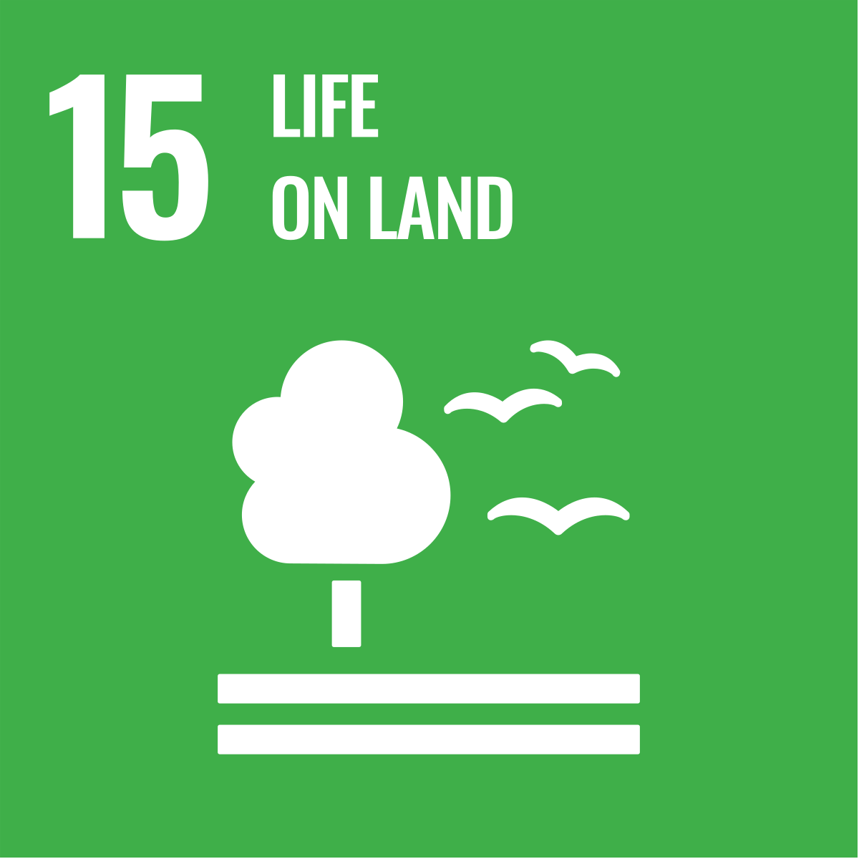

Slide 16
Research Questions
1. To what extent does the dialogical language instruction improve young learners’ environmental knowledge and language skills?
01
2. How do young learners’ environmental awareness and critical thinking abilities develop as a result of the dialogical language instruction?
02

Slide 17
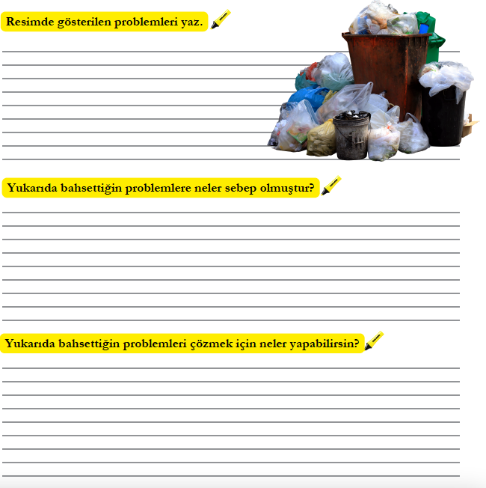

Slide 18
Environmental knowledge:
Identification of environmental issues
Categories | Pretest Results (%) | Posttest Results (%) | Sample Unit
Basic recognition | 52.9 | 23.0 | “Overthrowing trash bin“
Recognition of multiple issues | 23.1 | 47.8 | “Water pollution, air pollution and land pollution“
Cause-effect relationship | 21.6 | 17.1 | “Drought happens because people waste water.”
System thinking | 2.3 | 11.9 | “Everyone ignored the forest and lit fires forgot to put them out, people cut down trees, so oxygen decreased.

Slide 19
Environmental knowledge:
Identification of causes of environmental issues
Categories | Pretest Results (%) | Posttest Results (%) | Sample Unit
General attributions | 36.3 | 34.2 | “Because of what people have done to the environment.”
Specific attributions | 51.7 | 62.5 | “This happened as a result of people cutting down trees.”
No response | 11.8 | 3.2 | -

Slide 20
Thematic expansion
Awareness of interconnected systems
Emergence of socio-emotional codes (e.g., lack of love, lack of empathy)

Slide 21
Language Skills
Instrument | Data TYPE | Data format | Target construct | Analysıs
Eco-pedagogical Speaking Test | QUAN | MC items | Listening comprehension | Wilcoxon Signed-Rank Test
Eco-pedagogical Listening Test | QUAN | Recorded-oral data | Oral production | Assessment Rubric, Two raters

Slide 22
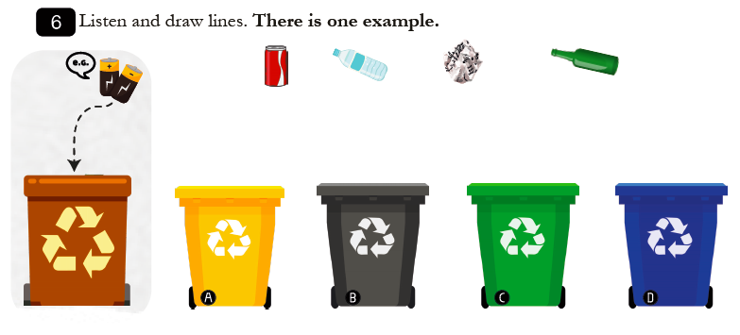
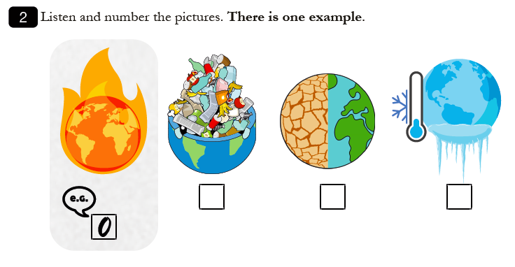
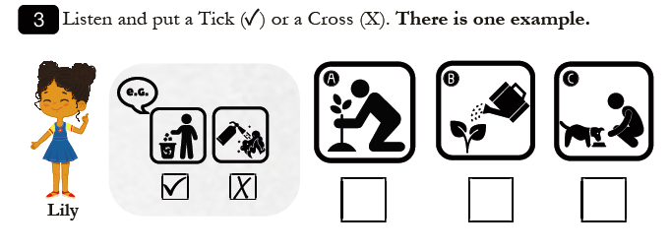

Slide 23
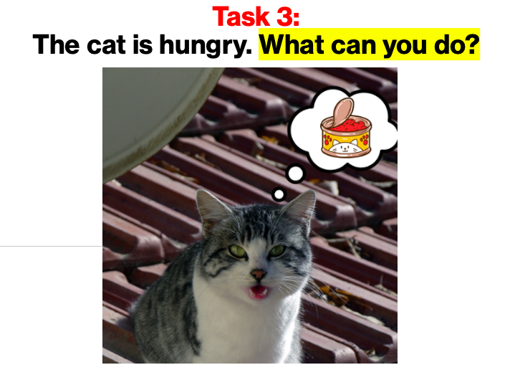
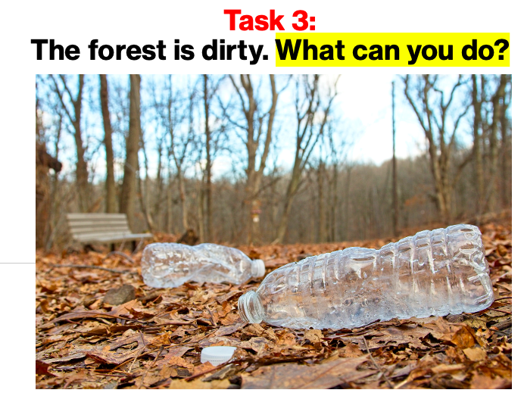
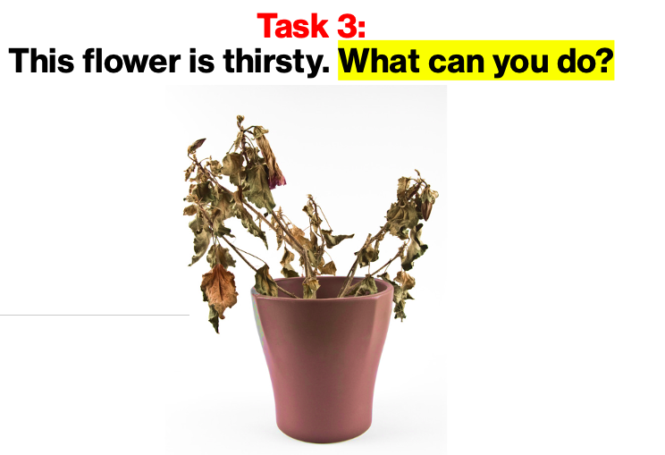

Slide 24
Language Skills
Sig. improvement in listening test results
Sig. improvement in speaking test results
An increase in their use of environmental vocabulary + triangulated through interviews
Environmental themes providing meaningful input and context for L2 acquisition
Greater engagement with lessons through the themes
Linguistic objectives of the study was limited; thus, the future research should consider the assessment dimension more standardized.

Slide 25
Environmental Awareness and Critical Thinking
Questioning the status quo and critical thinking
Learners as agents of change and action competence
Future thinking and normative competence
Meaningful and purposeful content
Linguistic complexity in L1

Slide 26
Hear from some participants
“I'm thinking of something. How can I put it... What if there were a robot, like a spider, that gradually cleaned all the trash from the sea? Then, smart faucets could ask why you’re using water and have a password. The passwords would be known by mothers. I have started thinking about these things... Maybe a solar-powered flying car.” (Future Thinking & System Thinking)
“When the Anatolian leopard went extinct, the people back then must have been very sad. Just like how we would feel sad if cats disappeared today.” (Normative Competence)
“I would want extinct animals, like the white lion, to still exist, and for people to see what would happen if they made them go extinct.” (Future Thinking & Normative Competence)
“I used to always think negatively, like people are always throwing trash on the ground. But now, I’ve started to think less negatively. I think maybe people will stop littering” (Self-awareness Competence)

Slide 27
More findings...
BENEFITING FROM THE DUAL OBJECTIVES
TEACHER AS THE FACILITATOR
MULTIMODAL IN-CLASS MATERIALS
GAMIFIED FLOW OF THE COURSE DESIGN
NEED FOR MORE HANDS-ON ACTIVITIES
PARENTAL SUPPORT

Slide 28
Pedagogical Implications
Problem-posing in YL classrooms
Importance of dialogic teaching
The use of L1
Lived experiences and life realities
Meaningful and fun materials
Reflective practices
Parental support

Slide 29
References
Jackson, L., & Kennett, B. (2025). Critical language pedagogues in Japan: enhancing student receptivity. ELT Journal, 79(1), 12-21.
Rashidi, N., & Safari, F. (2011). A model for EFL materials development within the framework of critical pedagogy (CP). English Language Teaching, 4(2), 250.
Rieckmann, M. (2018). Learning to transform the world: Key competencies in Education for Sustainable Development. Issues and trends in education for sustainable development, 39(1), 39-59.
Wallerstein, N., & Auerbach, E. (2004). Problem-posing at work: Popular educator's guide. Edmonton: Grass Roots Press.

Slide 30

THANK YOU!
For contact: eda.ozcan@btu.edu.tr

