Slide 1

In one word, where are you joining us from today?

Slide 2


Word Cloud submissions

Slide 3



Japan Association for Language Teaching
2025 Technology in Teaching / Professional Development Workshops
August 09, 2025
Power Up Your Slides: Interactive Teaching with
ClassPoint
Marge Joseph Sardo
Tokyo Metropolitan Chihaya High School

Slide 4


Session Outline
Get started
Signing Up, Installing and Signing In
Discover
ClassPoint Core Features
Create & Elevate
Building and Sharing Interactive Slides
JALT 2025 Technology in Teaching Workshop | Power Up Your Slides: Interactive Teaching with ClassPoint by Marge Joseph Sardo

Slide 5
Session 1
What is ClassPoint?
Interactive tool that adds quizzes and activities inside PowerPoint
Makes lessons more engaging and collects real-time student responses
Works for both online and in-person classes
JALT 2025 Technology in Teaching Workshop | Power Up Your Slides: Interactive Teaching with ClassPoint by Marge Joseph Sardo

Slide 6


Session 1
Signing Up, Installing and Signing In
Go to classpoint.io
JALT 2025 Technology in Teaching Workshop | Power Up Your Slides: Interactive Teaching with ClassPoint by Marge Joseph Sardo

Slide 7
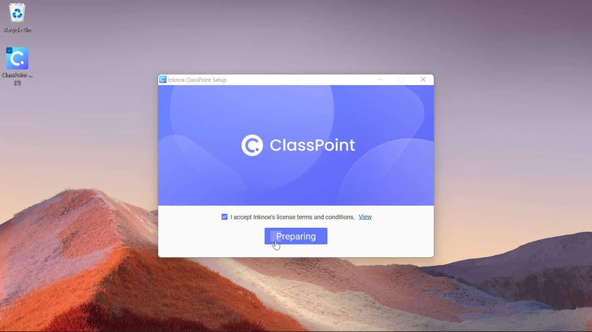
Session 1
Signing Up, Installing and Signing In
JALT 2025 Technology in Teaching Workshop | Power Up Your Slides: Interactive Teaching with ClassPoint by Marge Joseph Sardo

Slide 8
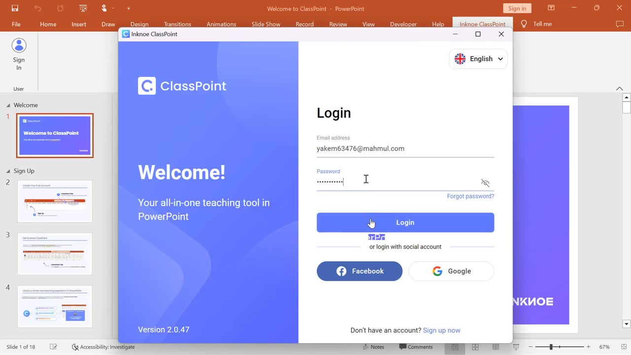
Session 1
Signing Up, Installing and Signing In
JALT 2025 Technology in Teaching Workshop | Power Up Your Slides: Interactive Teaching with ClassPoint by Marge Joseph Sardo

Slide 9






Session 2
ClassPoint Core Features
Quiz Types
ClassPoint Pro
Other Features
JALT 2025 Technology in Teaching Workshop | Power Up Your Slides: Interactive Teaching with ClassPoint by Marge Joseph Sardo

Slide 10

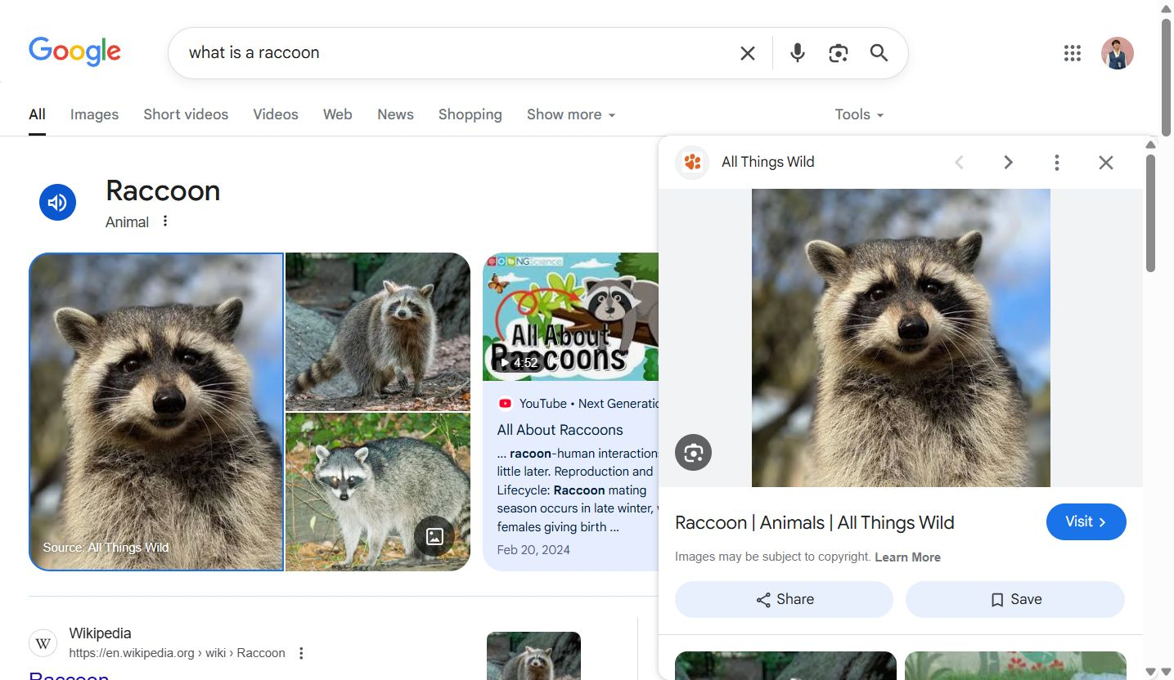
Browser snapshot

Slide 11


Slide 12


Session 2
ClassPoint Core Features
Prompt 1:
What is the scientifically proven side effect of attending too many PD workshops?
A. Increased caffeine tolerance
B. Speaking in acronyms nobody understands (TPR, CLIL, CEFR, etc.)
C. Both A and B
JALT 2025 Technology in Teaching Workshop | Power Up Your Slides: Interactive Teaching with ClassPoint by Marge Joseph Sardo

Slide 13
Session 2
ClassPoint Core Features
Multiple Choice
Sample Application
Poll
Quiz
JALT 2025 Technology in Teaching Workshop | Power Up Your Slides: Interactive Teaching with ClassPoint by Marge Joseph Sardo

Slide 14

Session 2
ClassPoint Core Features
Prompt 2:
Describe your Monday morning teaching mood… in one word.
JALT 2025 Technology in Teaching Workshop | Power Up Your Slides: Interactive Teaching with ClassPoint by Marge Joseph Sardo

Slide 15
Session 2
ClassPoint Core Features
Word Cloud
Sample Application
Vocabulary Bank (What new word did you learned today?)
Reflection (List 2 adjectives that describe today’s lesson)
Check-in (What’s your mood today?)
JALT 2025 Technology in Teaching Workshop | Power Up Your Slides: Interactive Teaching with ClassPoint by Marge Joseph Sardo

Slide 16


Session 2
ClassPoint Core Features
Prompt 3:
What’s the scariest word in English class?
JALT 2025 Technology in Teaching Workshop | Power Up Your Slides: Interactive Teaching with ClassPoint by Marge Joseph Sardo

Slide 17

Short Answer submission from Another Bill
“
Boring

Slide 18

Session 2
ClassPoint Core Features
Short Answer
Sample Application
Questions / Feedback
link submission
JALT 2025 Technology in Teaching Workshop | Power Up Your Slides: Interactive Teaching with ClassPoint by Marge Joseph Sardo

Slide 19


Session 2
ClassPoint Core Features
Prompt 4:
Draw what grammar rules look like to your students.
Note: Switch your phone to Landscape mode
JALT 2025 Technology in Teaching Workshop | Power Up Your Slides: Interactive Teaching with ClassPoint by Marge Joseph Sardo

Slide 20
Session 2
ClassPoint Core Features
Slide Drawing
Sample Application
Labeling parts
Identifying errors
Matching-typed questions
JALT 2025 Technology in Teaching Workshop | Power Up Your Slides: Interactive Teaching with ClassPoint by Marge Joseph Sardo

Slide 21


Session 2
ClassPoint Core Features
Prompt 5:
Upload a picture that shows what you think students think you do all day.
JALT 2025 Technology in Teaching Workshop | Power Up Your Slides: Interactive Teaching with ClassPoint by Marge Joseph Sardo

Slide 22
Session 2
ClassPoint Core Features
Image Upload
Sample Application
Storytelling
Output submission
JALT 2025 Technology in Teaching Workshop | Power Up Your Slides: Interactive Teaching with ClassPoint by Marge Joseph Sardo

Slide 23
Session 3:
Workshop Proper
Build Your Interactive Slide!

Slide 24
Special Announcement!
Giveaway: Two 3-Month ClassPoint Pro Subscriptions
JALT 2025 Technology in Teaching Workshop | Power Up Your Slides: Interactive Teaching with ClassPoint by Marge Joseph Sardo

Slide 25

Pricing and Plans
JALT 2025 Technology in Teaching Workshop | Power Up Your Slides: Interactive Teaching with ClassPoint by Marge Joseph Sardo

Slide 26
THANK YOU!
Get in touch:
sardomarge@gmail.com

