Slide 1
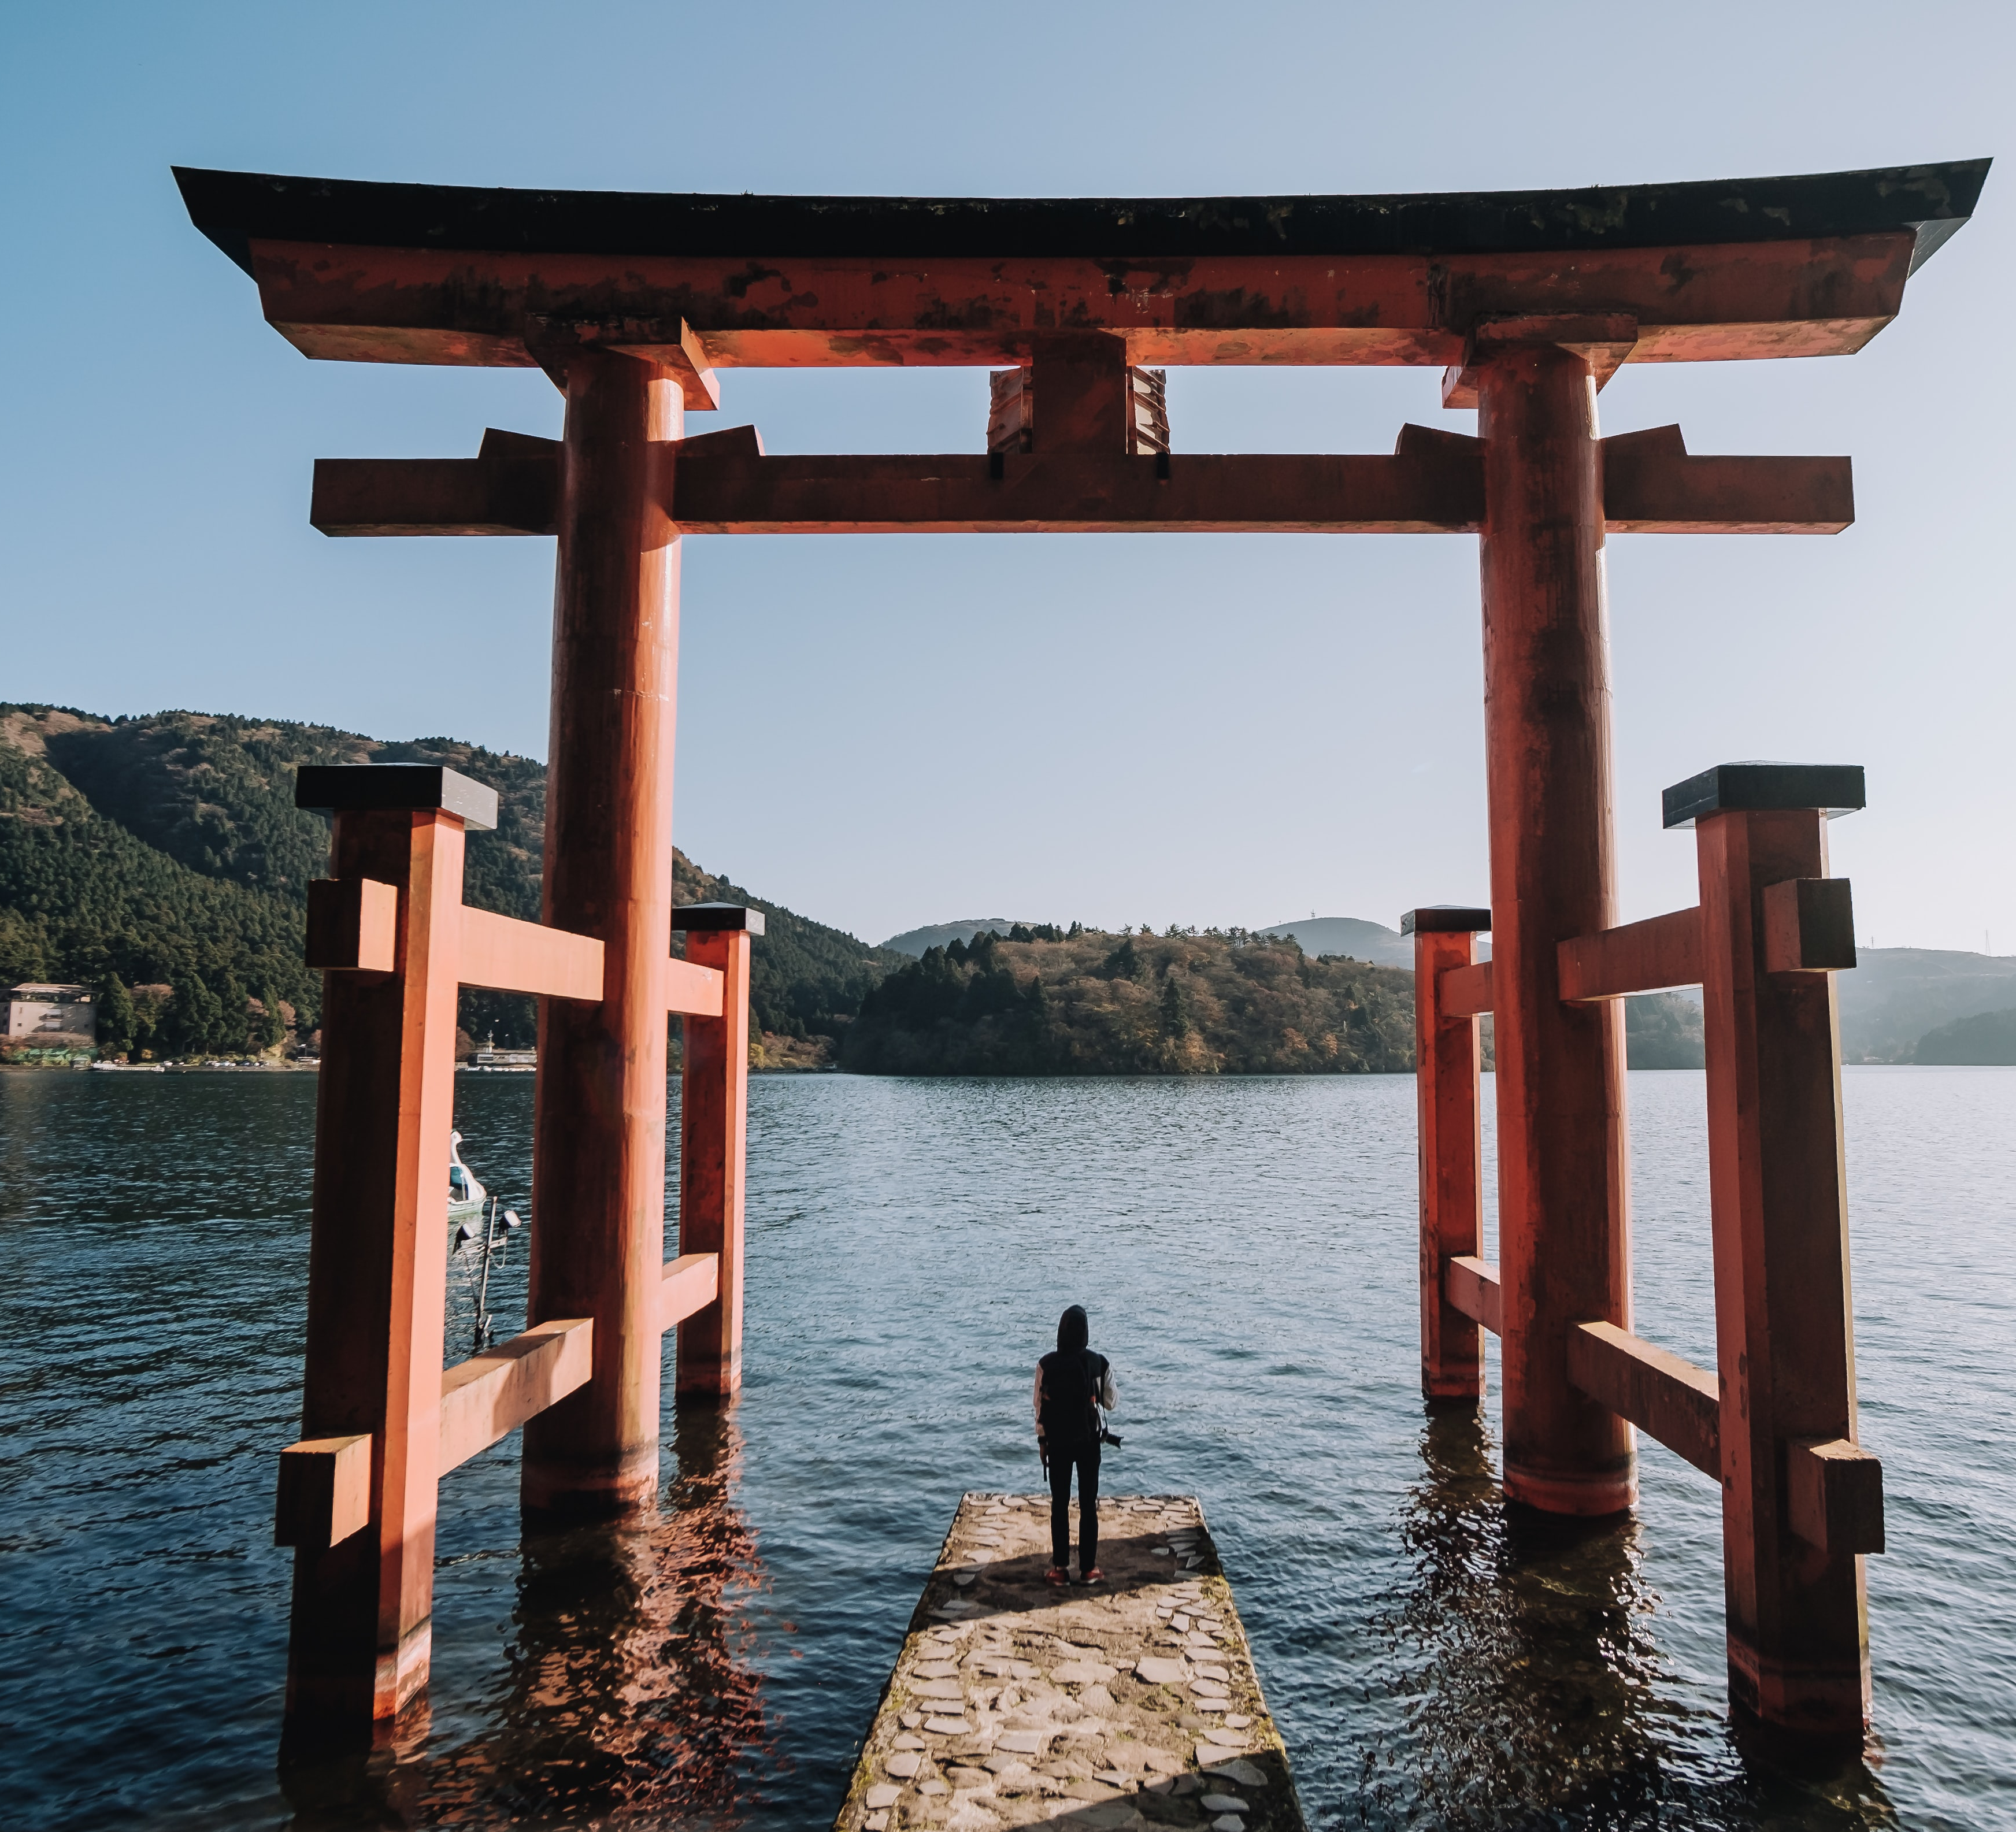
A course for inbound exchange students to explore their identity in Japan
John Rucynski
Okayama University
JALT PanSIG 2026
Nagoya

Slide 2


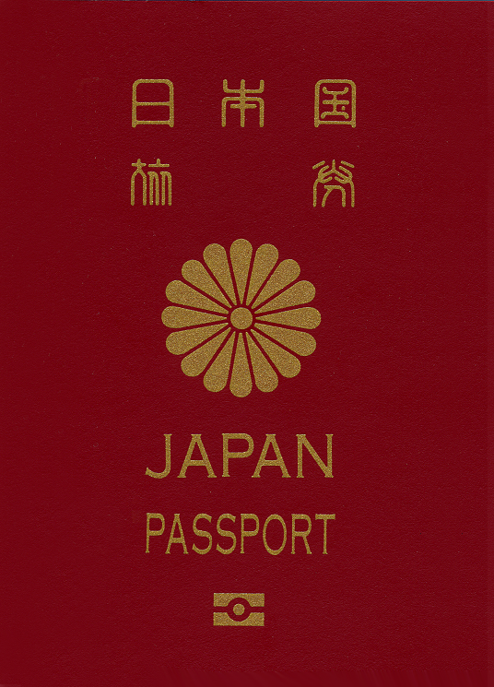
Only a part of our story….

Slide 3
My Homes? / Places I Have Lived?
Oswego, NY (USA)
Harleysville, PA (USA)
Lithonia, GA (USA)
El Paso, TX (USA)
Tomah, WI (USA)
Brattleboro, VT (USA)
Rabat (Morocco)
Sapporo (Japan)
Kyoto
(Japan)
Kobe
(Japan)
Palmerston North
(New Zealand)

Slide 4
“A Passion for Japan: Living, Working, and Thriving in Japan”
I. Okayama University EPOK combined course background
II. Inspiration for the course
III. Course contents summary
IV. Student reactions
V. Reflection & future directions

Slide 5
What is EPOK Combined?

Slide 6
EPOK Combined Class Background
Created to increase exchange between degree students and international exchange students
English requirement = 600 TOEIC (L+R)
Focused on intercultural communication or cultural studies (flexible)
One term (eight 100-minute classes)

Slide 7
Content & Course Challenges
Finding accessible, engaging, and relevant content as a springboard for discussion (multicultural setting)
Not making international students just feel like “English teachers” or “conversation assistants”
Not treating international students as “temporary visitors”

Slide 8
Previous Courses + New Course
Intercultural Communication
Humor & Cros-Cultural Communication
Foreign Perspectives of Japan through Documentaries
A Passion for Japan: Living, Working, and Thriving in Japan

Slide 9
Course Theme

Slide 10
A Passion for Japan: A Collection of Personal Narratives
THEME:
What is a passion that helped with the acculturation process and/or enriched your life in Japan?

Slide 11
Sample Themes + Contributor Nationalities
Shodō (USA)
Festivals (Romania)
Wadaiko (New Zealand)
Eisa (USA)
Sumo (Australia)
Hanshin Tigers (Canada)
Buddhism (UK)
Tea ceremony (Canada)
Dance / performing arts (Cameroon)
Hyakumeizan (USA)
Childbirth rituals (India)
Japanese literature (Belgium)
Traditional farmhouse (Australia)

Slide 12
Stages of
Cultural Adaptation
(Lysgaard, 1955)
1. Honeymoon stage
2. Frustration stage
3. Adjustment stage
4. Acceptance stage
5. ?

Slide 13
Stages of Culture Shock
1. Honeymoon stage
2. Frustration stage
3. Adjustment stage
4. Acceptance (+ accepted by) stage
5. This is HOME stage

Slide 14
Course & Student Information
Eight 100-minute classes (one term)
39 students (13 different countries)
International students: Short-term study abroad, department study abroad, degree students (Global Discovery Program)
Japanese students: “Typical” Japanese upbringing, returnees, IB students, mixed roots

Slide 15
Chapters + Themes

Slide 16
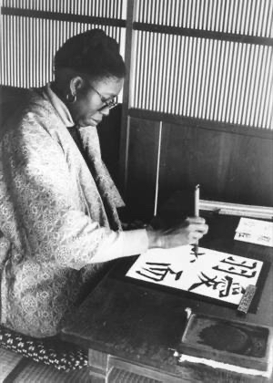
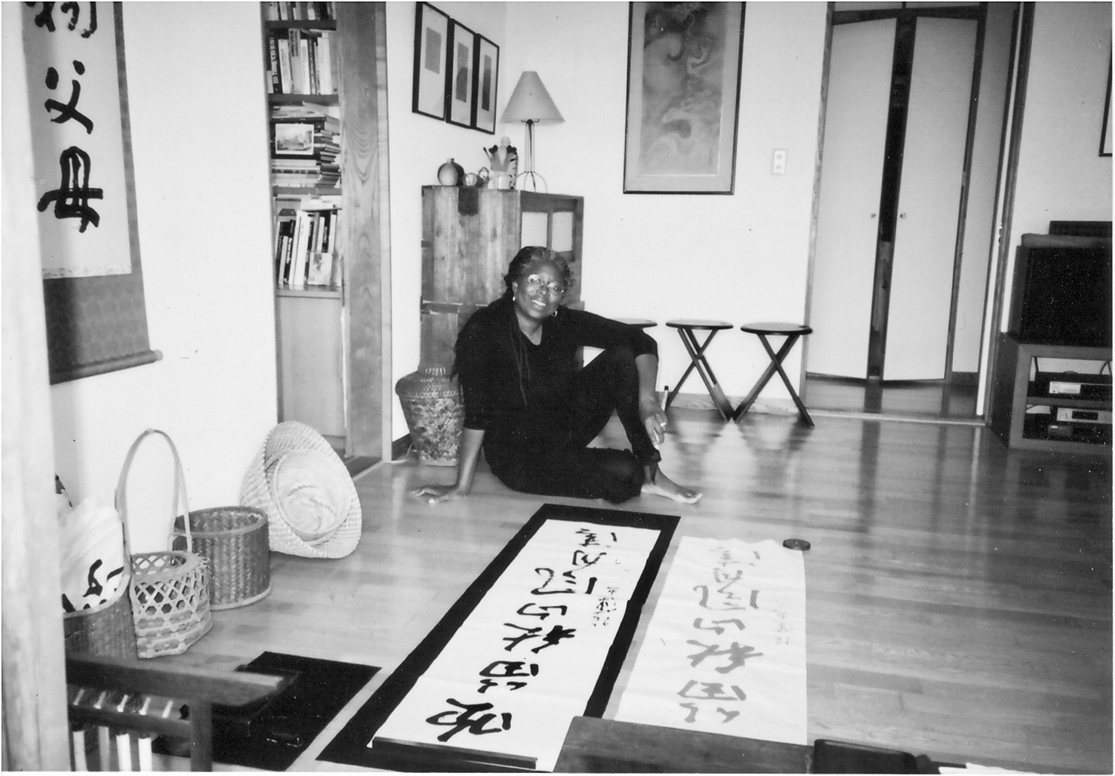
Karen Hill Anton: “Shodō: Finding My Way in the Way of Writing”

Slide 17

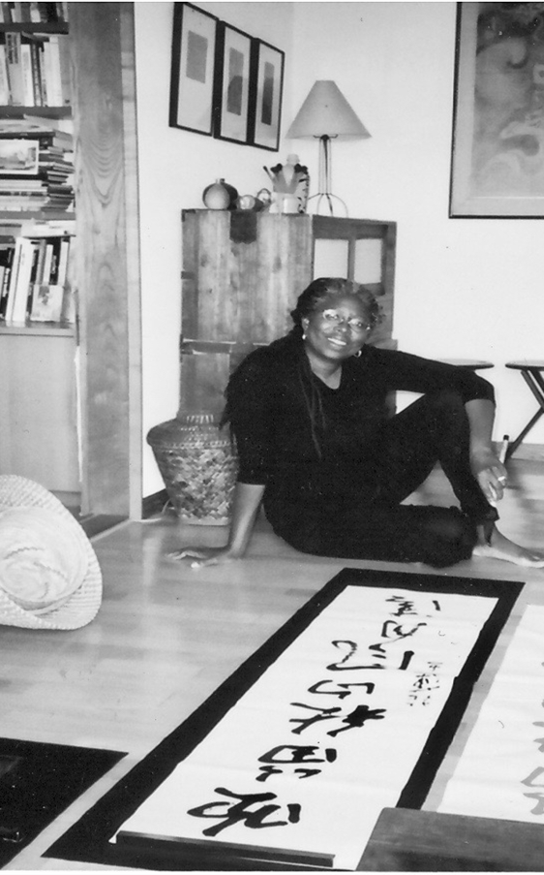
“I would stand out in Japan, always. But I could also fit in.”

Slide 18
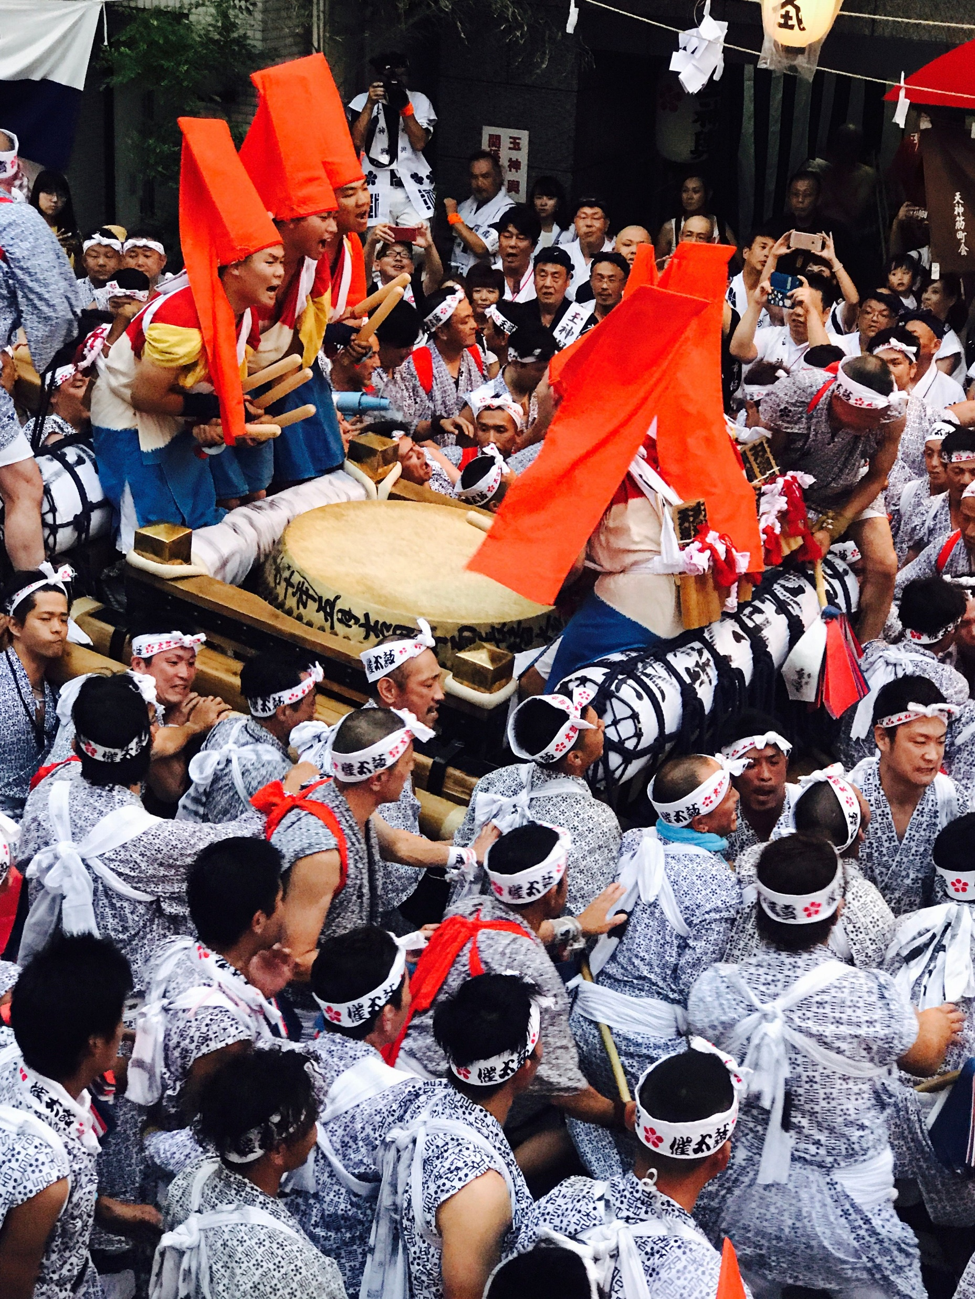
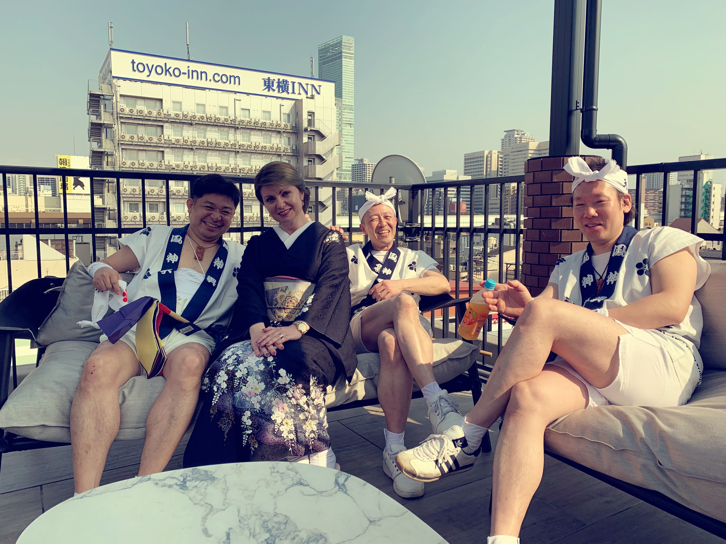
Carmen Săpunaru Tămaș: “One Year with the Guardians of the Phoenix”

Slide 19
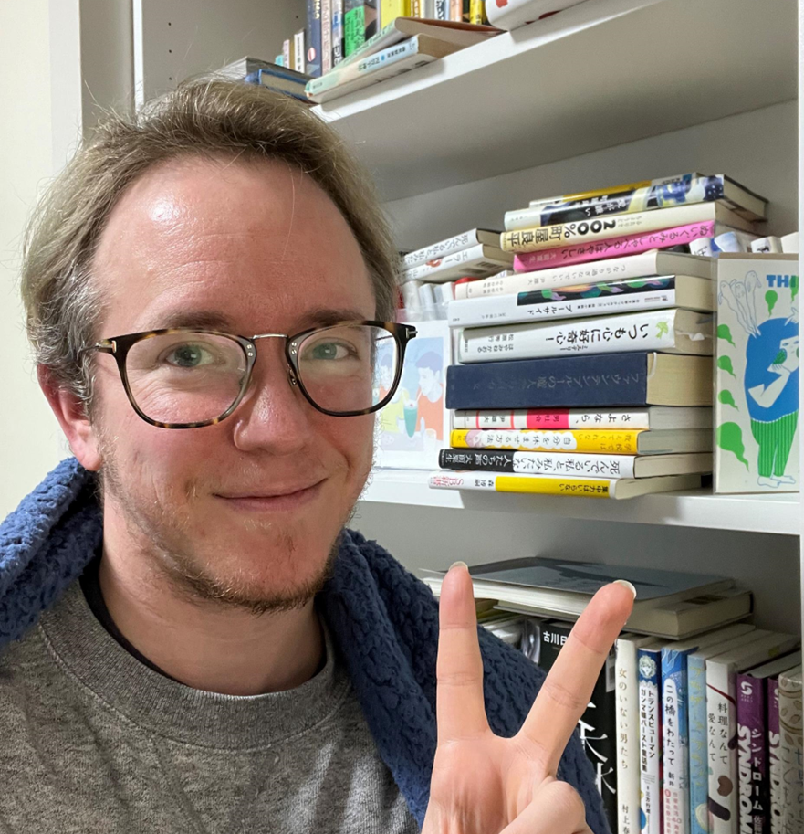
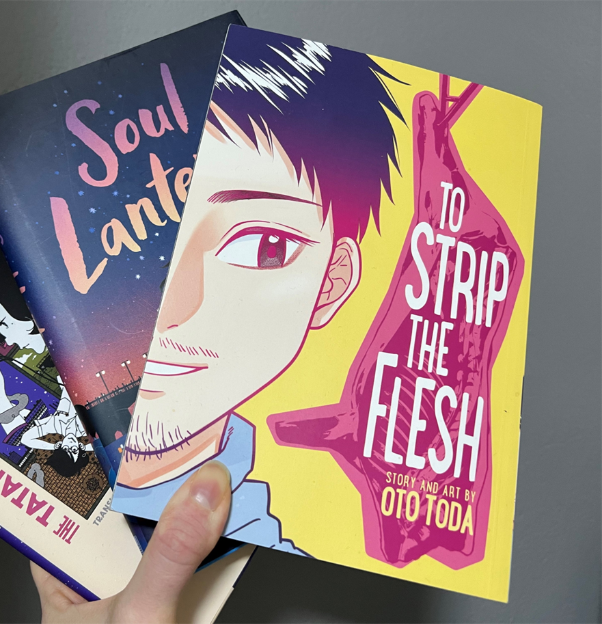
Emily Balistrieri (Tiger): “Too Many Novels I Want to Translate: Q&A”

Slide 20
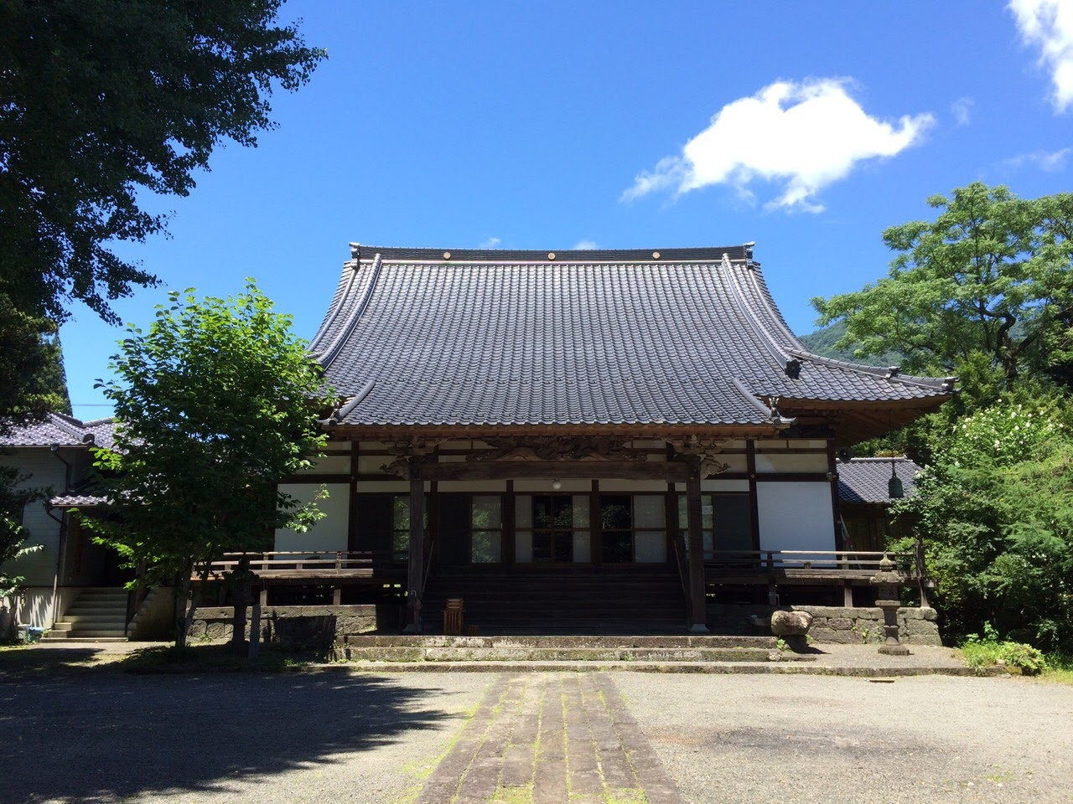
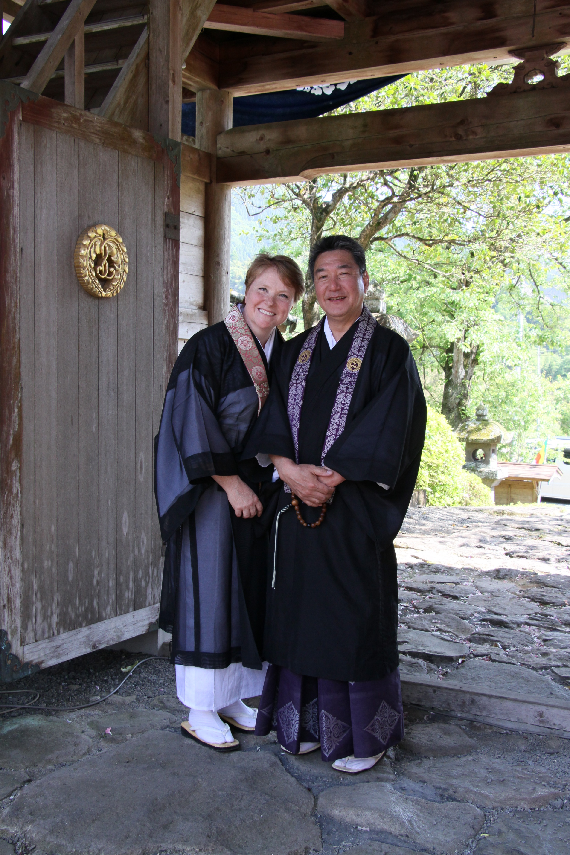
Victoria Yoshimura: “Coming Home: The Search for Belonging in Rural Japan”

Slide 21
Student Choices

Slide 22



Margaret C. Kim: “Who Am I? In Search of My Identity”

Slide 23
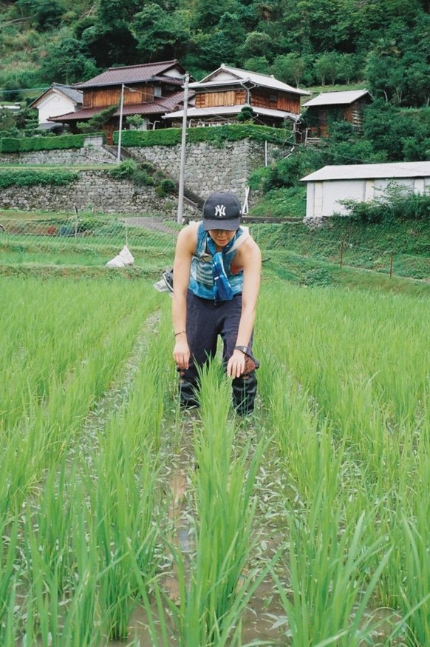
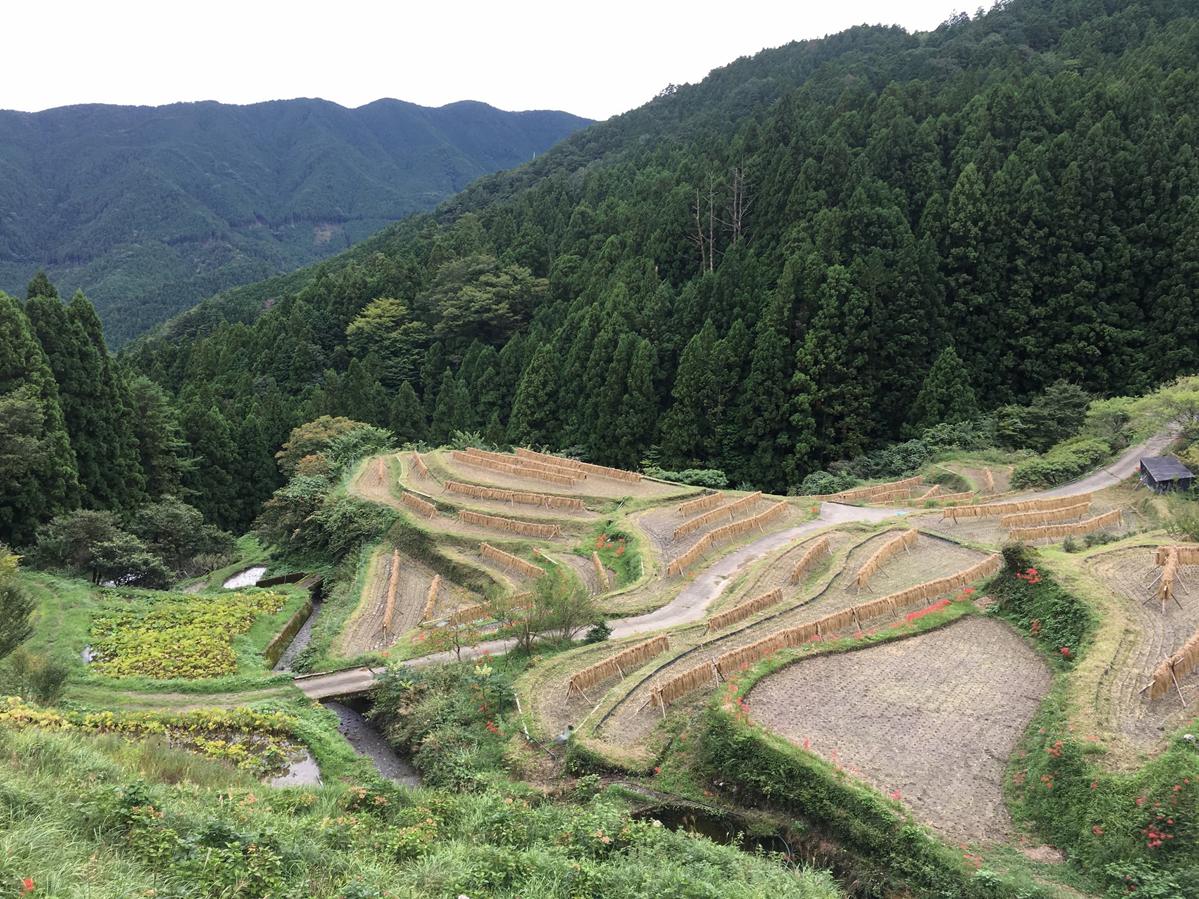
Linda Mengxi Ding: “Looking for the Good Life: Living as a Local In a Zero Waste Village”

Slide 24
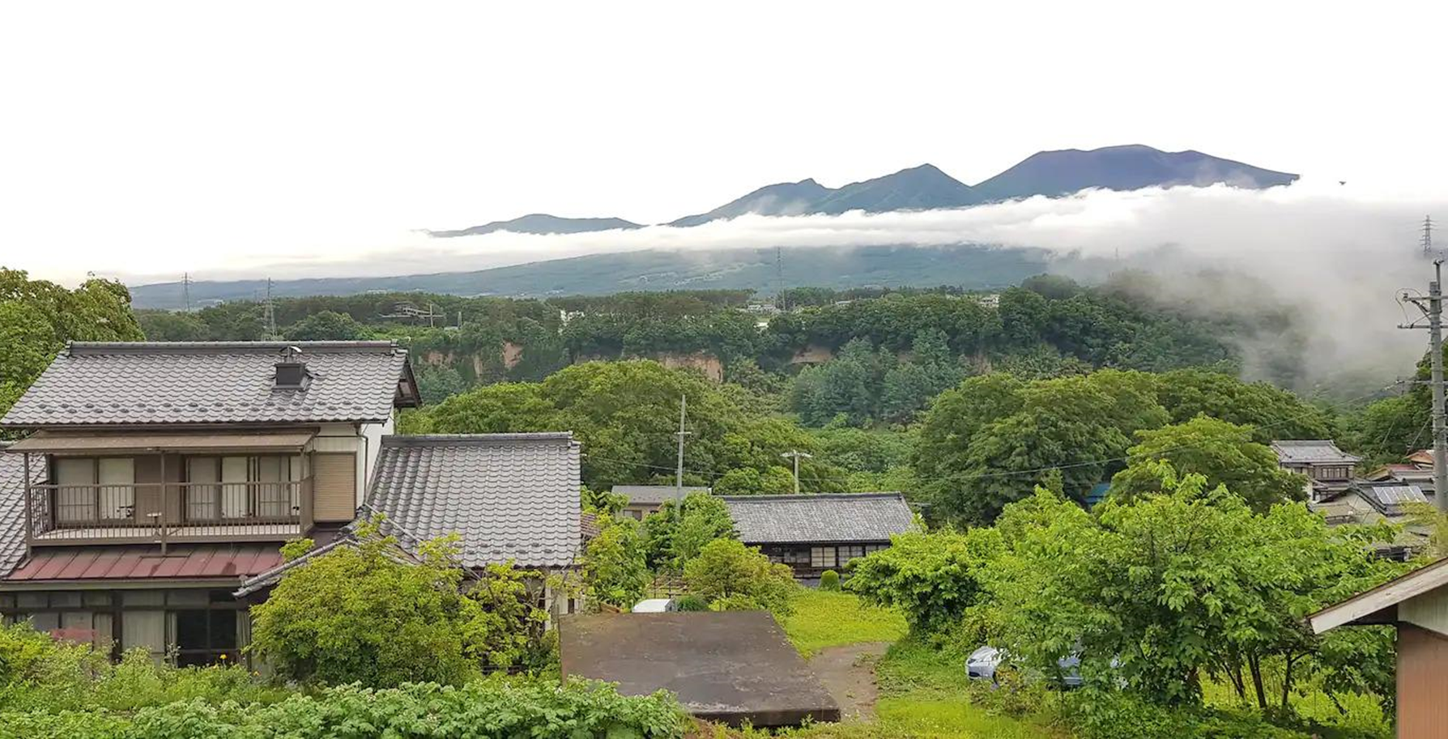
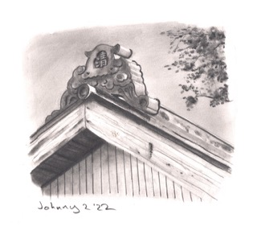
Wendy Bigler: “Roof Spotting in Japan”

Slide 25
Course Content
(the nitty gritty)

Slide 26
Course Objectives
By taking this course, students will:
1. increase their understanding of coping with culture shock and the acculturation process.
2. broaden their knowledge about challenges facing foreign residents of Japan.
3. deepen their intercultural awareness.
4. improve their intercultural communicative competence by engaging in discussions with people from a range of different cultures.

Slide 27
Typical Class Contents
I. Warm up (mini lecture about the theme / introduction to the chapter)
II. Warm up questions (student-generated questions)
III. Discussion (student-generated questions)
IV. Key quotes sharing (student-selected quotes)
V. All class summary and/or expansion activity

Slide 28
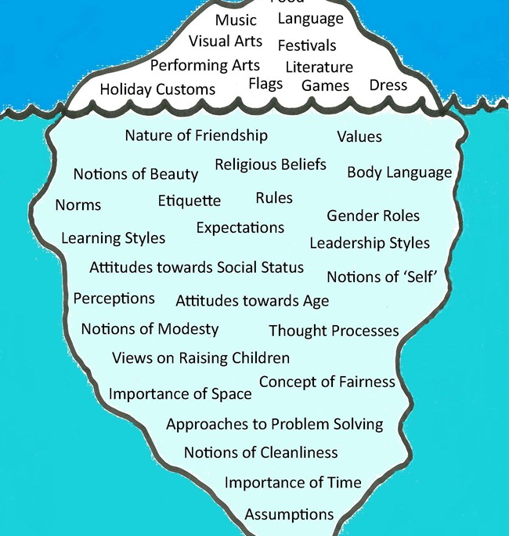
Surface level culture vs. “hidden” (Hall, 1966) or “deep” (Shaules, 2007) culture

Slide 29
I. Warm Up Questions (Karen Hill Anton chapter)
1. Have you ever practiced Japanese calligraphy (shodō)?
2. In addition to Japanese calligraphy, are there any traditional Japanese arts (or customs) that you are interested in?
3. Karen chose to come to Japan because her husband wanted to practice karate. Have you practiced or are you interested in any Japanese (or other) martial arts (budō)?
4. How much are your hobbies or interests a part of your identity?

Slide 30
II. Discussion Questions (student examples)
1.How important do you think it is to keep the traditional culture alive and why do we need to keep it alive?
2. How would you feel as a woman if your husband wanted to move to a foreign country to follow his passion?
3. I have heard often that a Japanese way of teaching is by observing closely and imitating what you see, rather than being told specific instructions, as was mentioned in this chapter as well. What do you feel about this teaching style? Which style of teaching do you prefer?

Slide 31
II. Discussion Questions
4. The kanji for shodō or Japanese calligraphy (書道) which can be also roughly translated as the "way of writing." The second kanji, 道 which we often see in different traditional arts such as 合気道(aikido) or 茶道 (tea ceremony) can be translated to “path” or “way.” So, all those described above can technically be said as a way of doing something….Do you think that 道 is being adequately translated into English? If not, how would you translate it?
5. Have you ever faced a situation where you didn't have all the answers but were still willing to take a chance? What motivated you, and what did you learn from that experience?

Slide 32
III. Key Quotes
“The lessons I received in calligraphy from watching Roppō-sensei write were more valuable than I appreciated at the time and have stayed with me to this day. I would come to understand that shodō was more than lessons, it was a discipline. A way.” (p.4)
“I felt I was missing that one element in calligraphy that I've always thought the most important: resolve. Because every time I soak my brush with sumi and apply it to paper, I know it's a commitment. You cannot fix or change it.” (p. 8-9)

Slide 33
III. Key Quotes
“I was sometimes almost overwhelmed with frustration that he didn't talk. I wanted desperately to be instructed in the way I was familiar with: Do this, don't do that. But he never said a word.” (p. 5)
“The lessons I received in calligraphy from watching Roppō-sensei write were more valuable than I appreciated at the time and have stayed with me to this day. I would come to understand that shodō was more than lessons, it was a discipline. A way.” (p.4)

Slide 34
Course Work & Assessment

Slide 35
Assessment
Weekly reading preparation (reading, warm up questions, discussion questions, key quotes)
Three short written “reflections” (discussion summaries and/or personal reflections)
Final presentation

Slide 36
Option 1: Expand on one of the main themes from one of (or more) the book chapters
An analysis of the role of festivals in Japan (Tamas chapter)
The importance/status of shodō and/or other traditional arts (Anton)
The current state of sustainability efforts (and/or the SDGs) in Japan (Ding)
The situation regarding akiya / traditional houses in Japan (Bigler/Otowa)

Slide 37
Option 2: Develop a presentation based on the theme of “life in Japan for foreign residents”
An analysis of several chapters from the book and what the writers have in common
A profile of a foreign person who has particularly thrived in Japan (does not have to be from the readings)
A look at issues foreign residents may still face in Japan (e.g., lack of voting rights, housing discrimination)

Slide 38
Sample presentation topics
Cross analysis of the chapters about zero waste village and akiya: Taking a fresh start in rural Japan
Moving house means moving into a community
Social pressures in Japan: Examples and how it shapes life
The struggles of mixed roots people in Japanese society
Challenges in Japanese traditional crafts (伝統工芸品)
Gender roles and segregation in Shinto

Slide 39
Sample presentation topics
The advantages and challenges of starting a business in Japan as an international student
The differences between attending a Japanese School and an American school as a Blasian student in Japan
Expected benefits of living in Japan vs. the actual benefits
A cross-chapter examination of why people chose to come to Japan and what made them stay
The impact of living abroad on one’s identity

Slide 40
Student Reactions

Slide 41
Content & Course Challenges Review
Finding accessible, engaging, and relevant content as a springboard for discussion (multicultural setting)
Not making international students just feel like “English teachers” or “conversation assistants”
Not treating international students as “temporary visitors”

Slide 42
Student Comments
I liked that we prepared for the class in advance and had enough time to think about the discussion topics on our own rather that coming up with them on the spot, and that the groups changed often thanks to what we had many opportunities to listen to other peoples' perspectives.
I think the arrangement of the class was brilliant, as I really get to know many people I didn’t meet or engage in a conversation outside the class. Moreover, we automatically had a topic to discuss, and thus get to know each other better. In terms of international exchange, I guess it was one of the best classes I’ve ever experienced.

Slide 43
Student Comments
I think the class encouraged critical thinking and discussion about the good and maybe troublesome things about Japan. I enjoyed reading the chapters which is often hard for me.
The teacher actually made students look forward to doing their homework and coming to class. As a foreigner living in Japan, it was also very comforting to be able to share our struggles together, but at the same time, talk about what we like and enjoy about Japan.

Slide 44
Future Directions / Possible Improvements
Guest speakers?
Greater variety of diversity (chapters)?
“Choose your own chapter” reading circle?
Group projects / presentations?

Slide 45
Exploring Identity Through Personal Narratives by Long-Term Residents of Japan
John Rucynski
Okayama University
rucyns-j@okayama-u.ac.jp

